Slide 1

Coffee with the City Manager
May 14, 2025

Slide 2
Agenda
Summer Programs and Special Events
Q&A
City Updates
Water Updates

Slide 3
General Election Results
1174 Total Ballots
737 early, 419 election day, 18 by mail
Bobby Watson & Todd Eidson Elected to 2 Year Terms
Canvassing of Results – May 14th
First Meeting of 2025-26 Council- May 20th

Slide 4
City Updates
May 20th Council Meeting Agenda
FY 26 Budget Process
Town Hall Meeting Series

Slide 5
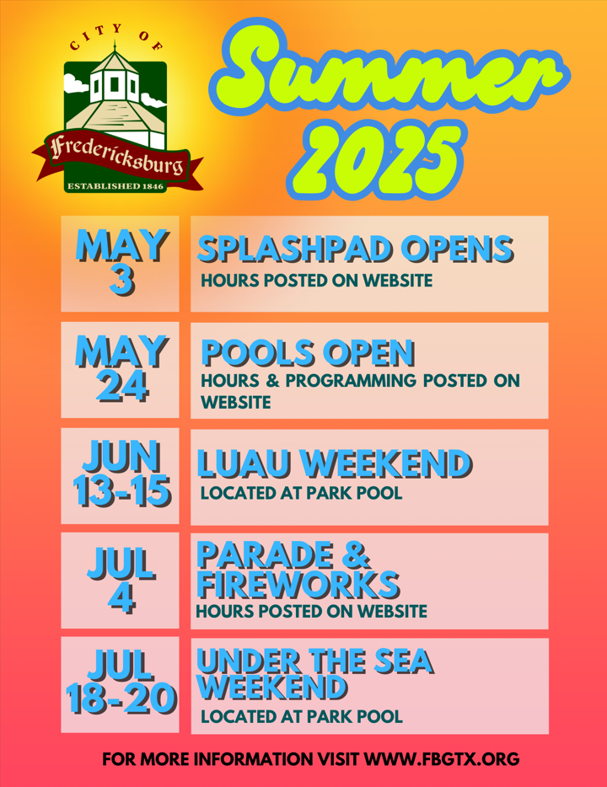
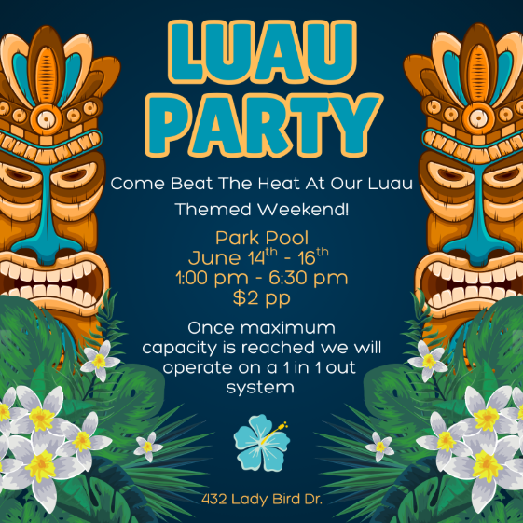


Slide 6


Slide 7

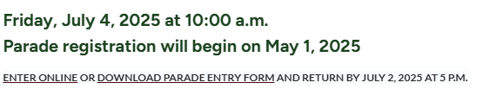
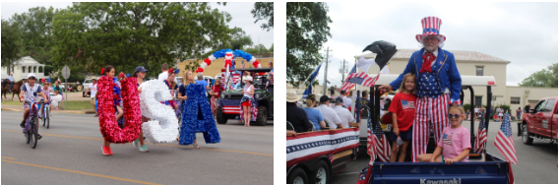

Slide 8
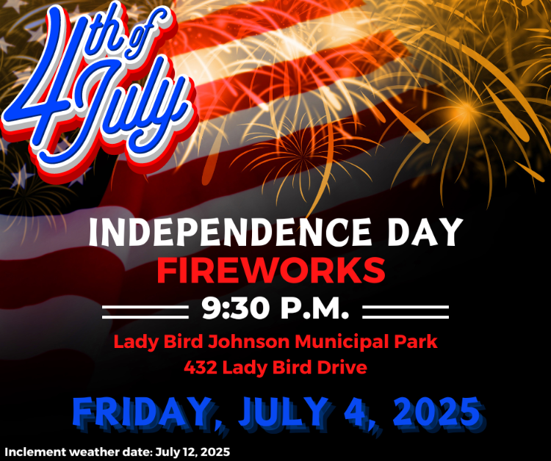

Slide 9


Slide 10
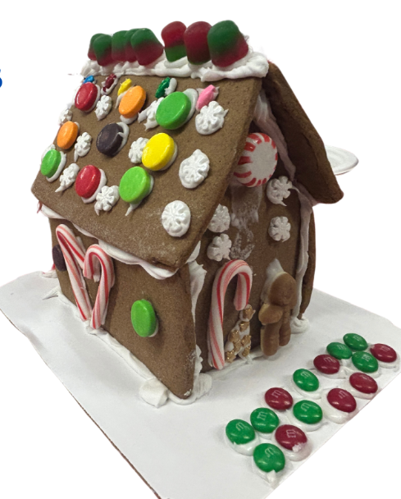
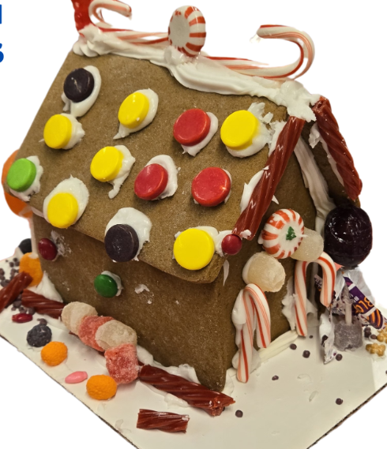
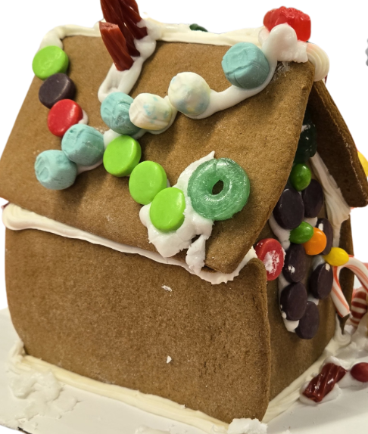
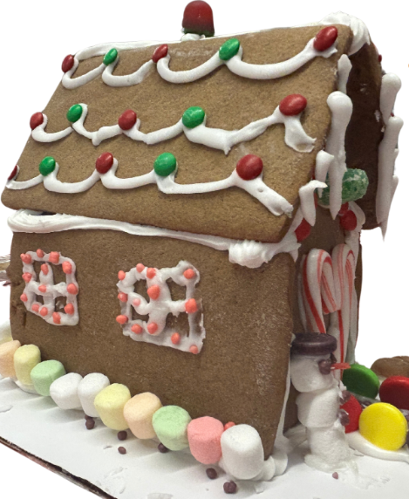
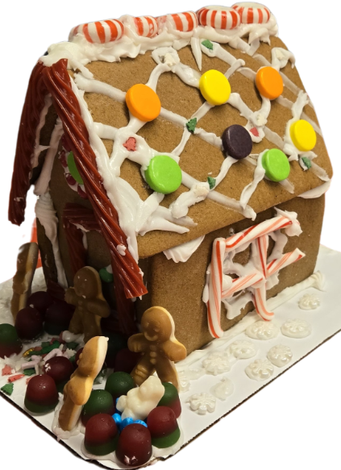
Gingerbread House Decorating Competition
Tuesday, December 9, 2025
Open to children ages 5-12
$10 entry fee
John Wm. Klein Room - December from 5:30-7:30 p.m.

Slide 11
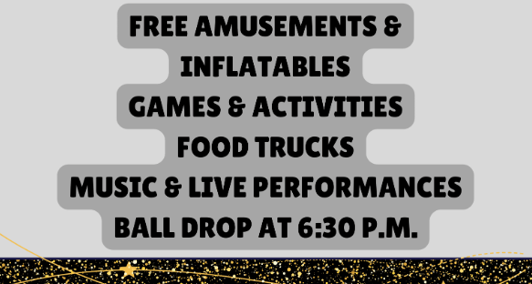
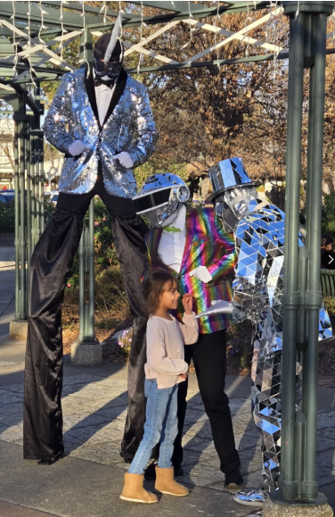
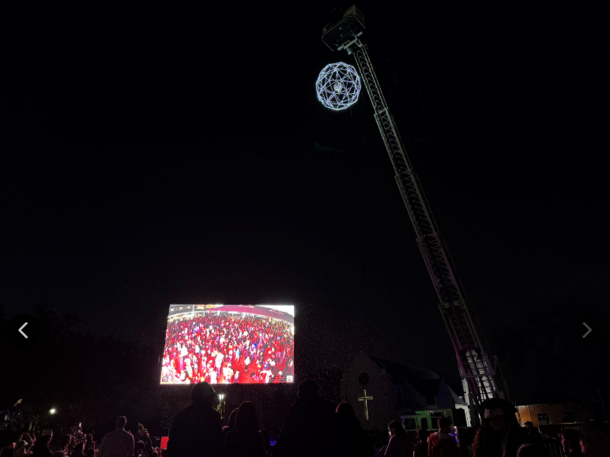
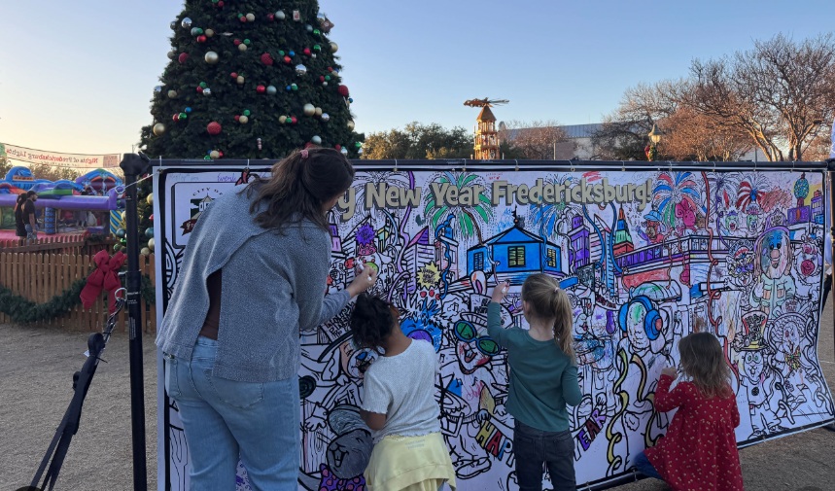
New Year's Eve
Countdown to 2026
December 31st, 3:00 - 6:30
Marktplatz

Slide 12

City of Fredericksburg Water Update
May 14, 2025

Slide 13
Todays Presentation
  City of Fredericksburg and HCUWCD
  Historical Local Rainfall
  Current Water Well Levels, Trends and History
  Residential Water Use vs. Residential Connections
  Water Conservation Program – Goals
  Water Rates and Watering Restrictions
  Water Distribution System Integrity
  Local, State and Nation-Wide Short and Long-Term Weather Forecast

Slide 14
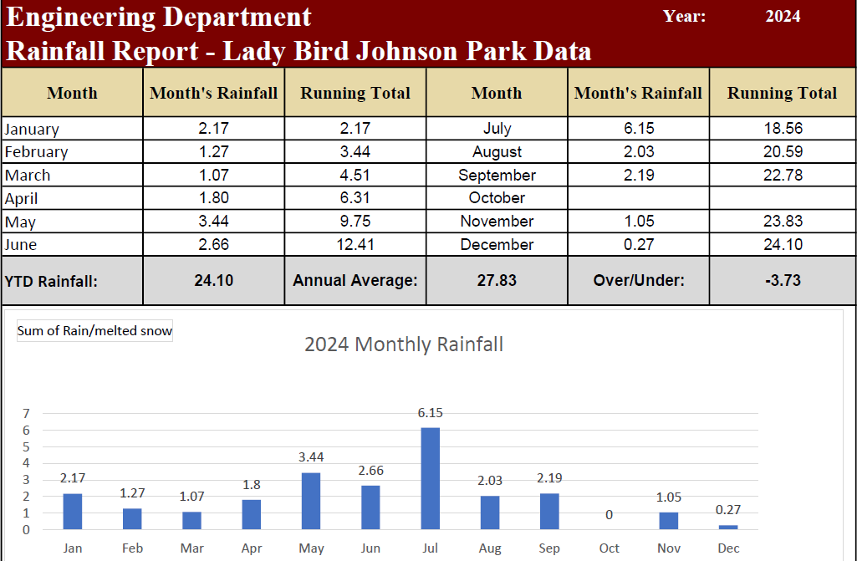
City of Fredericksburg 2024 Rainfall
  Rainfall total 2023: 24.10 inches measured at LBJ Park
  Annual average rainfall for Fredericksburg is about 28 inches
Notes:
Drought began in 2005. More years of less than average rainfall (some significantly less) than average rainfall. 6” of rain to make average this year; 16” of rain to equal last year.

Slide 15
Historical Rainfall: 2000-2024

Slide 16
Historical Rainfall: 2010-2024

Slide 17
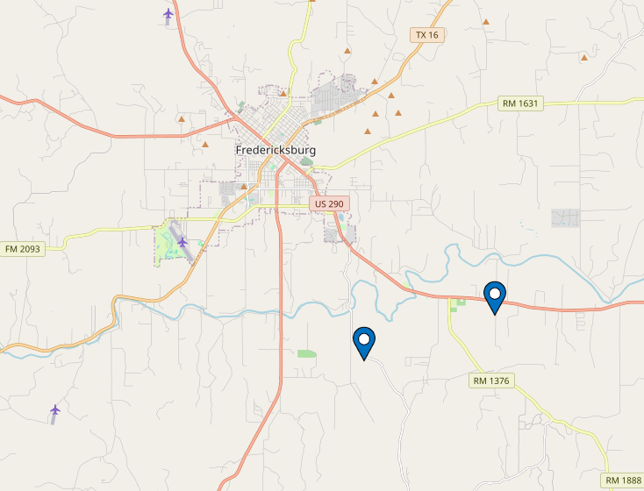
TWDB Aquifer Monitoring
Knauth
Old SA Road

Slide 18
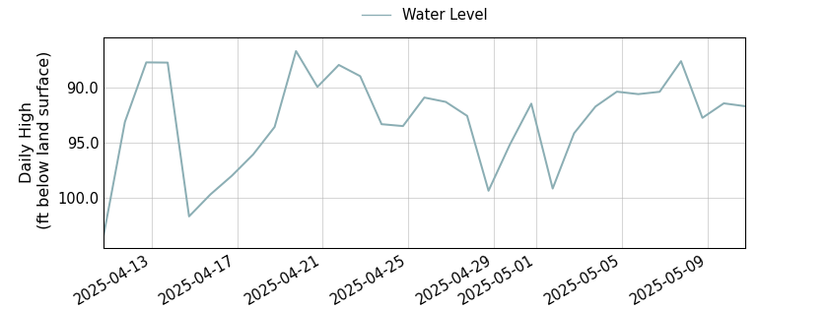
Knauth Well Field – 30 days
Measurement below ground surface at well
On May 12, 2025- – 91.72 ft OR 9.5 ft higher

Slide 19
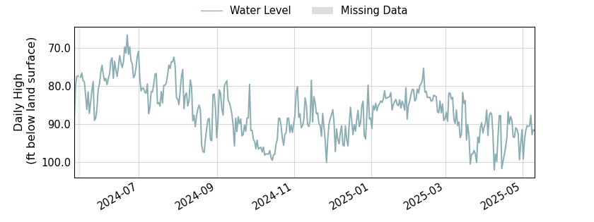
Knauth Well Field – 1 Year
Redline indicates aquifer level 12 months prior
15 feet below measurement in May 2024
Notes:
Lower well levels attributed to lower than average rainfall especially in September

Slide 20
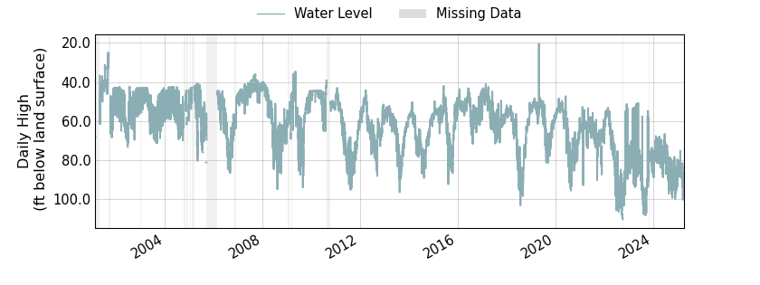
Knauth Well Field – Period of Record
Redline shows trend line of aquifer

Slide 21
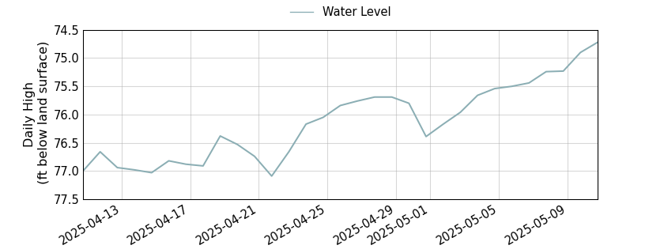
Old SA Rd Well Field – Last 30 days
Measurement below ground surface at well
On May 12, 2025 – 74.72 ft OR 2.5 ft higher

Slide 22
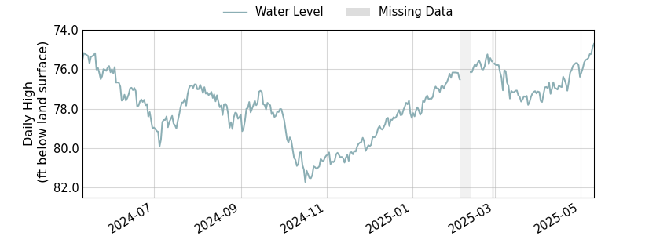
Old SA Rd Well Field – 1 Year
Redline indicates aquifer level 12 months prior
0.62 feet above measurement in May 2024

Slide 23
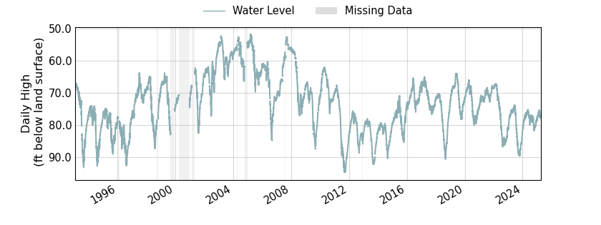
Old SA Rd Well Field – Period of Record
Redline shows trend line of aquifer

Slide 24
Residential Water Use vs. Residential Connections

Slide 25
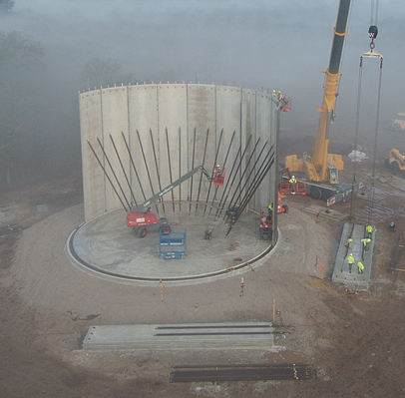
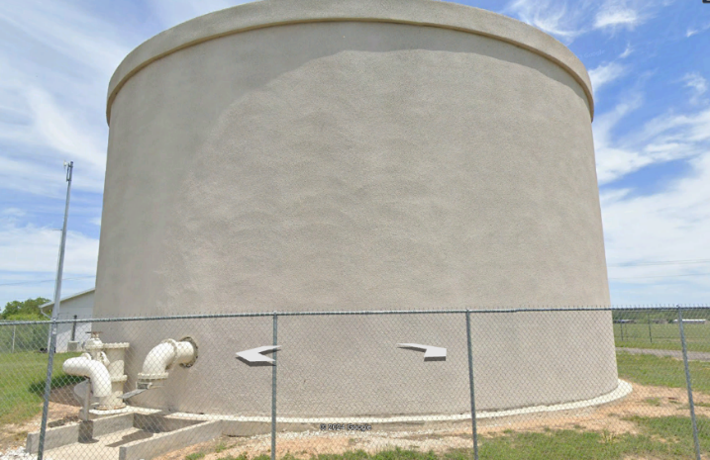
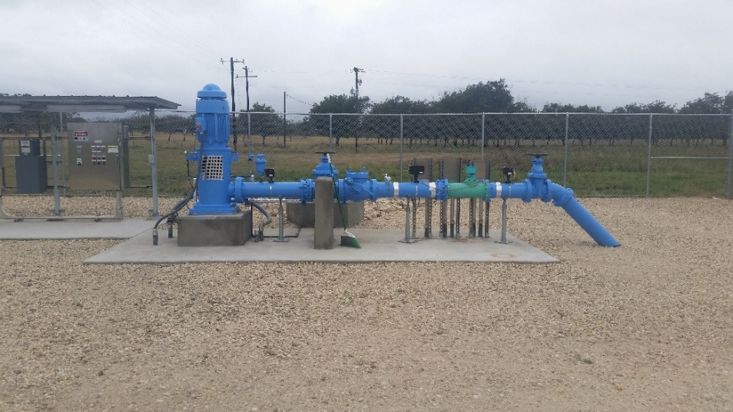
Water Distribution System Integrity
    Recent Projects
    Windcrest Water Storage Tank Rehabilitation
    New South Heights Water Storage Tank
    New Goehmann Ln Water Storage Tank
    Recompletion of Knauth #2 Well
    Bell Street Waterline Project
    Sensus Water Meters
    New Pump Station at Knauth Wellfield
    290 East Water Supply Line
    3 New 1M Gallon Concrete Water Storage Tanks
    East Main Street Waterline Rehab
    2” Water Main Replacement Projects (various locations in town)
    Long-term Water Supply Study
Notes:
Average daily water use = total water used divided by number of days in the year
Maximum daily water use = maximum quantity of water used on any one day of the year
Peaking factor of 2 recommended by F&N in 2007 study based on historical data

Slide 26
Water Conservation Measures
What have we been doing to conserve water?
  Water system leak detection survey
  AMR “smart” meters
  Re-use of reclaimed water
  Water rate adjustment/increase
  Watering restrictions

Slide 27
Current Water Conservation Measures
  1. Water System Leak Detection Survey
    Phases 1 completed in November 2022 (FY23)
    Phase 2 completed in February 2024 (FY24)
    Phase 3 completed in February 2025 (FY25)
    Surveys Included:
      134 miles of piping
      6,700 service lines
      350 fire hydrants
    22 leaks were identified
    Water loss audit

Slide 28
Current Water Conservation Measures

Slide 29
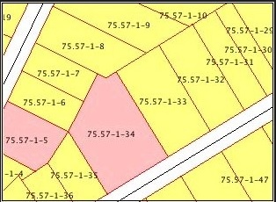
Current Water Conservation Measures
  2. AMR “Smart” Meters
    Meter data from new meters includes date/time/volume of consumption
    Enables utility billing and code enforcement to easily identify leaks and water violations
    Sensus Customer Portal allows customers to monitor water usage and/or receive alerts.
    https://www.fbgtx.org/1124/Sensus-Customer-Portal

Slide 30
Current Water Conservation Measures
  3. Re-Use of Reclaimed Water
    500M gallons produced annually (50% of potable water volume)
    35-40% currently re-used annually, 100% during summer months
    Golf Courses: Boot Ranch and Lady Bird Johnson
    TCEQ 210 permit permitting sale of reclaimed water for construction use
    Frieden Subdivision Development

Slide 31
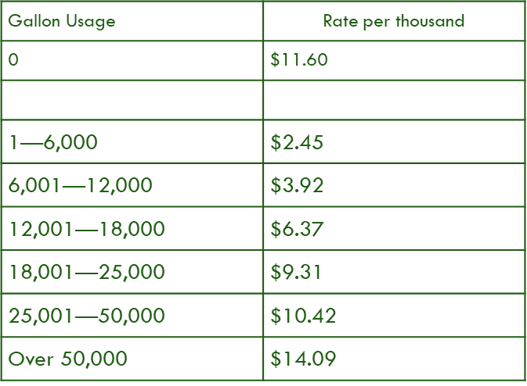
Current Water Conservation Measures
  4. Water Rate Structure Encourages Conservation
    New Rate Structure in October 2013
    Amended Rates with Rate Study in November 2019
    Inclining Block Rate Structure “Tiered”… Higher consumption = higher cost
    Commercial sewer rates based on actual water usage

Slide 32
Watering Restrictions
    New watering restrictions went into effect May 1, 2014
    5 stages (1-5) of watering restrictions
    Goal of each stage is to reduce demand of water
Trigger Conditions
    Stage of the “Local Drought Index” based on local drought sensitive parameters
      Daily Average water levels from two wells in the Ellenburger aquifer
      Average daily flow of the Pedernales River
      Prior 10-month cumulative rainfall amount
      Palmer Drought Index
    Pumping capacity of pumps that transfer water into the City’s distribution system
    Decrease in well field production capacity
    * Initiation and Termination of Stages by City Manager proclamation

Slide 33
Stage | Last Digit of Address | Watering Day | Weekends | Watering Times | Reduction Goals
1 | All | Mon. – Sun. | Yes | *5-9 a.m. *7-11 p.m.
2 | 1 or 2 3 or 4 5 or 6 7 or 8 9 or 0 | Mon & Sat Tues & Sat Wed & Sun Thurs & Sun Fri & Sun | Yes | *5-9 a.m. *7-11 p.m. | 10% Avg Daily Water Demand
3 | 1 or 2 3 or 4 5 or 6 7 or 8 9 or 0 | Mon Tues Wed Thurs Fri | Yes but with handheld hose, bucket or drip only | *5-9 a.m. *7-11 p.m. | 15% Avg Daily Water Demand
4 | 1 or 2 3 or 4 5 or 6 7 or 8 9 or 0 | Mon Tues Wed Thurs Fri | Yes but with handheld hose, bucket or drip only | 6-10 a.m. | 20% Avg Daily Water Demand
5 | All | None | No | None | 35%
*Discussed changing watering times from 6-10am and 6-10pm for all watering stages

Slide 34
Future Projects and Staff
    Long-term Water Supply Study
    Statement of Qualification - review
    Professional Services Contract – City Council June
    Schedule – 8 to 10 months
Groundwater Exploration Project
Water Conservation Ordinance Amendment
    Water Stages
Unified Development Code
    Low Impact Development
Public Works Community Liaison
    Public outreach and education programs
      Water and electric conservation; Recycling
    New full-time position – FY 2026 budget

Slide 35
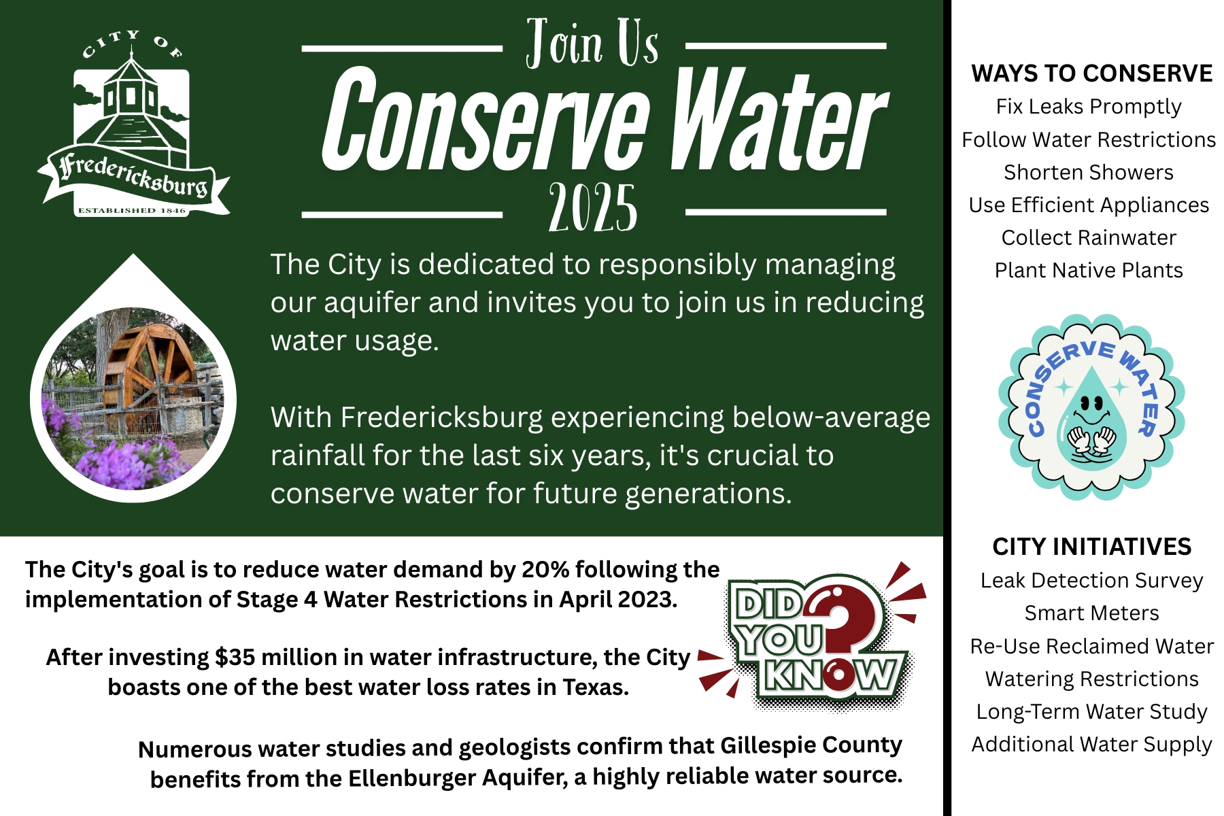

Slide 36
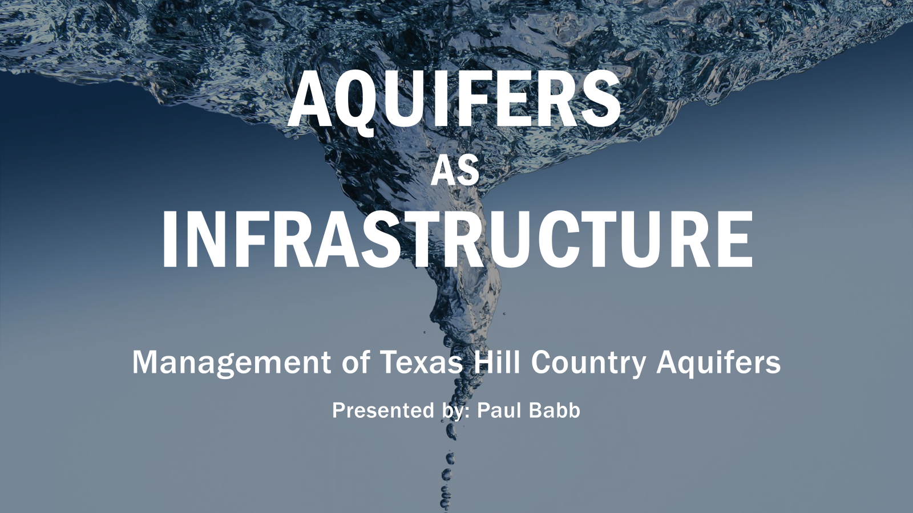
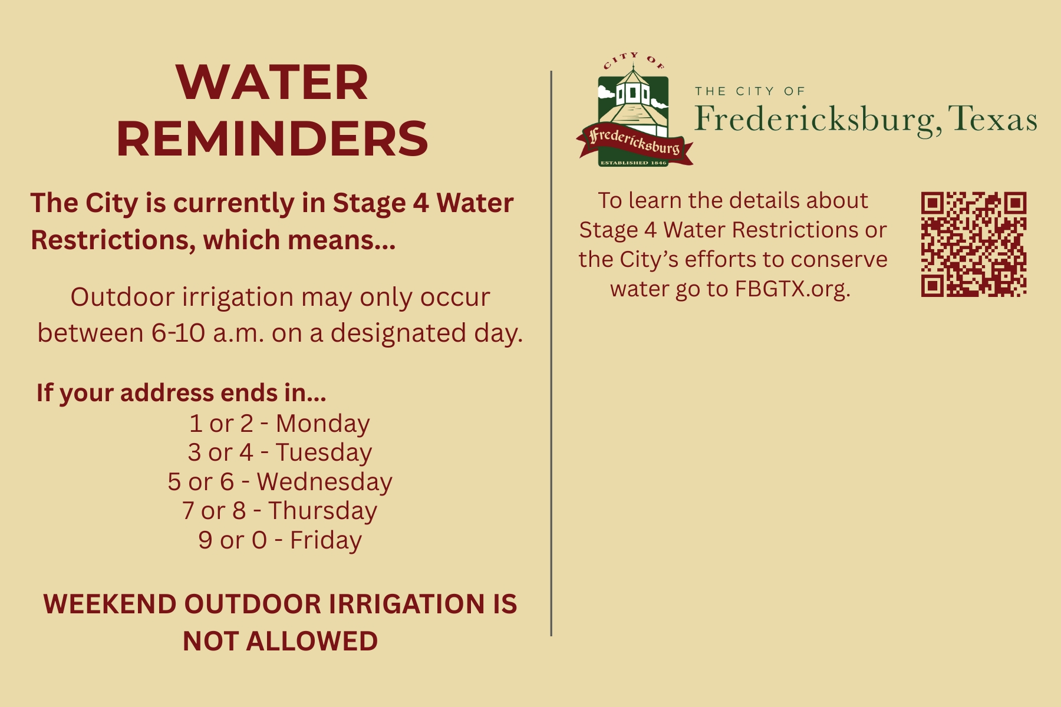

Slide 37
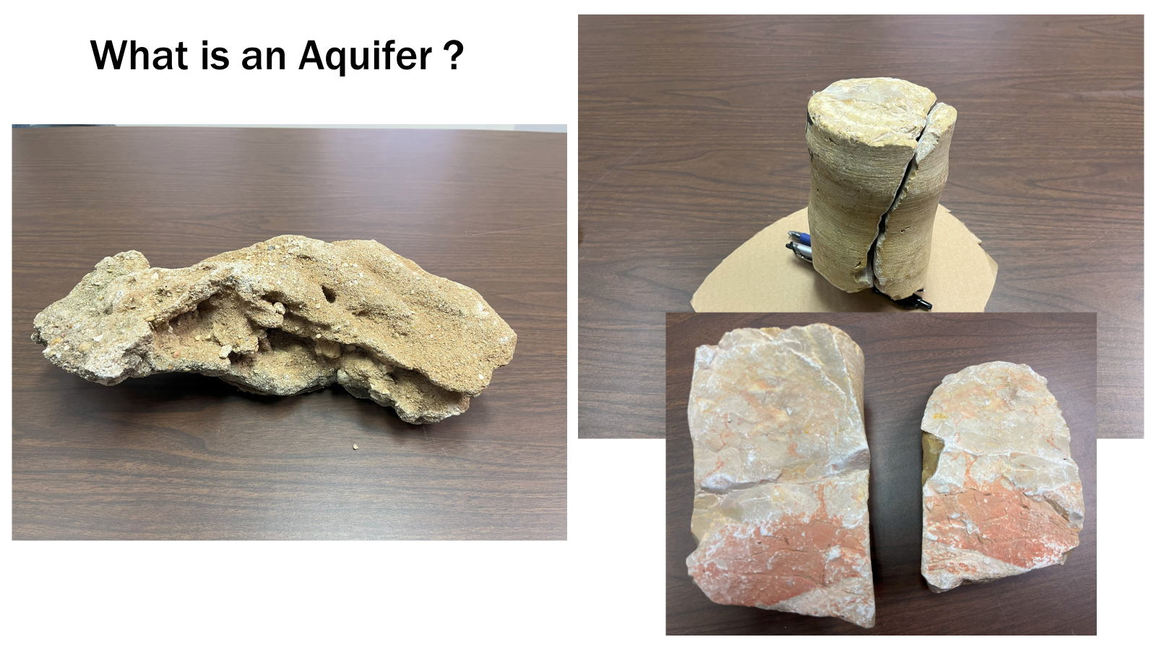
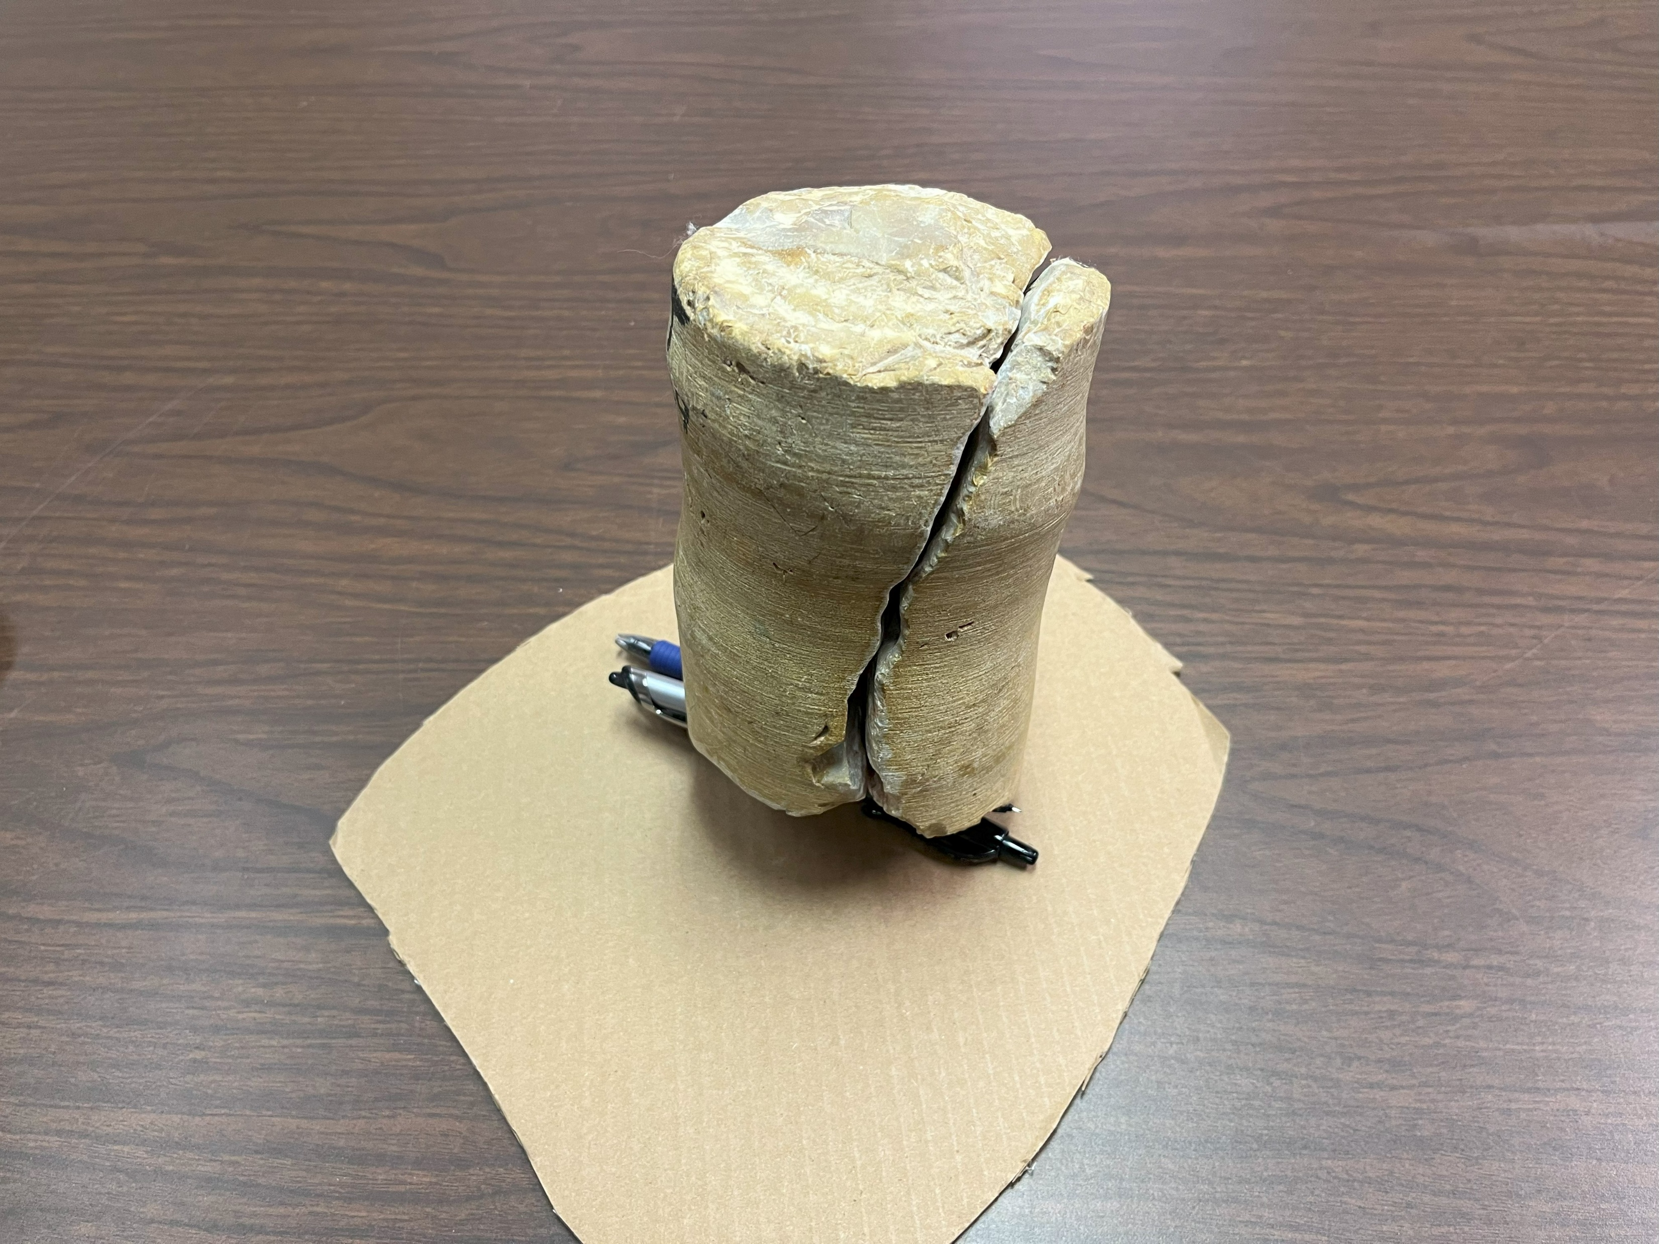
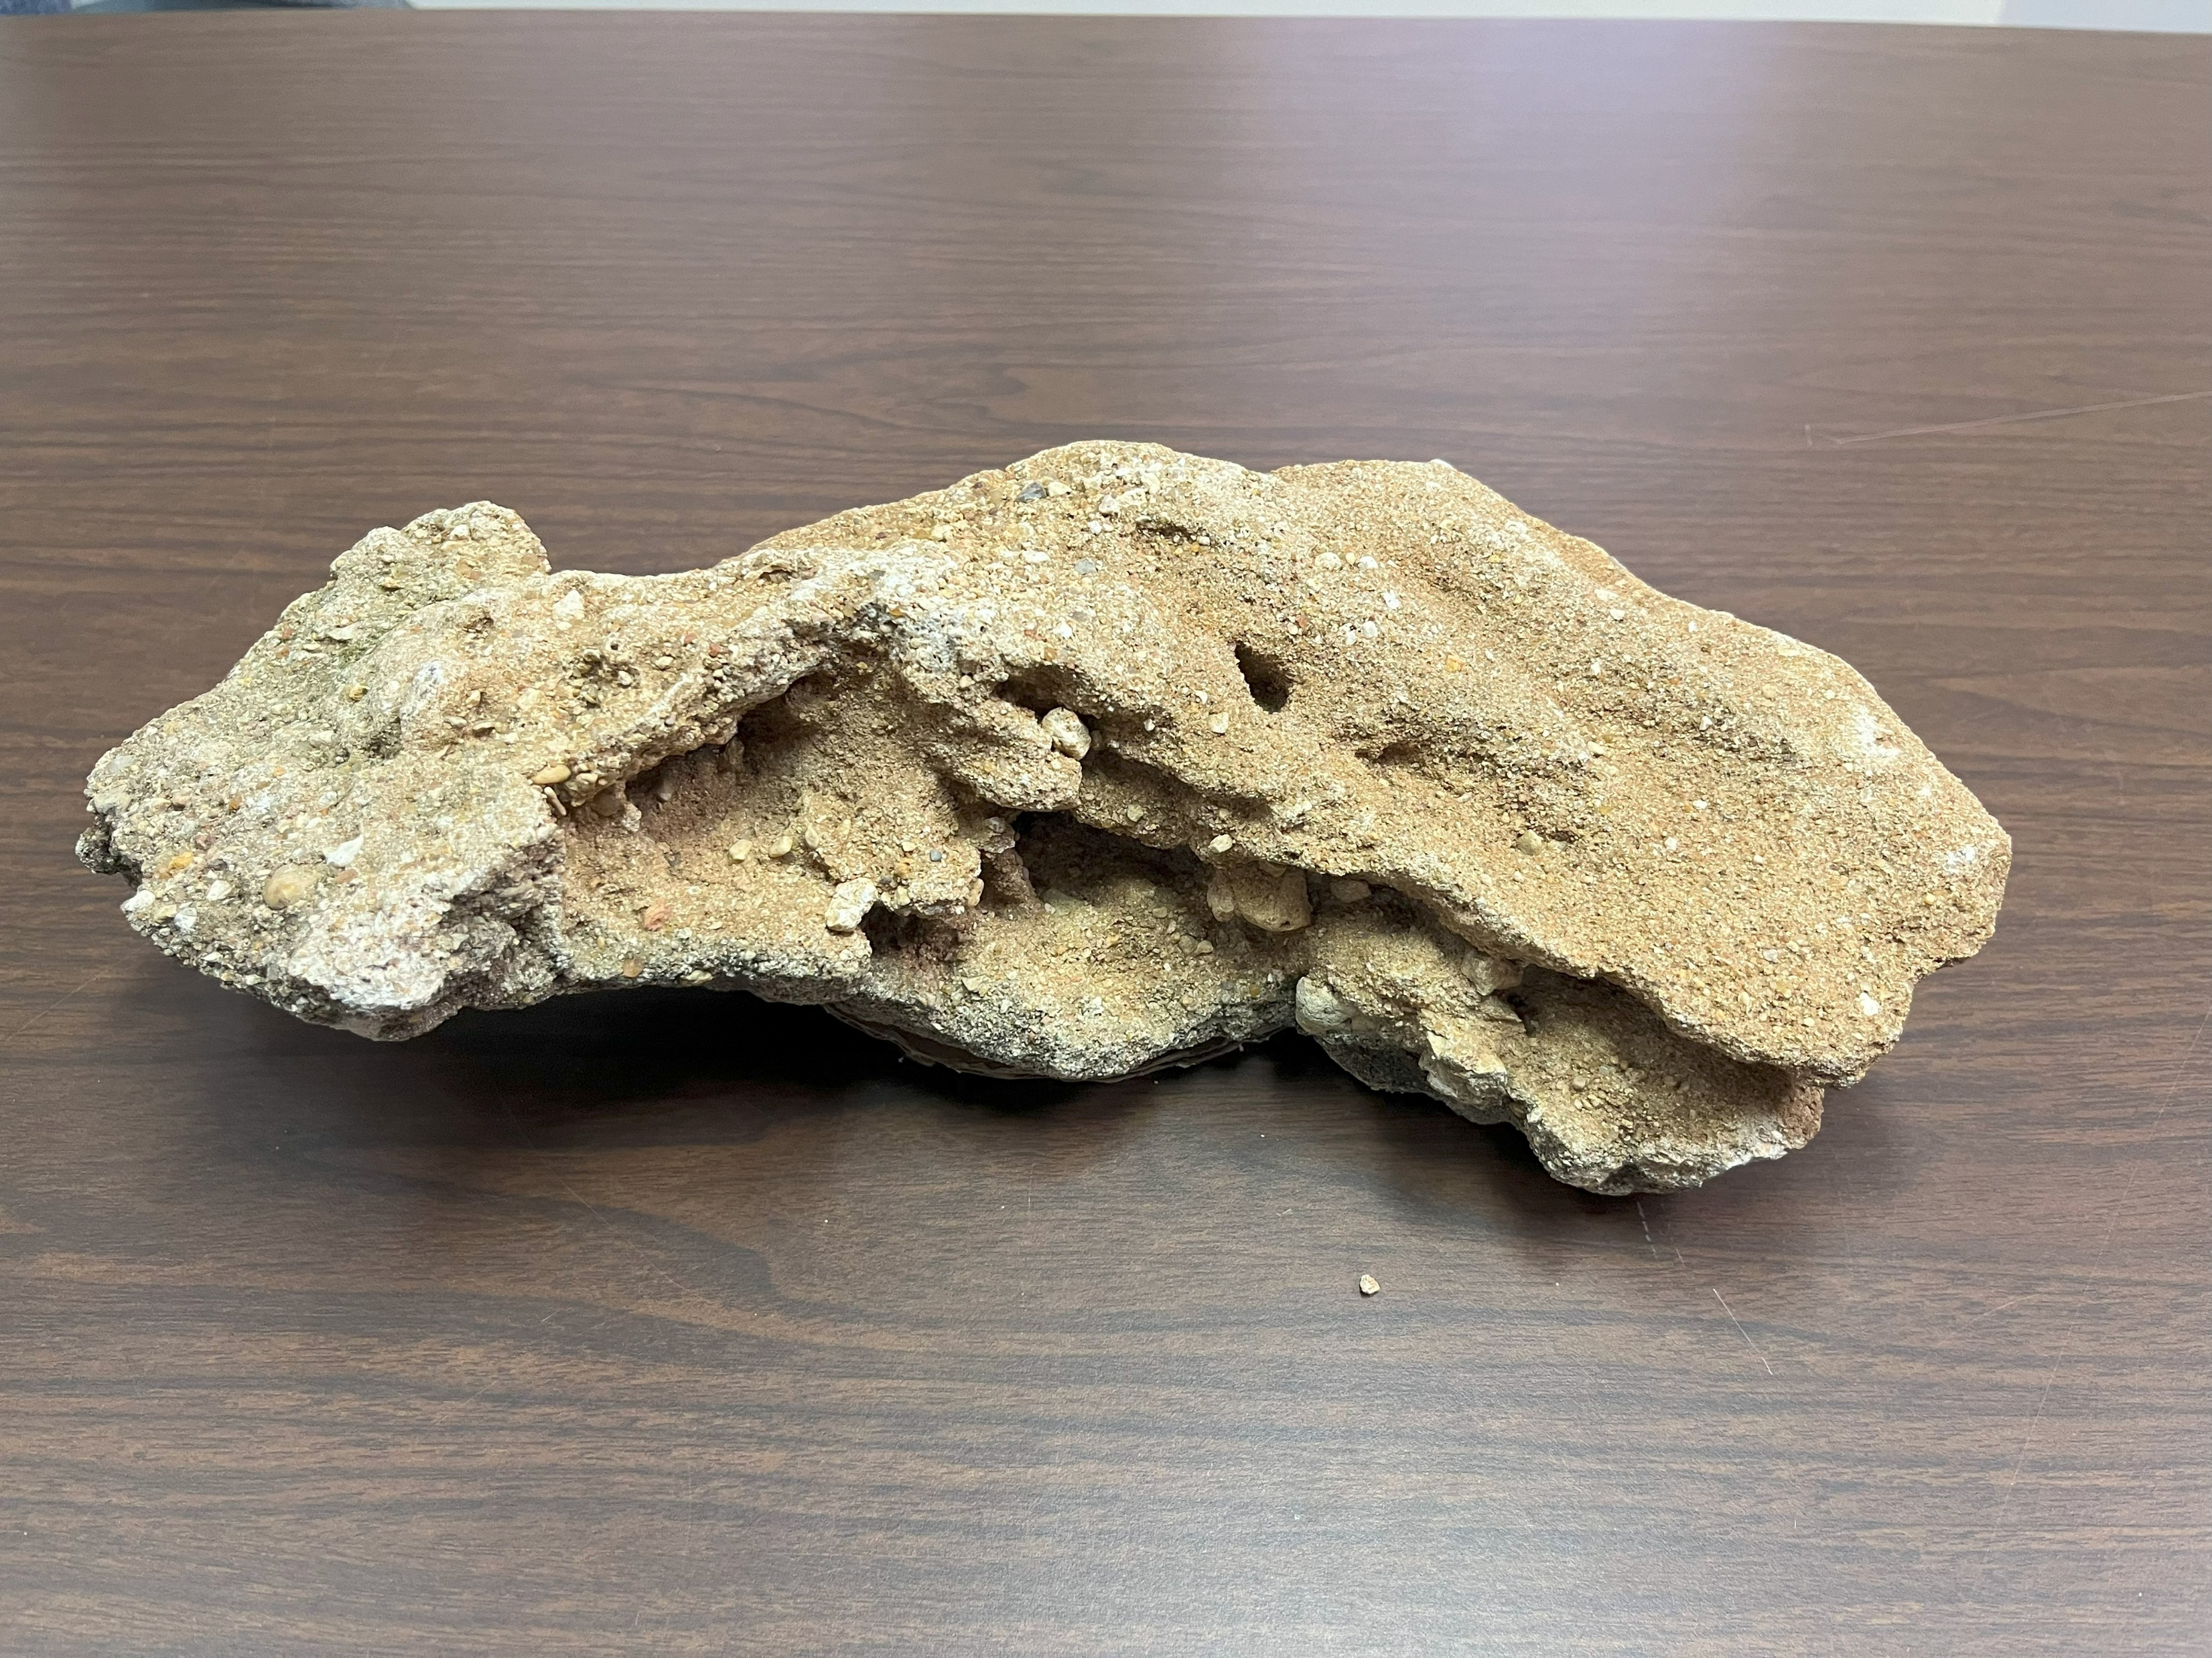
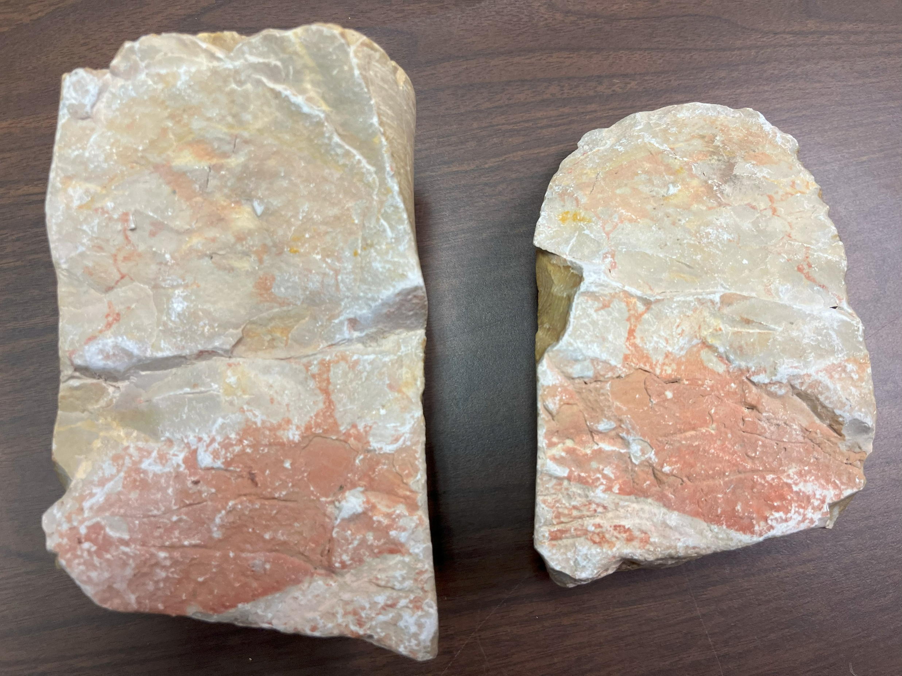
What is an Aquifer ?

Slide 38
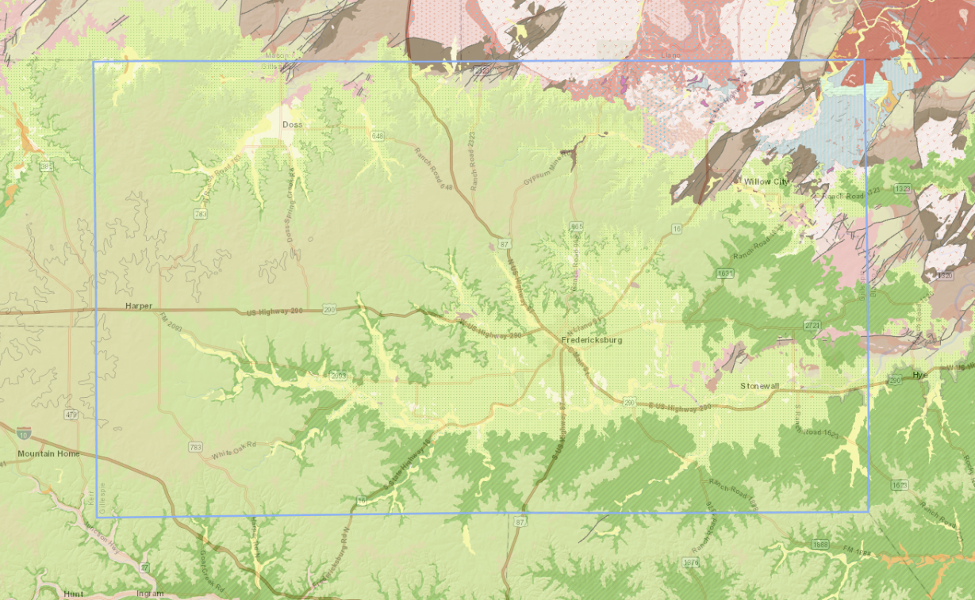

Slide 39
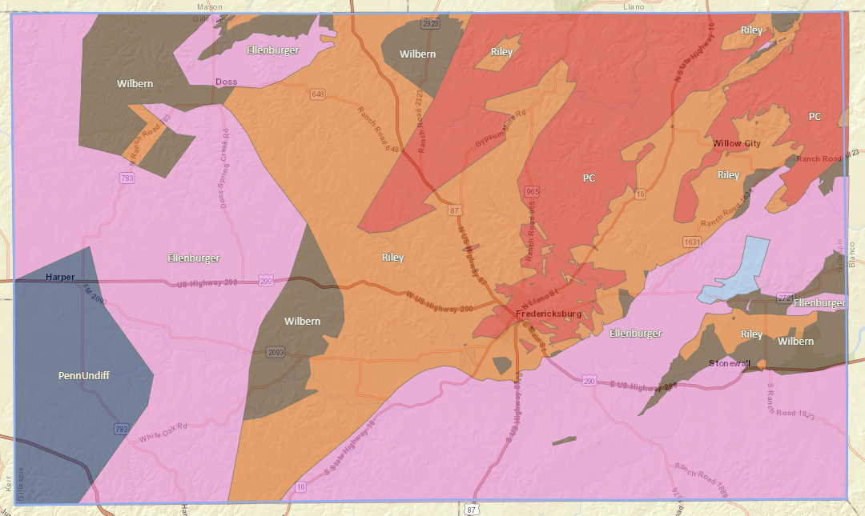

Slide 40
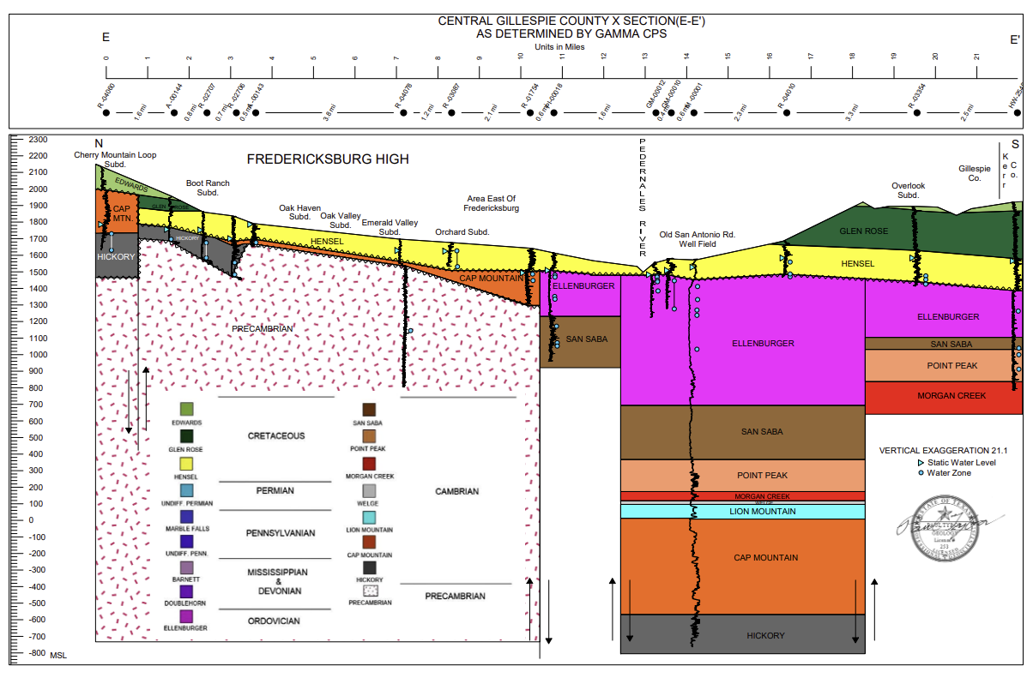

Slide 41
Terms and Administrative Framework
Texas Constitution Article XVI Sec.59
Texas Water Code Chapter 36 & 35
GCD Management Plan & Rules
Groundwater Management Area –GMA7
Desired Future Conditions -DFC
Modeled Available Groundwater –MAG

Slide 42
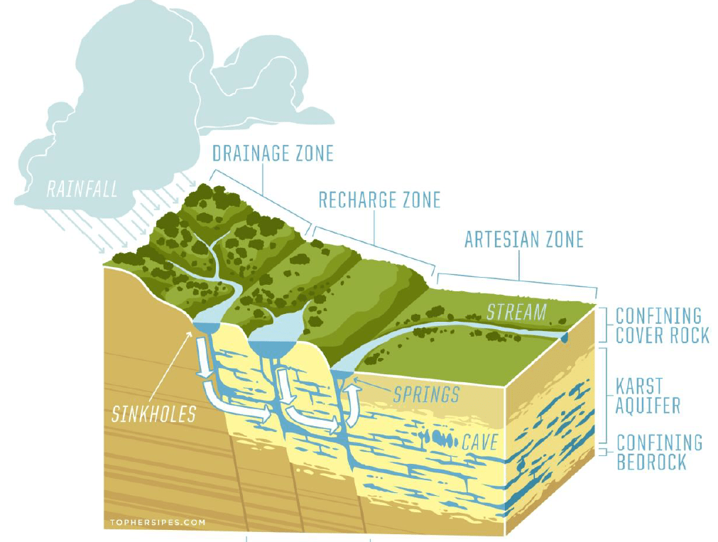
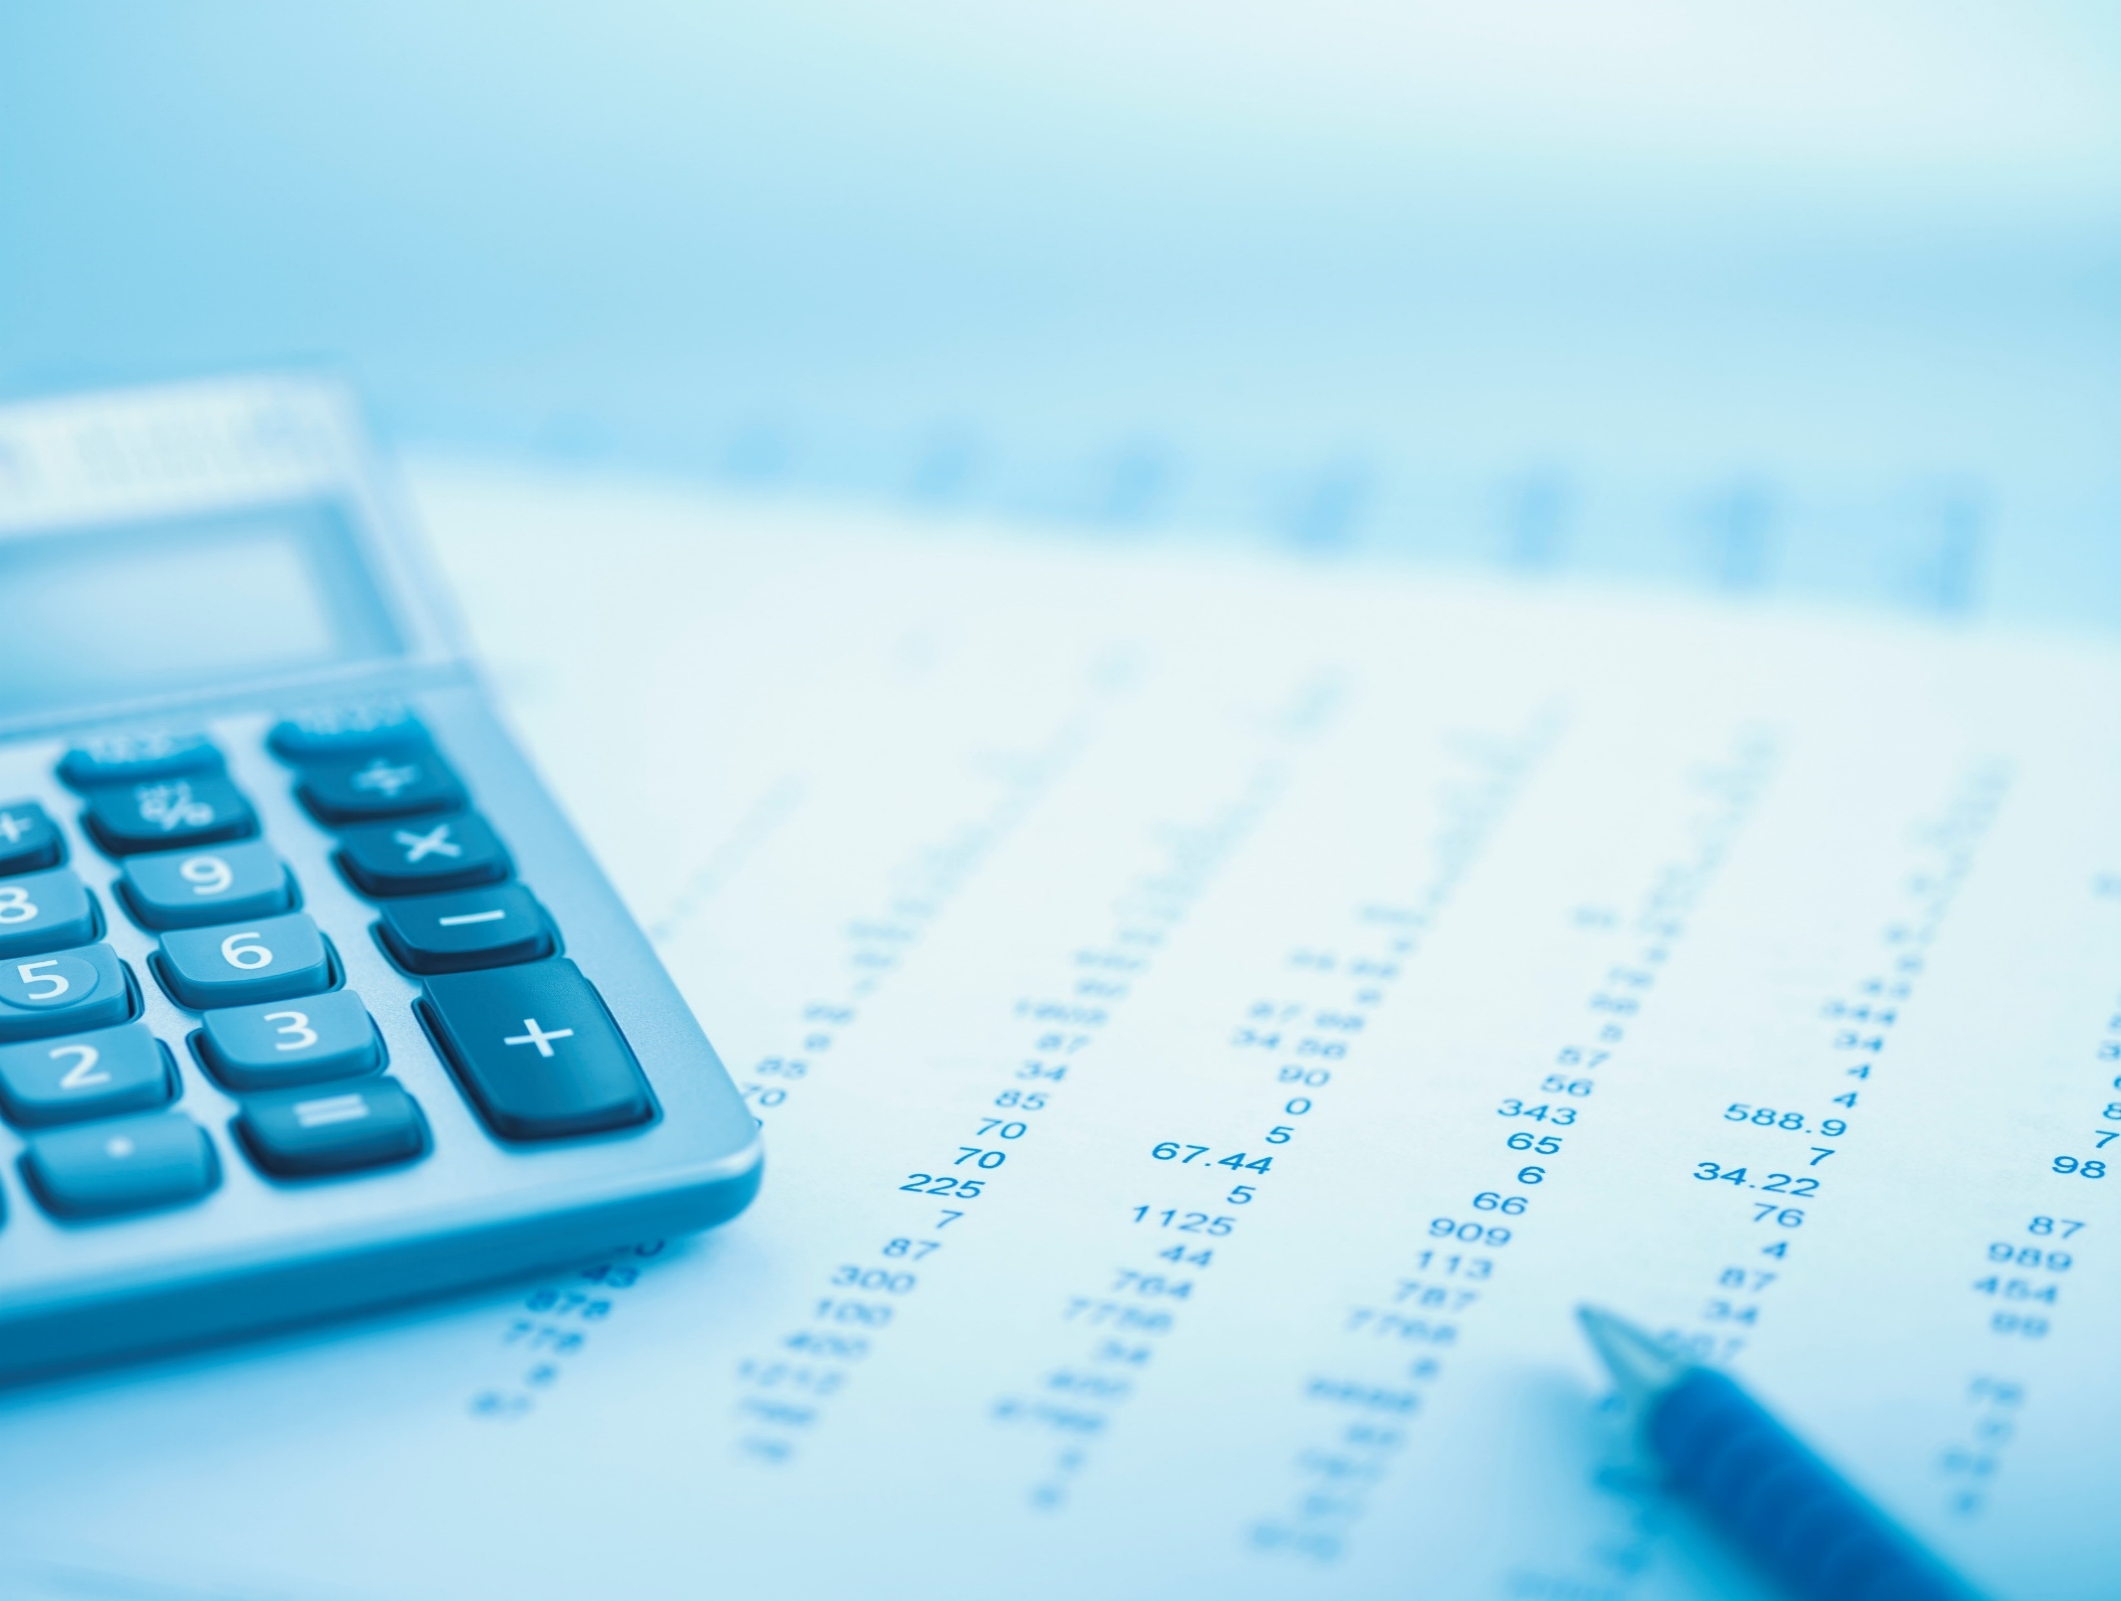
If you understand managing money, you
understand groundwater management

Slide 43
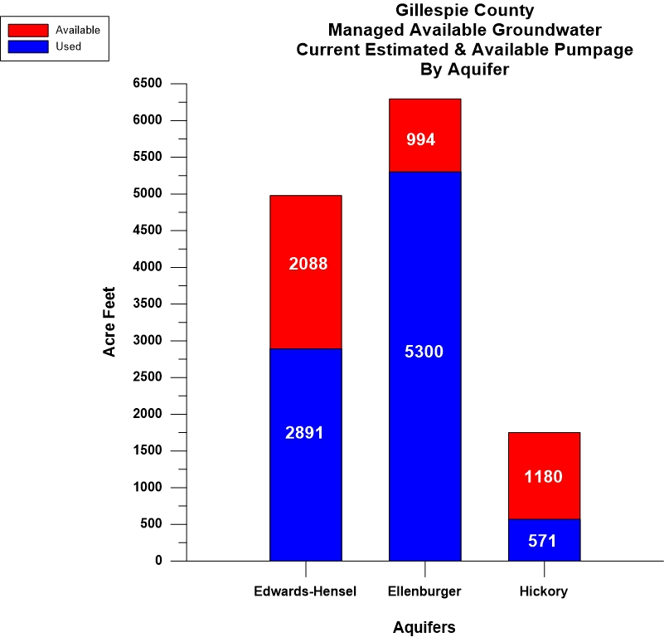

Slide 44
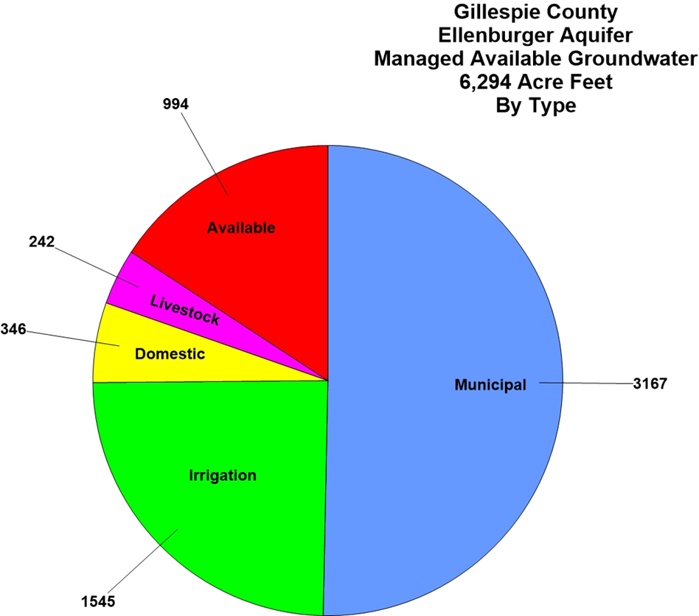

Slide 45
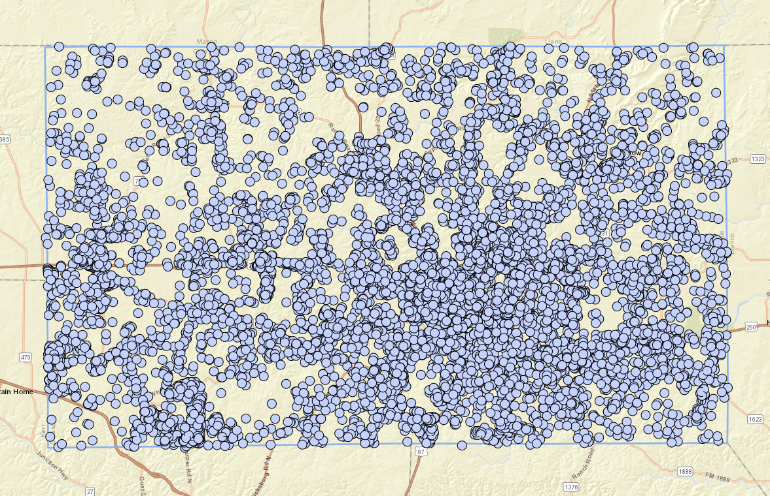
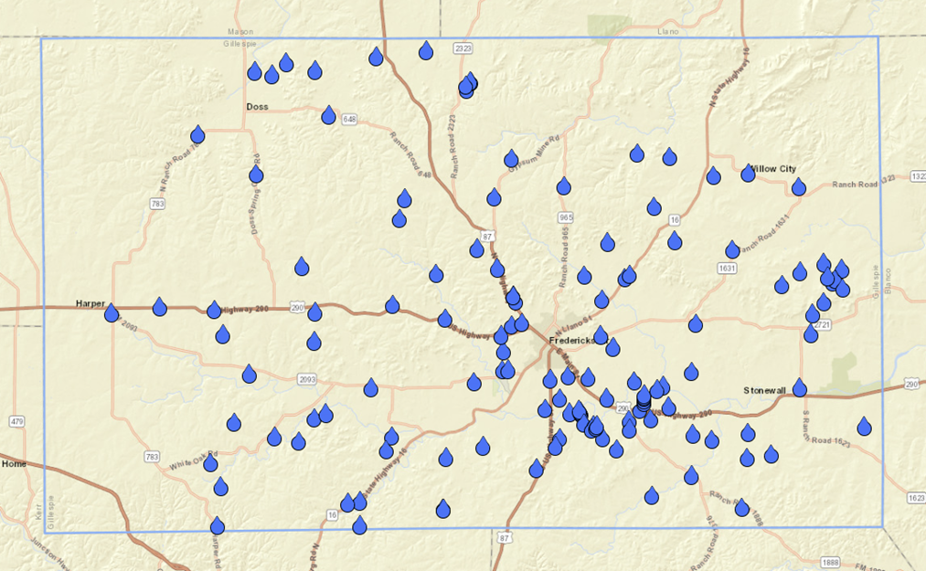
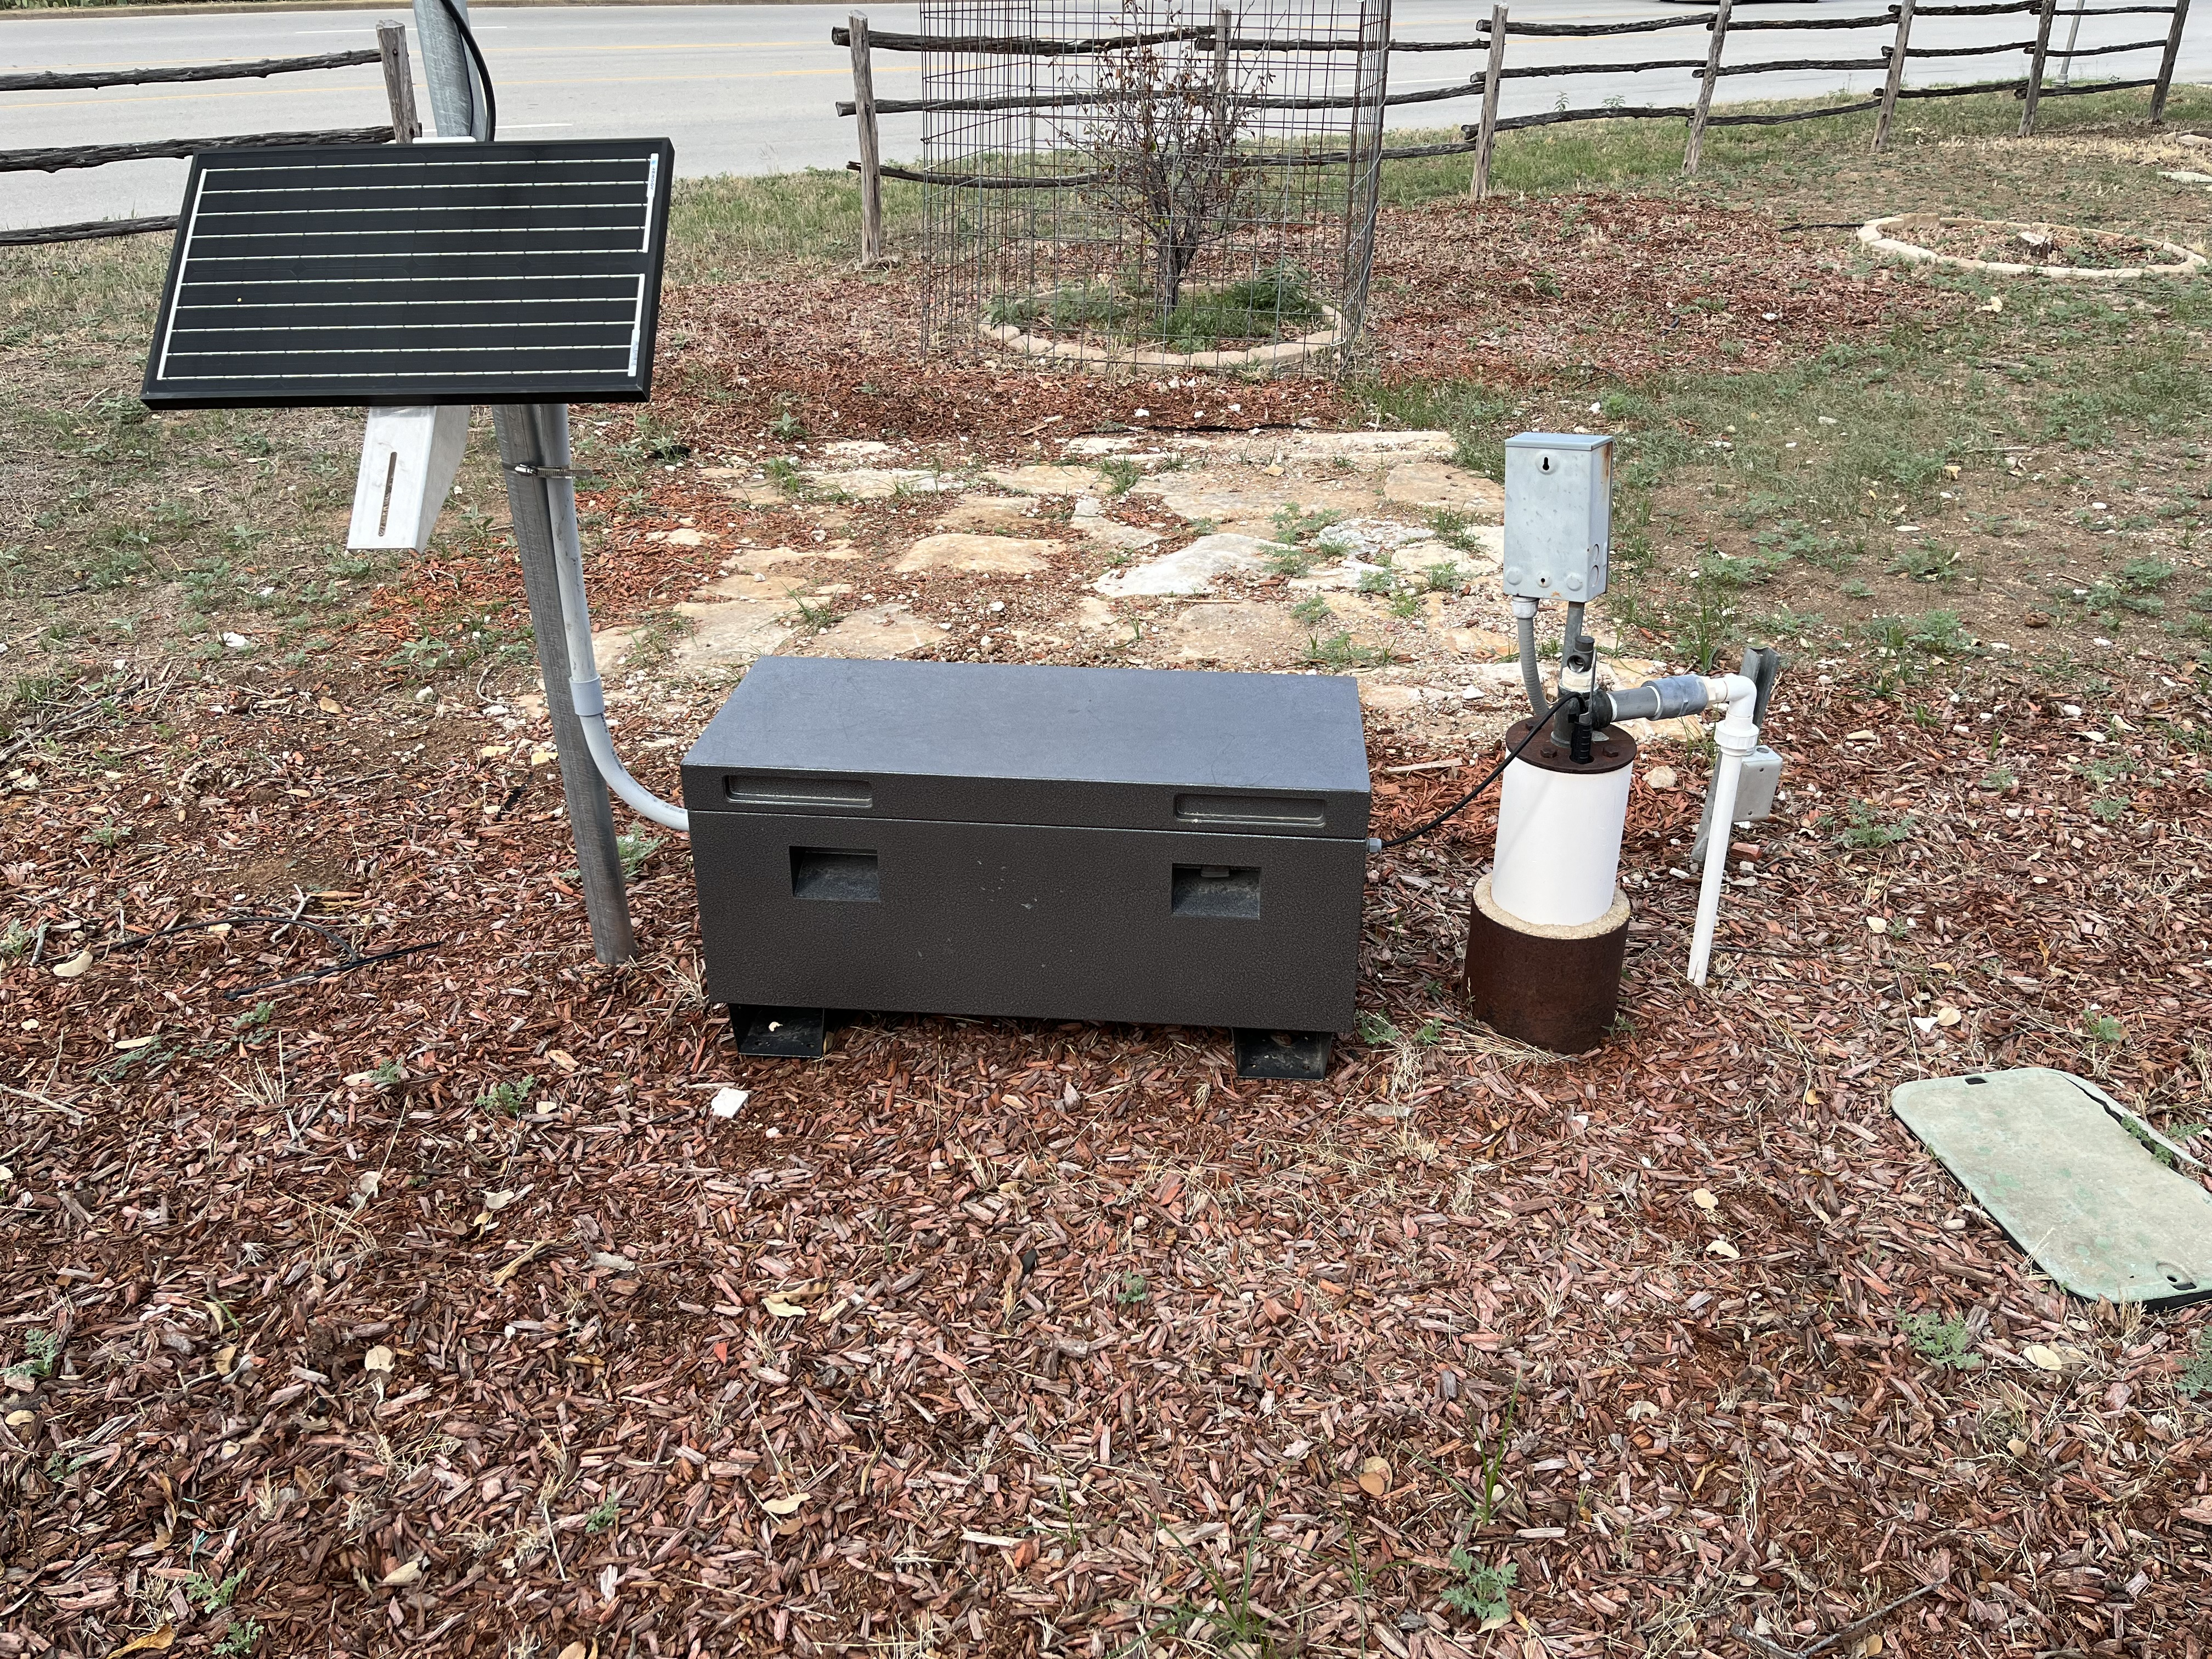
12000+ Wells
120+ Monitor Wells

Slide 46
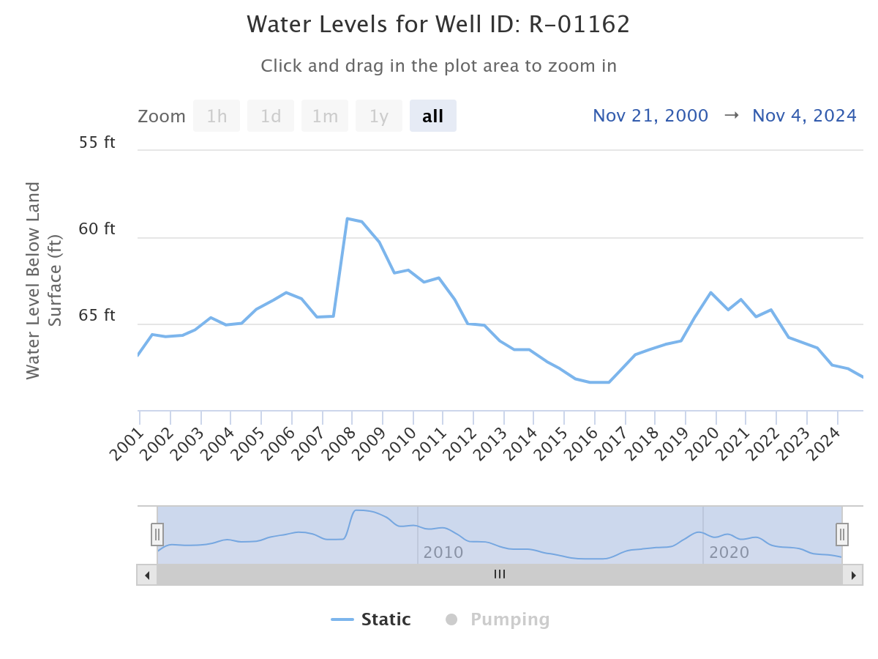
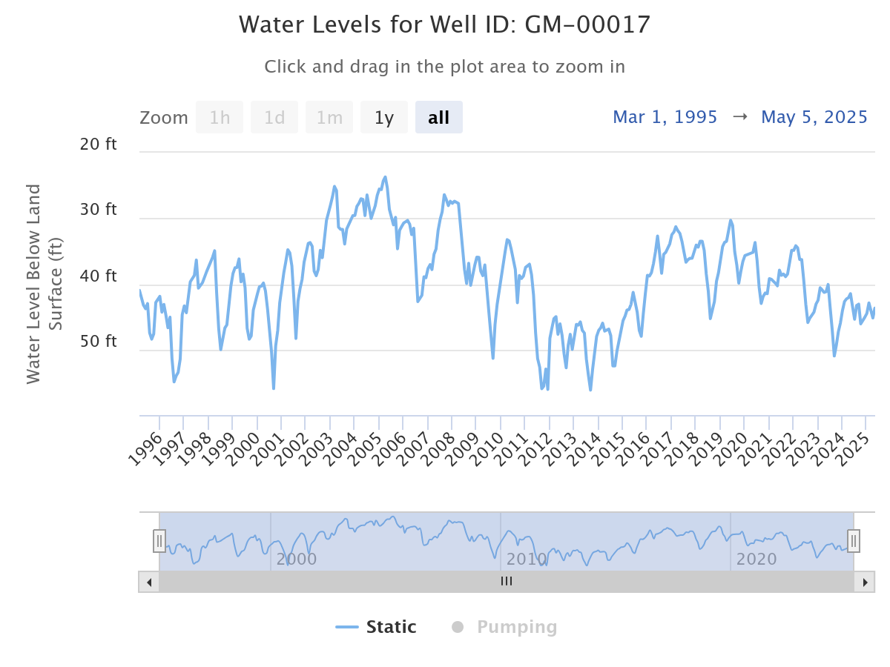
Water Levels
Edwards-Trinity
Ellenburger

Slide 47
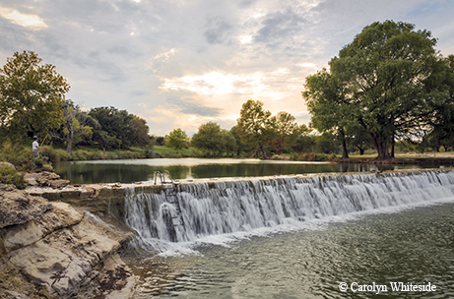
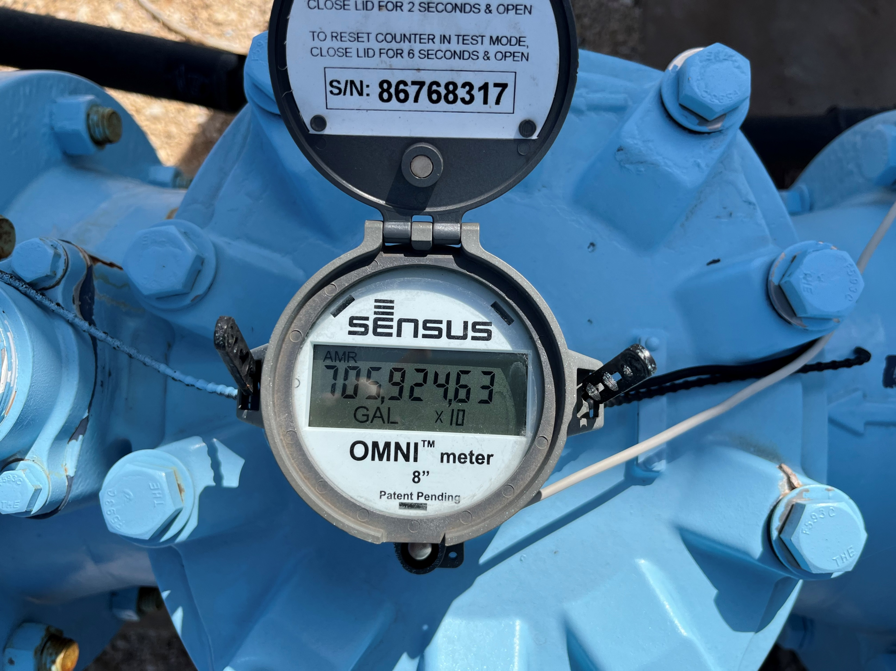
Base Flow and Spring Flow
Production Reporting

Slide 48
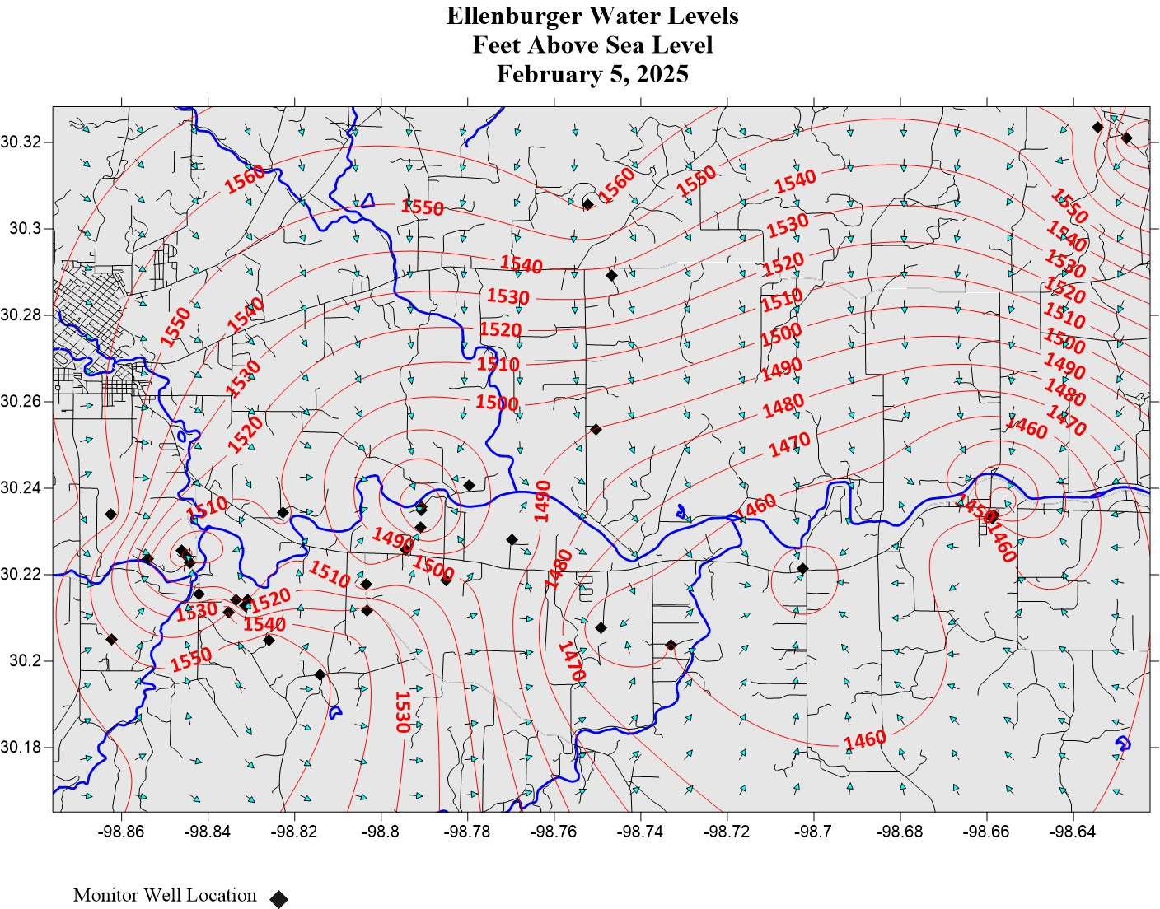
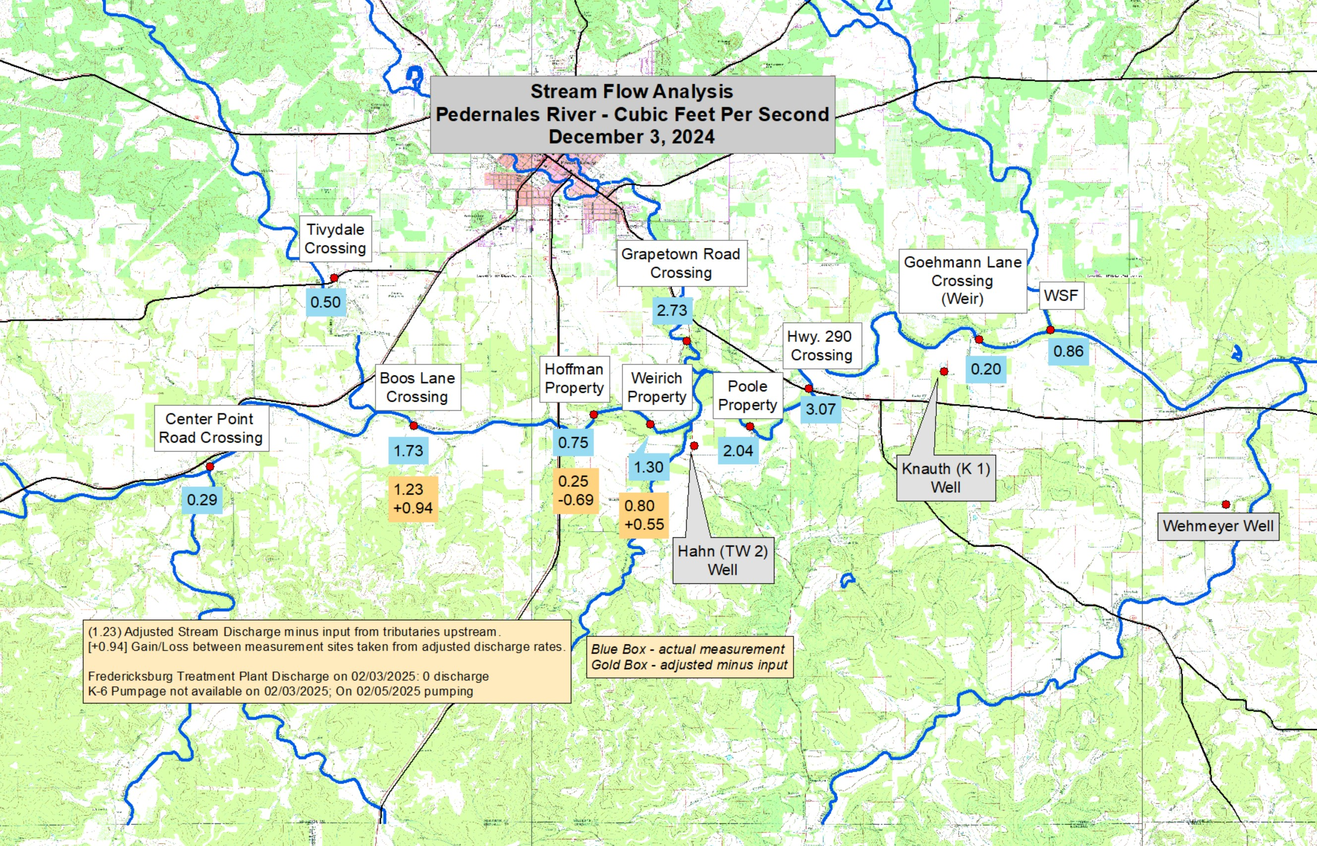


Slide 49

Historical Rainfall: 1877-2025

Slide 50


Drought

Slide 51


Slide 52


Slide 53


`
Conservation is Key
Drought Tolerant Plants
Irrigation Efficiency

Slide 54


Rainwater Catchment/ Collection
Repair leaking plumbing fixtures and pipes

Slide 55

Website: www.hcuwcd.org

Slide 56

Q&A
Q&A
Coffee with the City Manager

Slide 57
City Holidays/Events
Community Blood Drive – Thursday, May 29 1-6pm
City Holiday – Memorial Day – Monday, May 26

Slide 58

Next Coffee With the City manager
Wednesday, June 11

