Slide 1
Development Services
STR
OWNER/OPERATOR UPDATE
June 18, 2024

Slide 2
STR Updates - What we'll cover
Tyler Baethge, STR Specialist
MGO Permitting Software System
2024 Ordinance Changes
H.O.T.

Slide 3
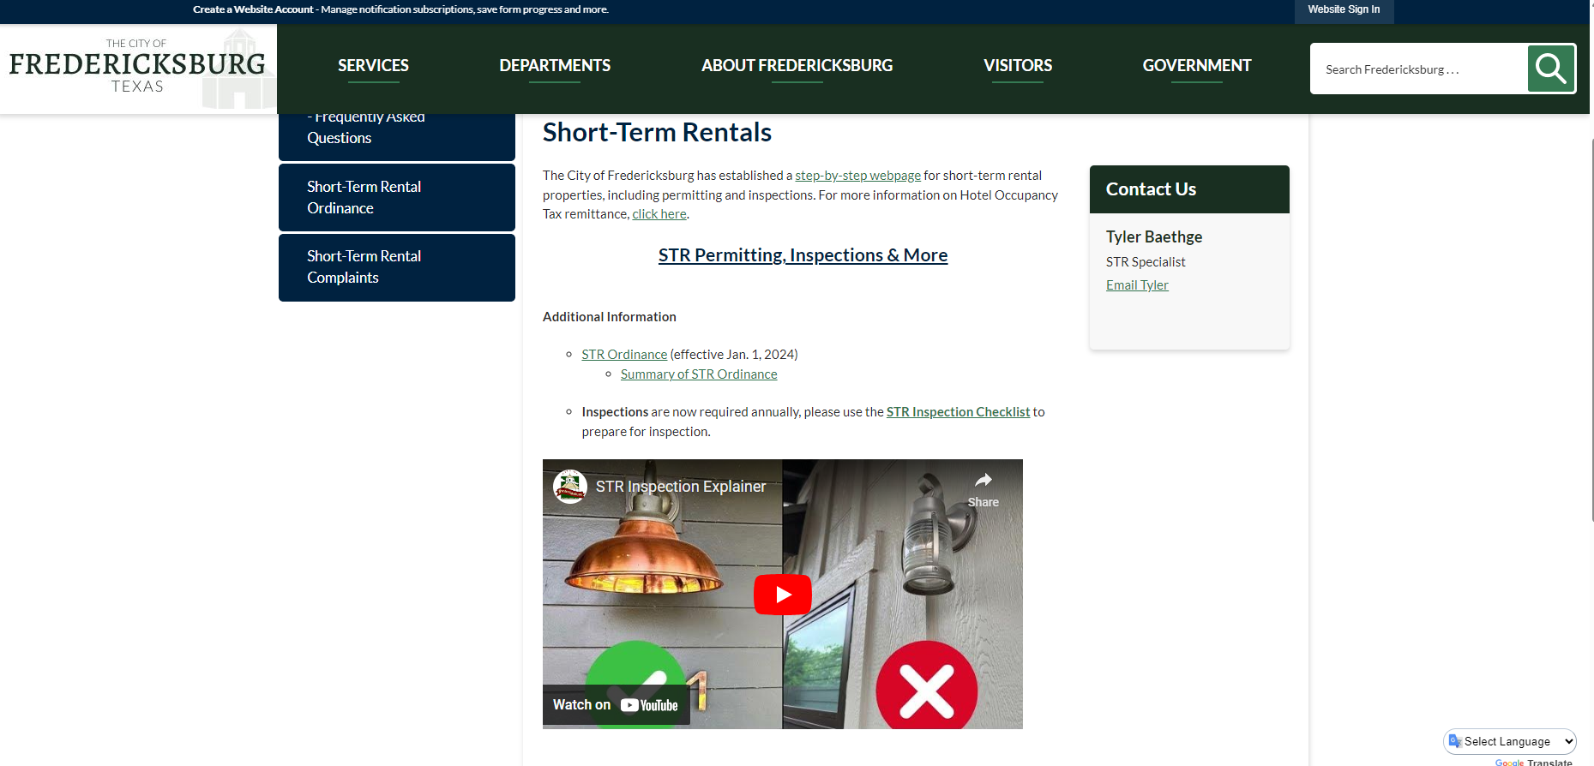
STR WEBSITE
Rentals | Fredericksburg, TX - Official Website (fbgtx.org)

Slide 4
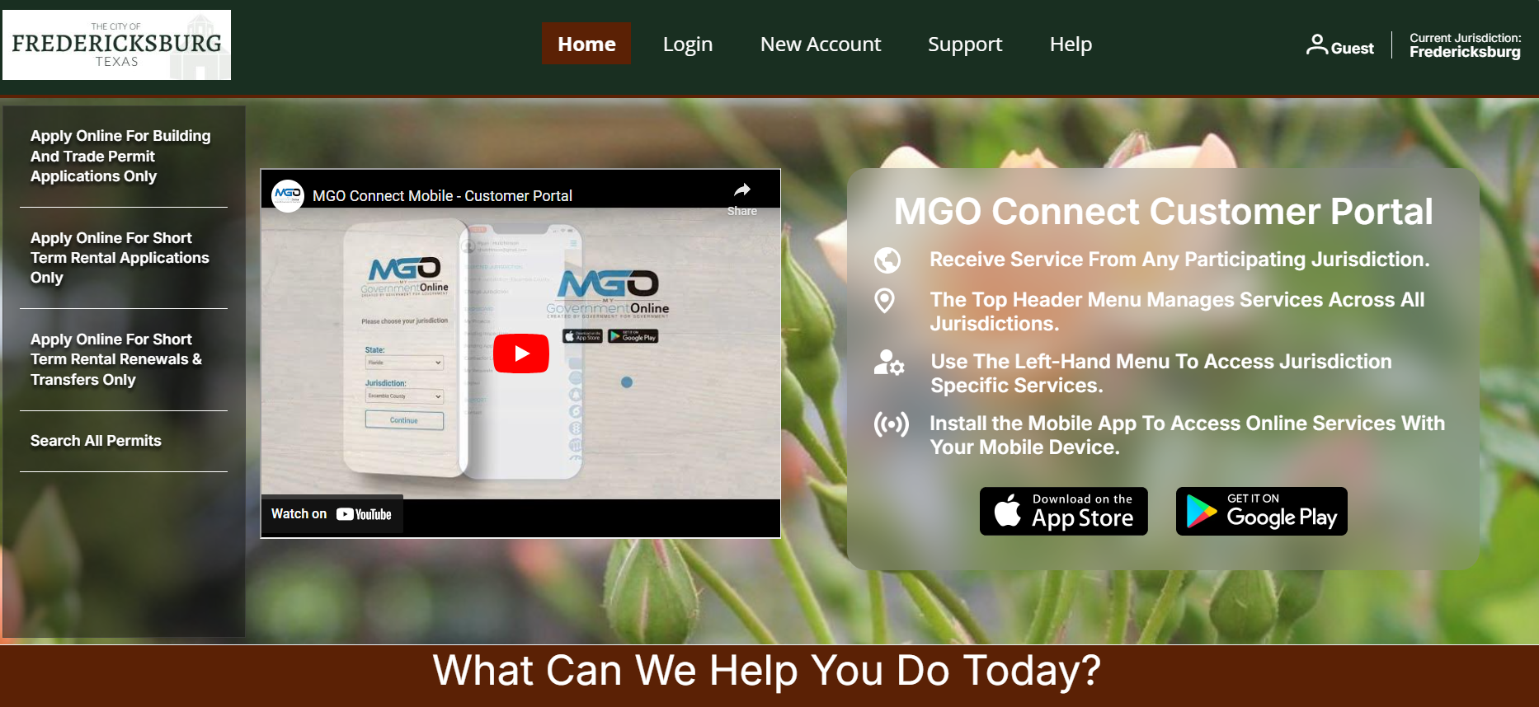
MGO CUSTOMER PORTAL

Slide 5
MGO
New Permits
Renewals
  60 days prior to expiration
  next year notifications will go out
  Require inspection
Transfers

Slide 6
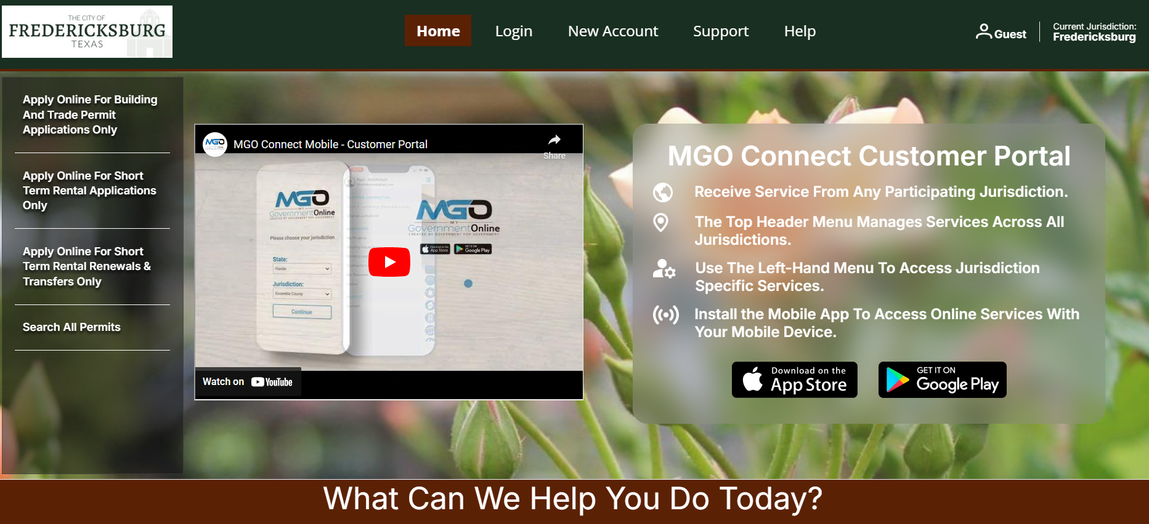

HOW TO LINK YOUR ACCOUNT

Slide 7
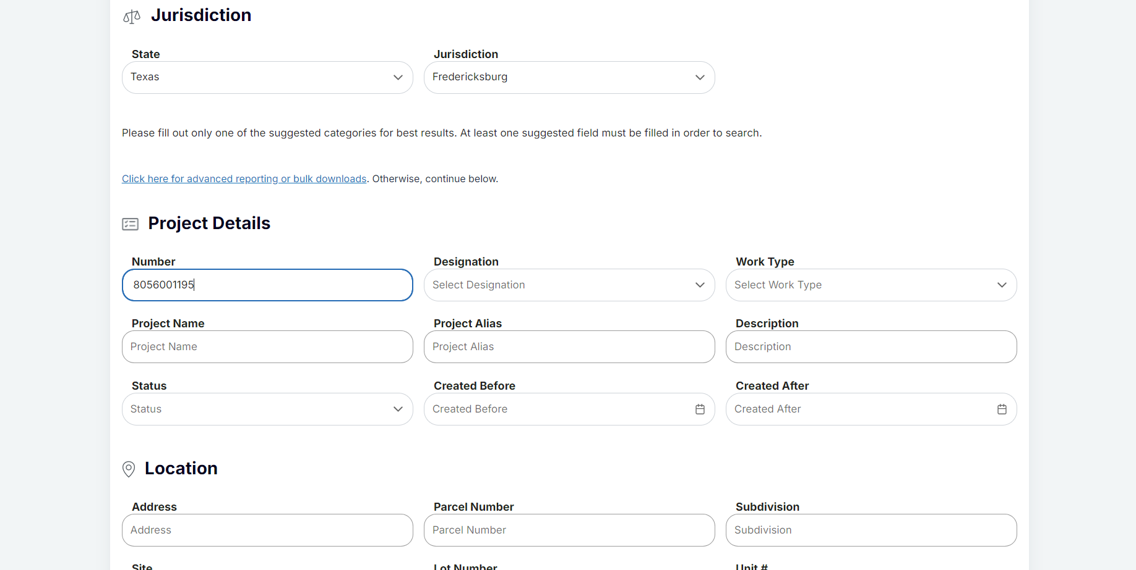

HOW TO LINK YOUR ACCOUNT
Project # = Permit #

Slide 8
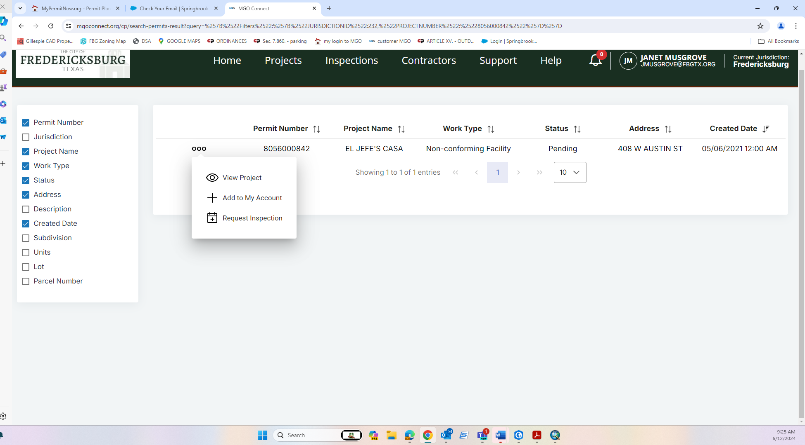

HOW TO LINK YOUR ACCOUNT

Slide 9
MGO STEP-BY-STEP
CREATE AN ACCOUNT
CREATE ACCOUNT AND LINK YOUR PROPERTY/PROPERTIES
GATHER DOCUMENTS:
  COPY OF DRIVERS LICENSE
  PHOTO OF FRONT OF THE HOUSE
  ANSWER 5 SIMPLE QUESTIONS
  UPLOAD DOCUMENTS AND SUBMIT

Slide 10
MGO STEP-BY-STEP
MGO WORKFLOW
  CUSTOMER SUBMITS RENEWAL APPLICATION
  STAFF PROCESSES AND ISSUES INVOICE
  CUSTOMER PAYS INVOICE THROUGH MGO PORTAL
  CUSTOMER SCHEDULES STR INSPECTION THRU MGO
  PASSING INSPECTION, WITHIN MINUTES PERMIT IS AVAILABLE
  PRINT AND POST!

Slide 11
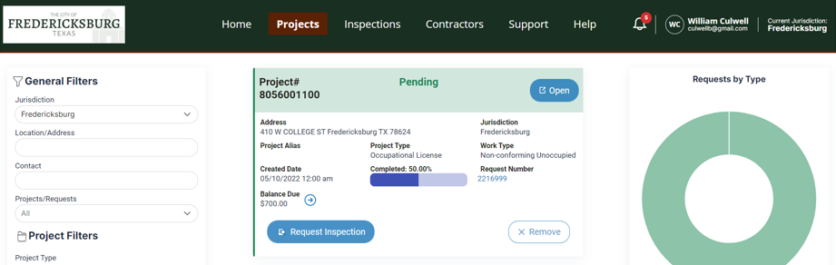

INSPECTION REQUEST

Slide 12
INSPECTION REQUEST
Go to MGO portal
Click on projects
Click request an inspection
Follow prompts
Staff will assign an inspector and time slot
You will receive email conformation of inspection appointment
If inspection fails, Re-inspection is required and a fee of $75 is payable prior to rescheduling

Slide 13
2024 STR ORDINANCE
Effective January 1, 2024
STR permitting software- My Government Online (MGO)
No new STR-Unoccupied in R1, R2 or R3
Eliminated STR-Condominium use
Created Special Exception process- approved through Zoning board of Adjustments

Slide 14
2024 STR ORDINANCE
Annual STR inspection required on EVERY renewal
Transfers allowed
Continuation of Non-Conforming
  Loss of non-conforming status if permit expired longer than 90 days

Slide 15
STR Fees
Based on Bedrooms
  1 bedroom - $300
  2 bedroom- $500
  3 bedroom- $700
  4 bedroom- $900
  5 bedroom- $1,000
Transfer fee -$300

Slide 16
Hotel Occupancy Taxes
City of Fredericskburg

Slide 17
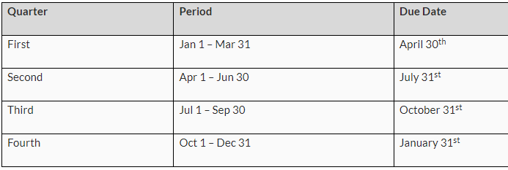
H.O.T. Remittances are due:

Slide 18
Online Form thru Xpress Bill Pay
New starting in 1Q24
Can fill out form and pay online through credit card or ACH
Also remit $0.00
Credit card fee is 4%, ACH bank draft no fee
Notes:
Note that there are still some bugs being worked out. Can contact me (Darren) or Xpress Bill Pay customer service at 385-218-0343 if experiencing technical difficulties.

Slide 19
What is Taxable Revenue?
Taxable revenue includes
gross taxable receipts,
cleaning fees
pet fees.

Slide 20
What is Taxable Revenue?
When calculating the Hotel Occupancy Tax due, seven percent (7%) is multiplied by the gross taxable receipts amount, cleaning fees and pet fees.
Example: If the nightly rate is $300 per night, a cleaning fee of $100 is charged, a pet fee of $50 is charged and the guest stays two nights, the total taxable receipts amount is $750.
$300 X 2 nights = $600 plus $100 cleaning fee + $50 pet fee = $750 total taxable receipts
$750 X 0.07 (7%) = $52.50 hotel tax due

Slide 21
$0.00 Receipts
If you do not have any receipts during a quarter, you will file a zero-dollar receipts remittance.
This will prevent the City from sending a delinquent notice to you for the quarter you did not have any receipts.

Slide 22
Reservation Services
Reservation services like AirBnB or VRBO do NOT remit HOT to the City of Fredericksburg on behalf of their customers. It is your responsibility to make sure you charge and collect the appropriate amount of hotel tax and remit it to the City of Fredericksburg.
If you use or plan to use a reservation service, they usually remit State HOT under their taxpayer number on your behalf. However, you should always verify what services your reservation service is performing for you. This is especially important as it relates to remitting HOT.

Slide 23
Exemptions
Customers who stay in a hotel, motel, bed and breakfast or short-term rental for longer than 30 consecutive days.
Common Exemptions from Hotel Occupancy Tax:
Guest stays over 30 consecutive days,
State & Federal Officials or Employees,
Charitable Entities – 501 (c)(3) or nonprofit organizations,
Educational Entities (exempt from State hotel tax, but NOT local hotel tax), and
Religious organizations

Slide 24
H.O.T. Contact information
Darren Eckhardt – Hotel Occupancy Tax Collections Specialist
City of Fredericksburg Finance Department
deckhardt@fbgtx.org
(830) 990-2069

Slide 25
STR Contact information
Tyler Baethge –STR Specialist
City of Fredericksburg Development Services
tbaethge@fbgtx.org
(830) 990-2028

