Slide 1

Short-Term Rental Inspections

Slide 2
Resources and Tips
Tips
Conduct your own inspection prior to scheduling your inspection with the City
Ask Questions in advance of your inspection
Have a representative present during the inspection to answer questions and address corrections
Check the City and Code Enforcement website for latest information on STRs
Resources
Municode – Code of Ordinances https://library.municode.com/tx
City Ordinance Short Term Rentals 2023-18 Chapter 20 (City website)

Slide 3
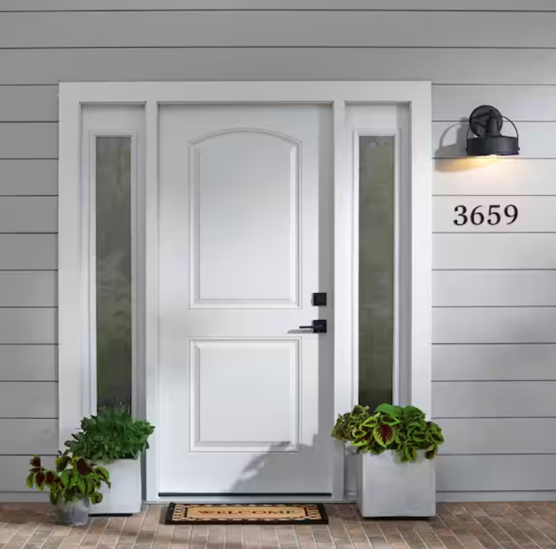
Address Numbers
4-inch Address Numbers
On Front of Unit facing the Street

Slide 4

Swimming Pools and Hot Tubs
2015 International Property Maintenance Code (IPMC)
Section 303 Swimming Pools, Spas and Hot Tubs
303.2 Enclosures.
Private swimming pools, hot tubs and spas, containing water more than 24 inches (610 mm) in depth shall be completely surrounded by a fence or barrier not less than 48 inches (1219 mm) in height above the finished ground level measured on the side of the barrier away from the pool. Gates and doors in such barriers shall be self-closing and self-latching. Where the self-latching device is not less than 54 inches (1372 mm) above the bottom of the gate, the release mechanism shall be located on the pool side of the gate. Self-closing and self-latching gates shall be maintained such that the gate will positively close and latch when released from an open position of 6 inches (152 mm) from the gatepost. No existing pool enclosure shall be removed, replaced or changed in a manner that reduces its effectiveness as a safety barrier.
Exception: Spas or hot tubs with a safety cover that complies with ASTM F1346 shall be exempt from the provisions of this section.
City Code of Ordinances – Sec 7.330 and Sec 7.340
Pools -10 ft setback, Hot tubs - 15 ft setback

Slide 5
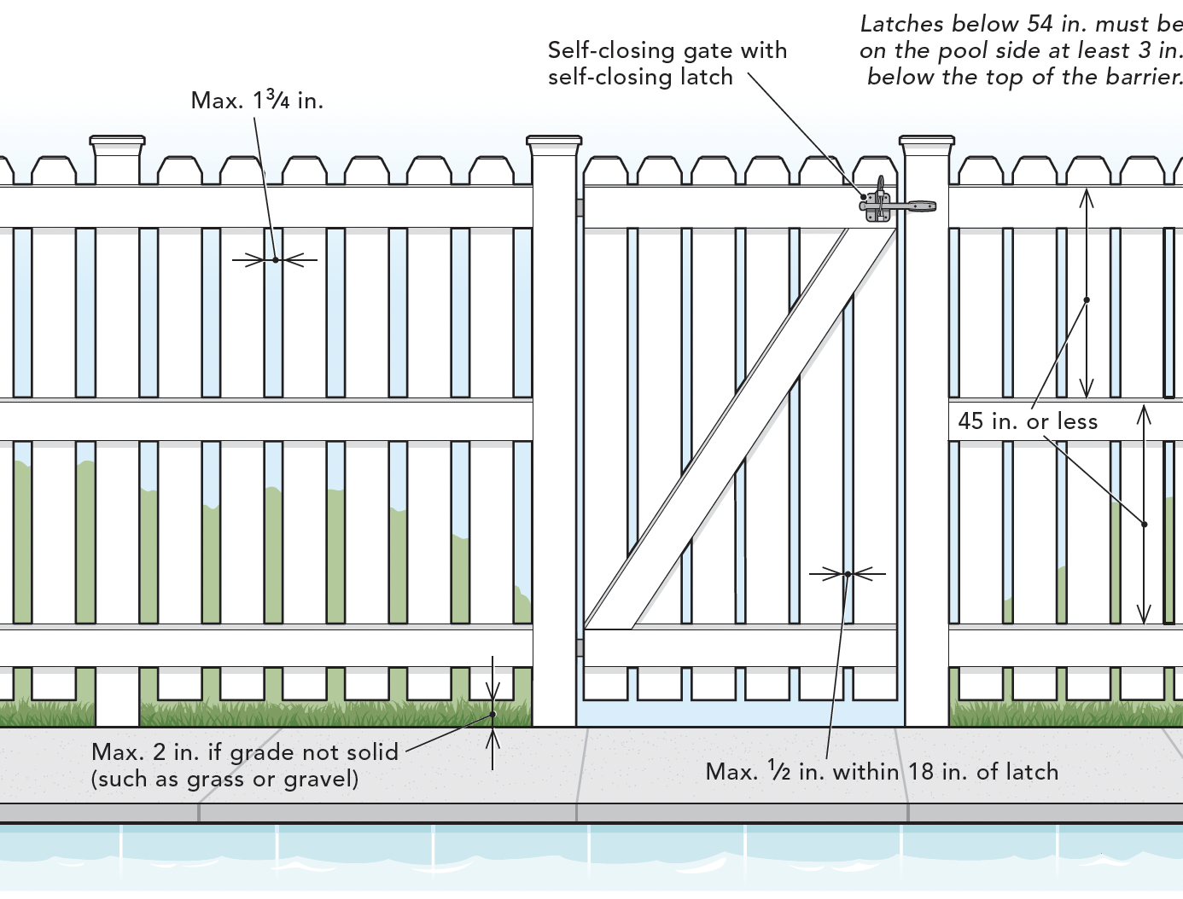
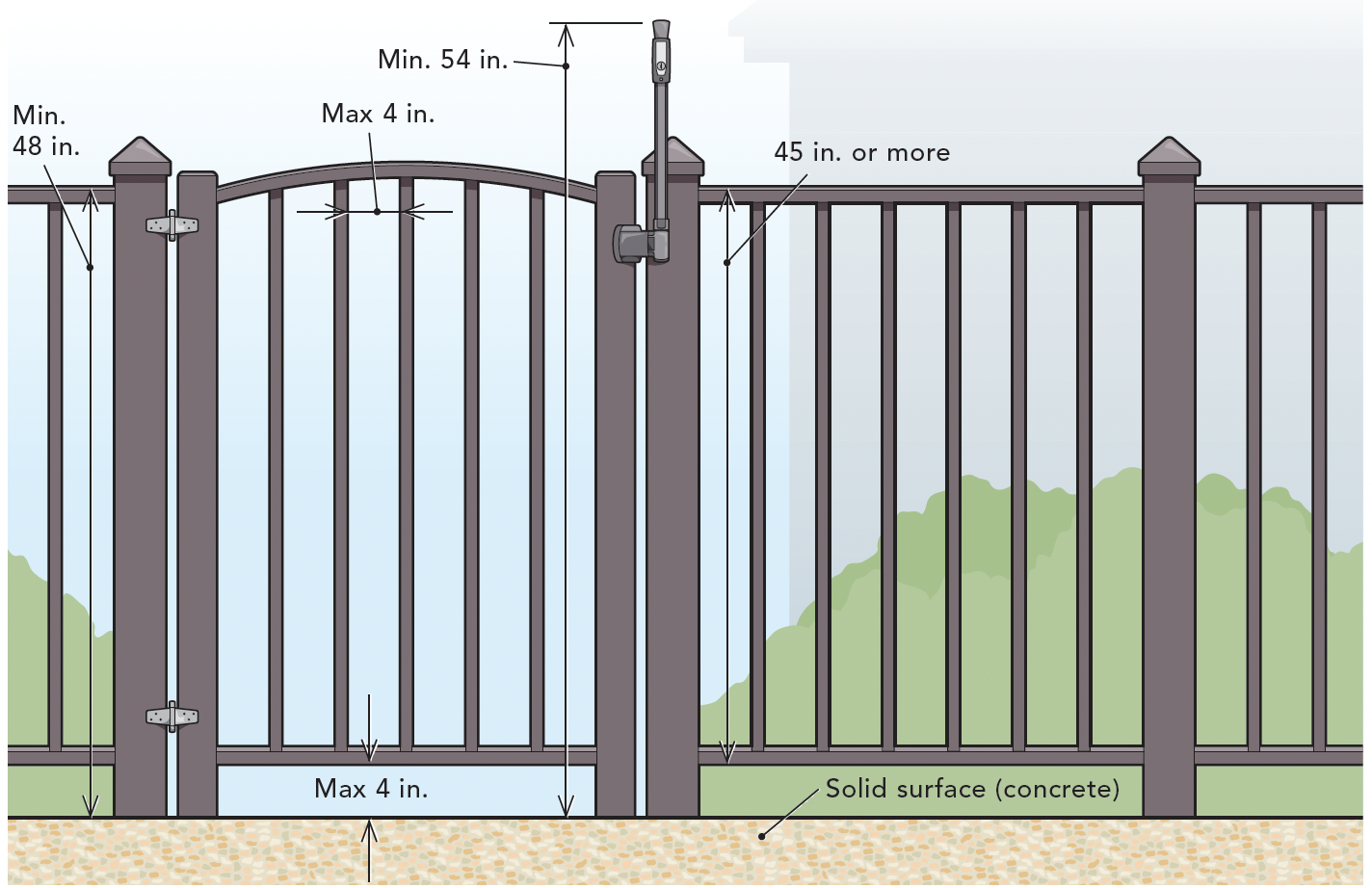
Swimming pools, Hot tubs and Spas
Acceptable Fencing
Metal or wood fence – Min. 48” tall from the ground, 54” minimum to latch if located on the outside of gate or no minimum height if on the pool side of the fence
Gates – must be self latching and self closing when released from 6”

Slide 6
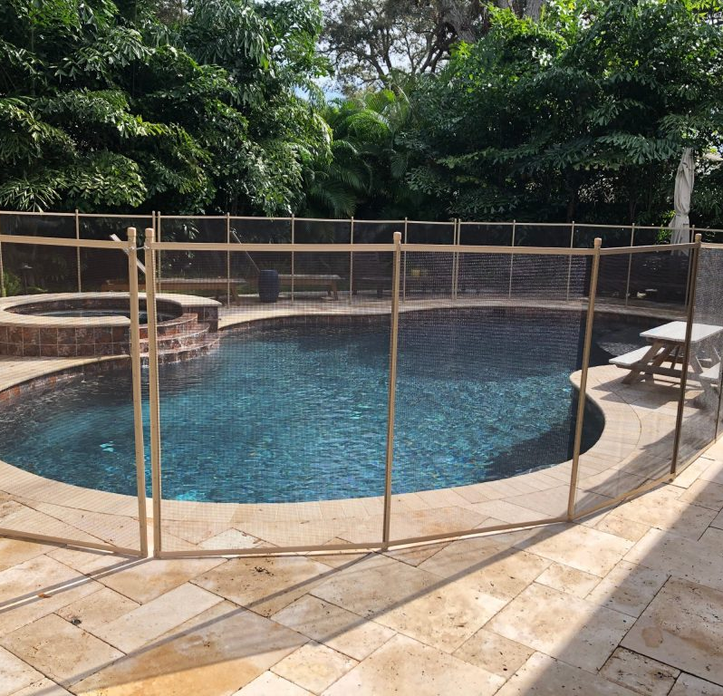
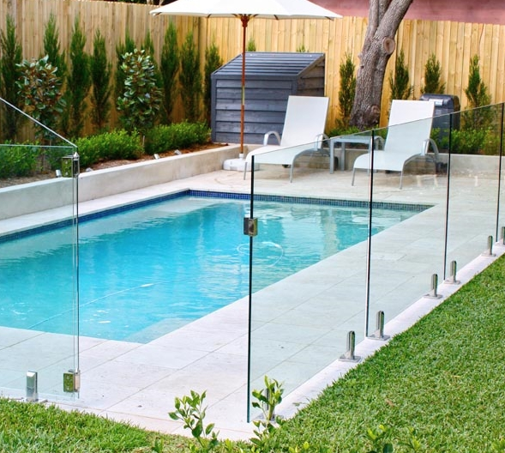
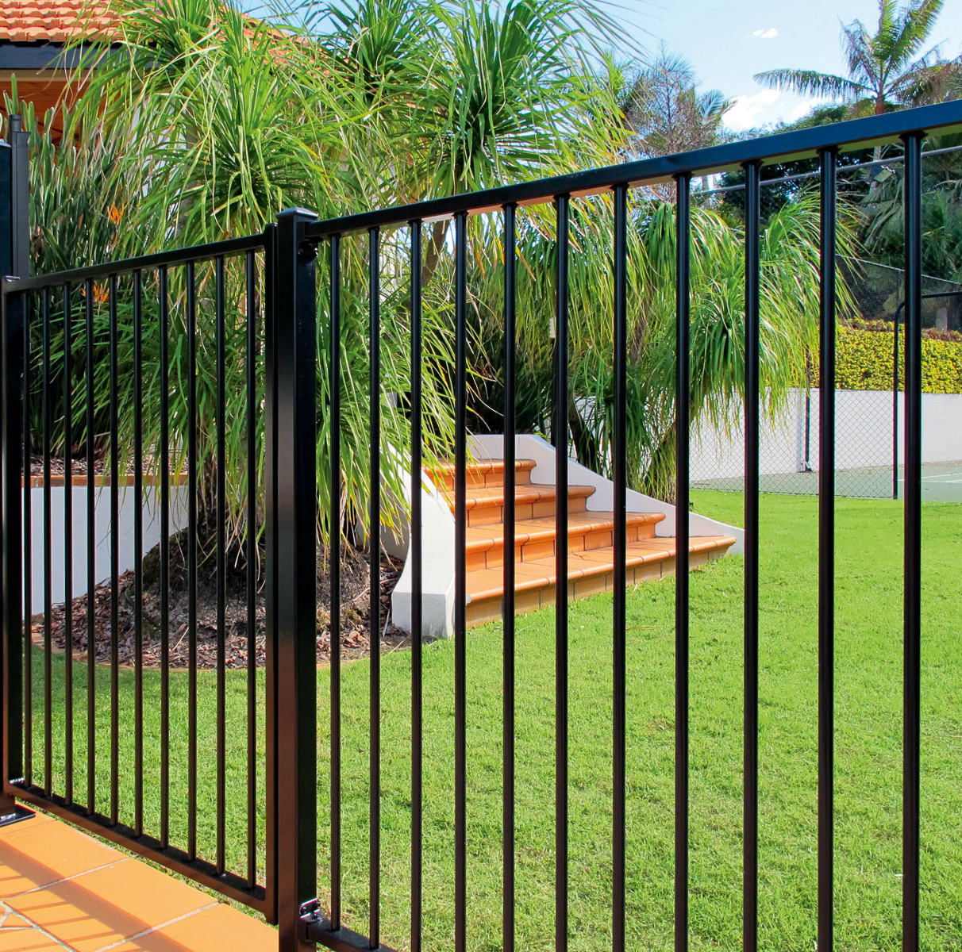
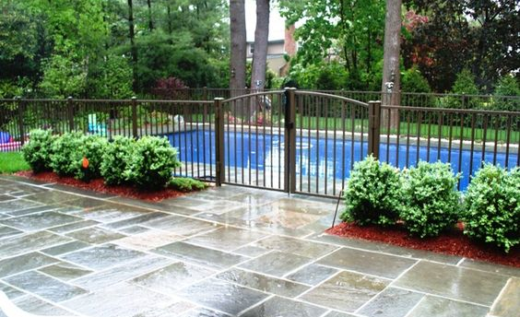
Swimming Pools, Hot Tubs and Spas

Slide 7
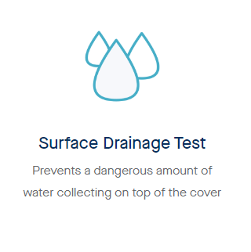
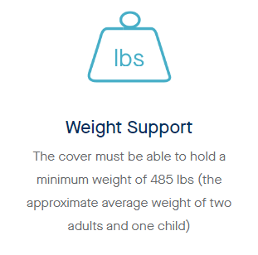
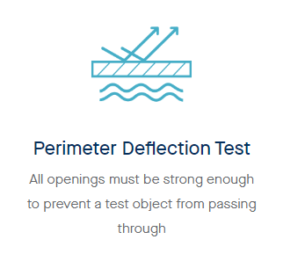
Hot Tubs and Spas
Exception: Spas or hot tubs with a safety cover that complies with ASTM F1346 shall be exempt from the provisions of this section.

Slide 8
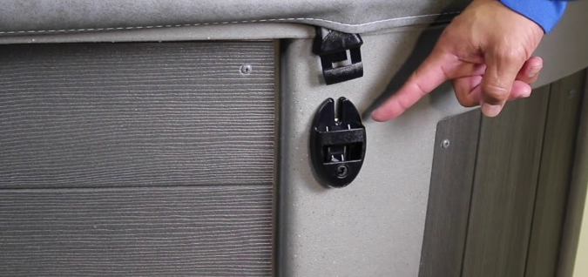
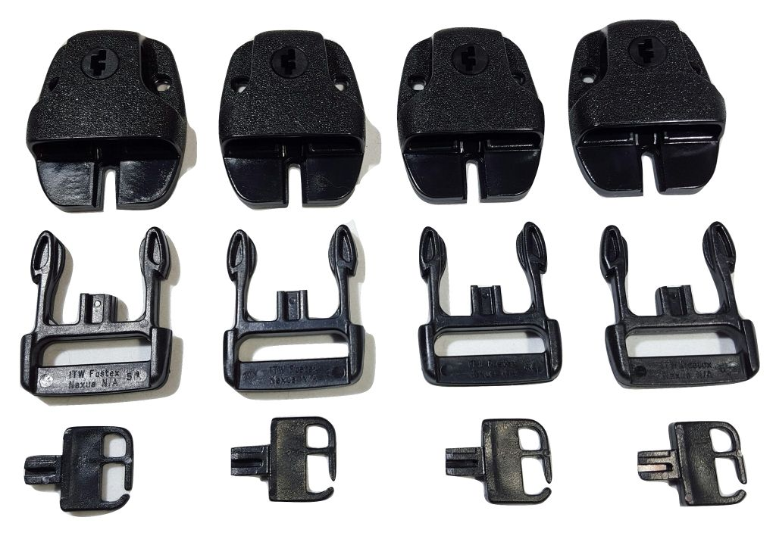
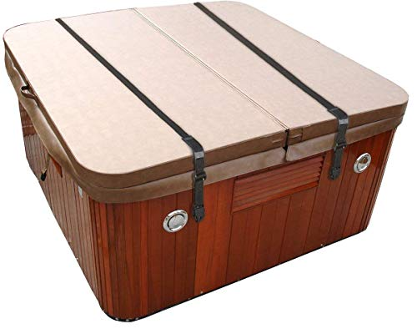
Hot Tubs and Spas
Locking Mechanism:
The cover should have a lockable mechanism to prevent unauthorized access. This is crucial to prevent young children from accidentally gaining access to the hot tub.
The locking mechanism should be designed so that it is not easily operated by children, typically requiring a key, combination, or other secure methods of opening.
Example of Acceptable Latching System:
Locking Straps or Clips:
These should be robust and require a key or combination to unlock. The straps should securely hold the cover in place, preventing it from being easily removed.
Mechanical Locks:
Integrated locks within the cover, which may include combination locks or keyed locks, ensuring the cover cannot be removed without the proper unlocking method.

Slide 9
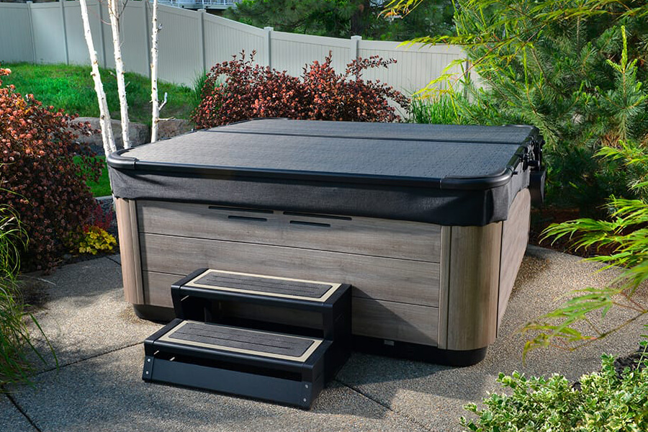
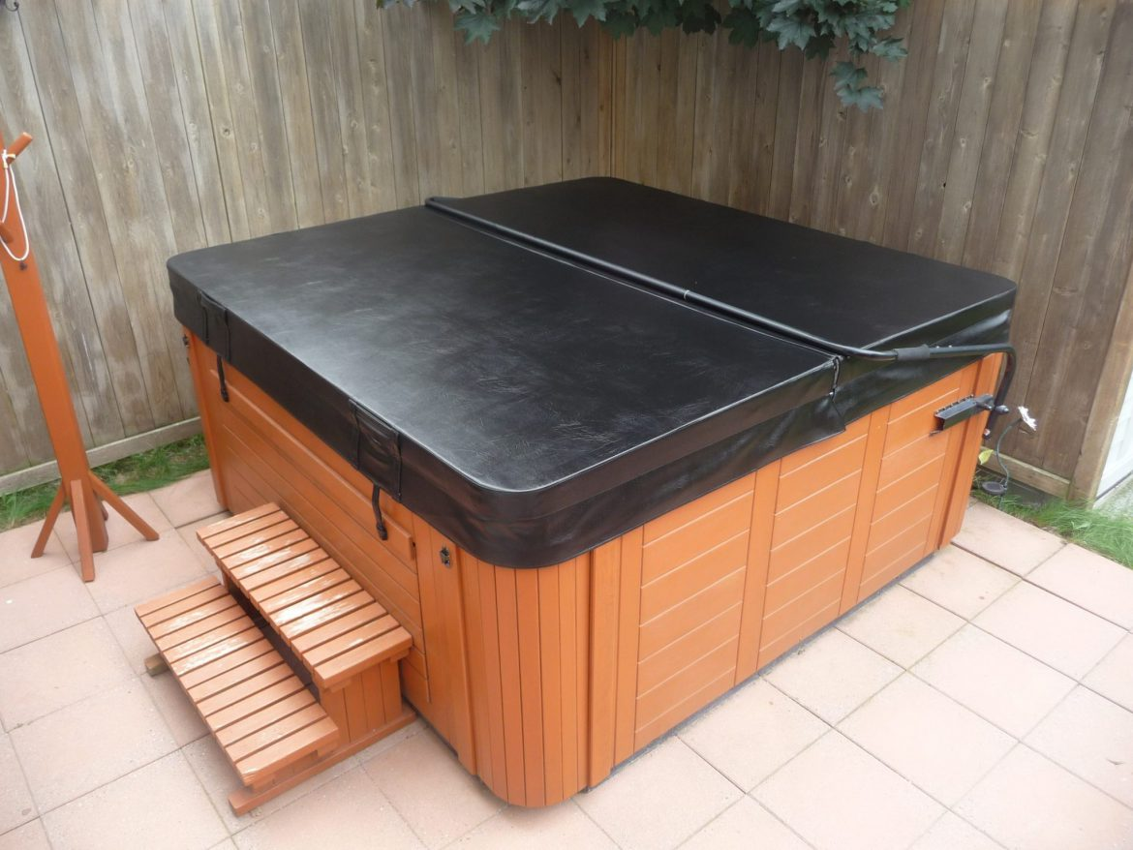
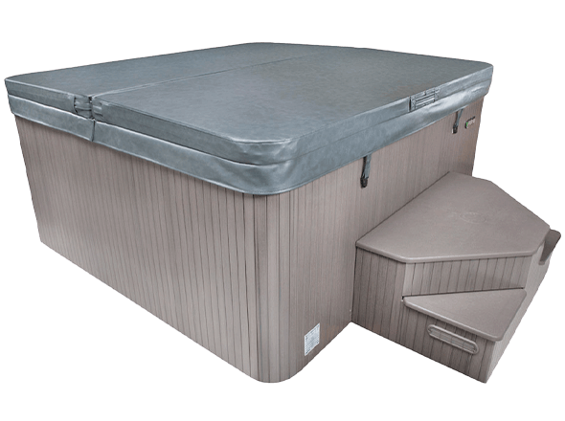
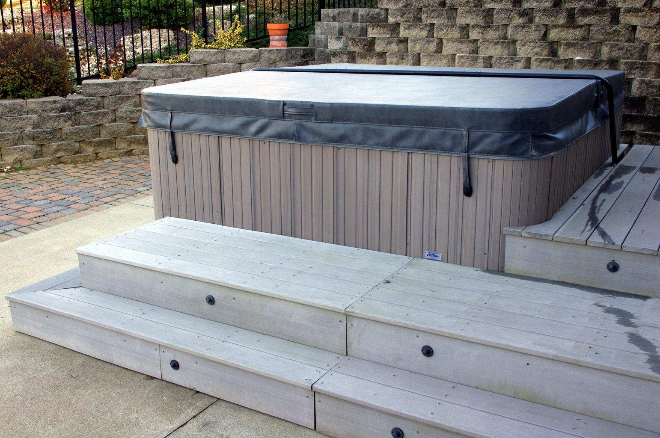
Hot Tubs and Spas
Acceptable
Maintenance and Inspection:
- Regularly inspect the cover and locking mechanism to ensure they are in good working order.
- Replace any damaged or worn parts immediately to maintain safety.

Slide 10
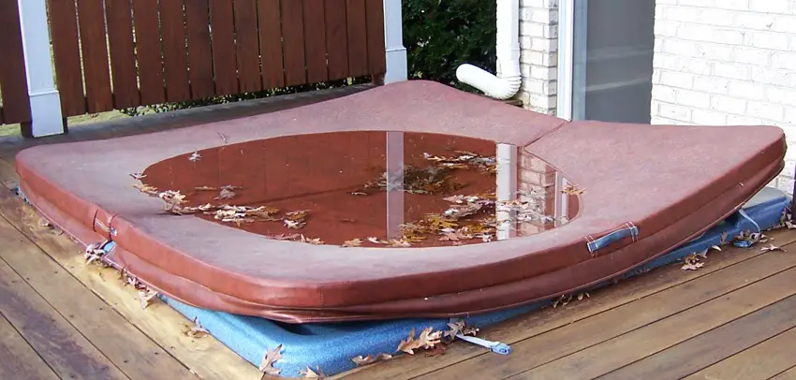
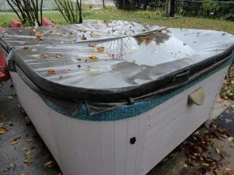
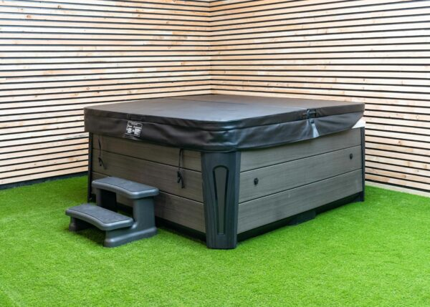
Hot Tubs and Spas
Unacceptable

Slide 11
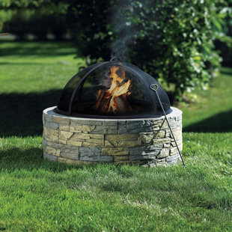
Outdoor Fire Regulations
Wood Burning Units means:
  Portable Fire Pits
  Portable Outdoor Fireplace
  Chiminea,
  Any other Portable Wood Burning Device
Construction material must be:
  Steel, concrete, clay or other non-combustible material with a fuel area of no more than 3 feet in diameter and 2 feet in height
Setback must be 15 Feet from rear and side of yard
Firepits shall be completely covered by a fine metal grate to prevent embers from escaping

Slide 12
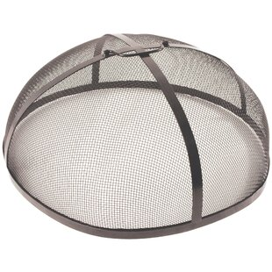
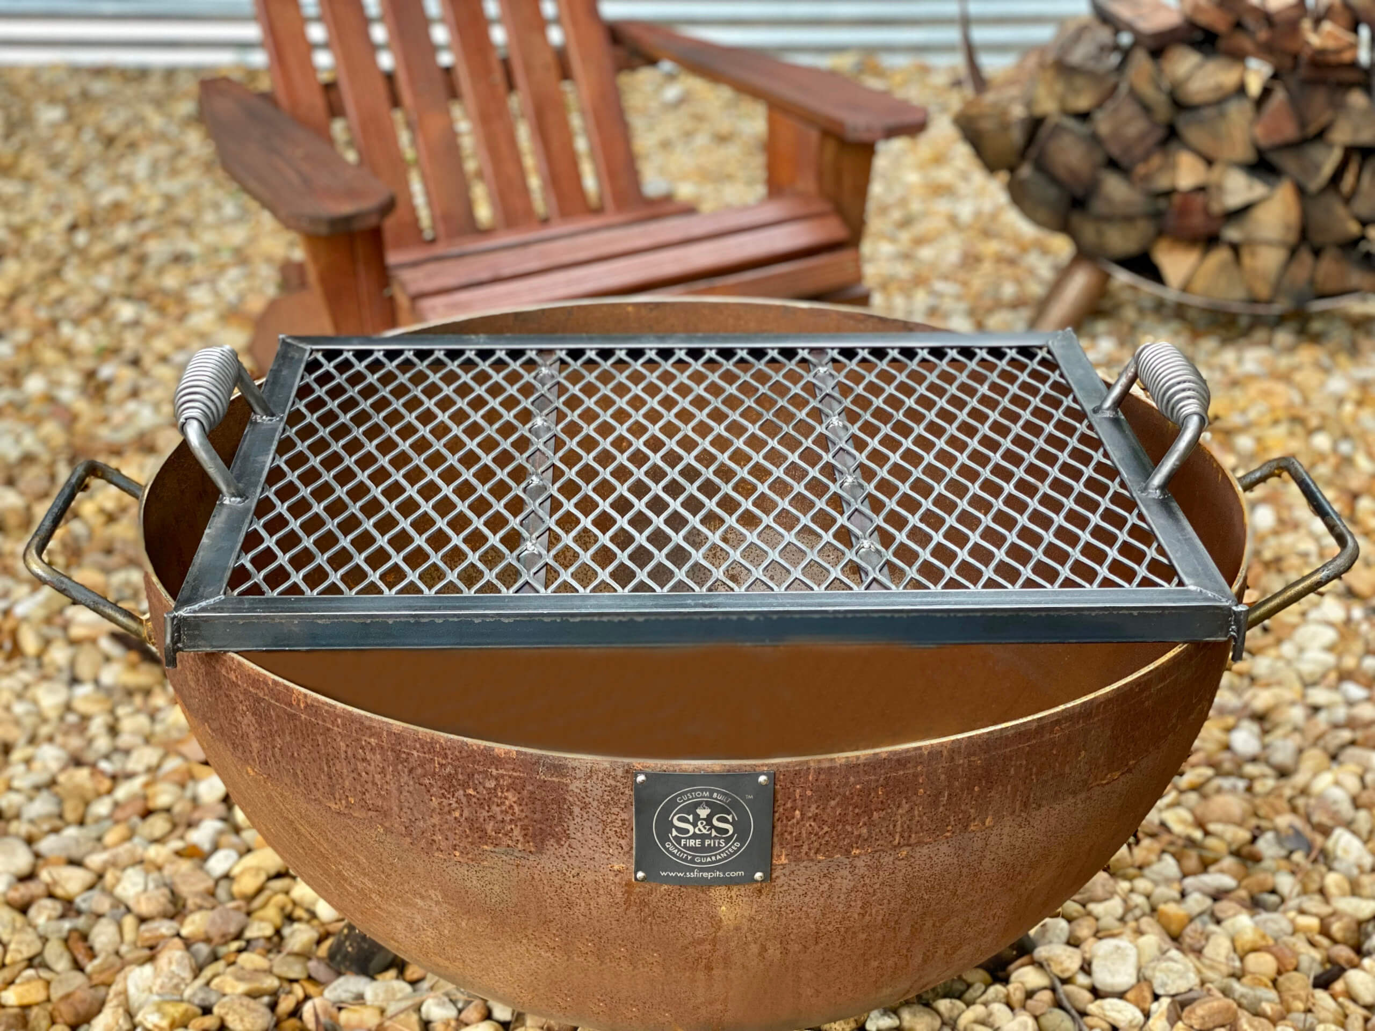
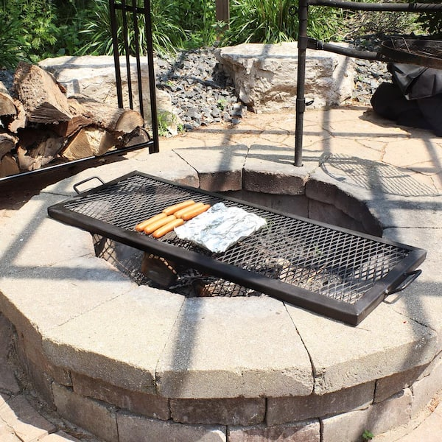
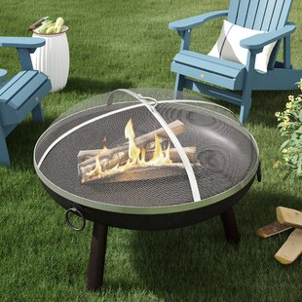
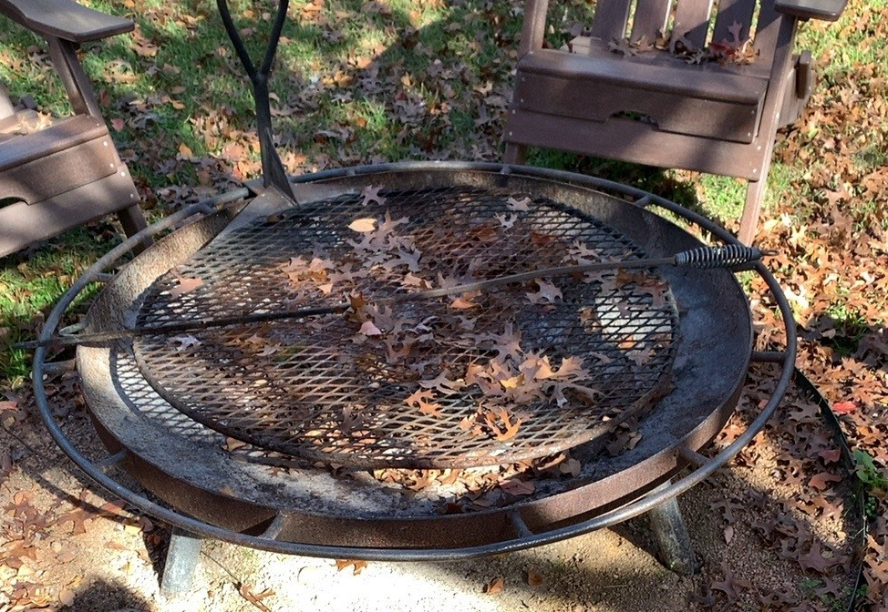
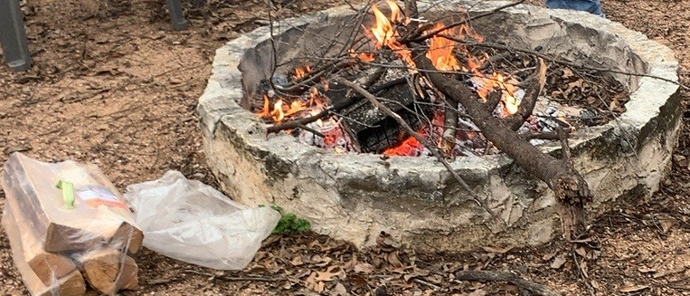
Outdoor Fire Regulations
Compliant Fire Covers
Non-Compliant Fire Covers

Slide 13
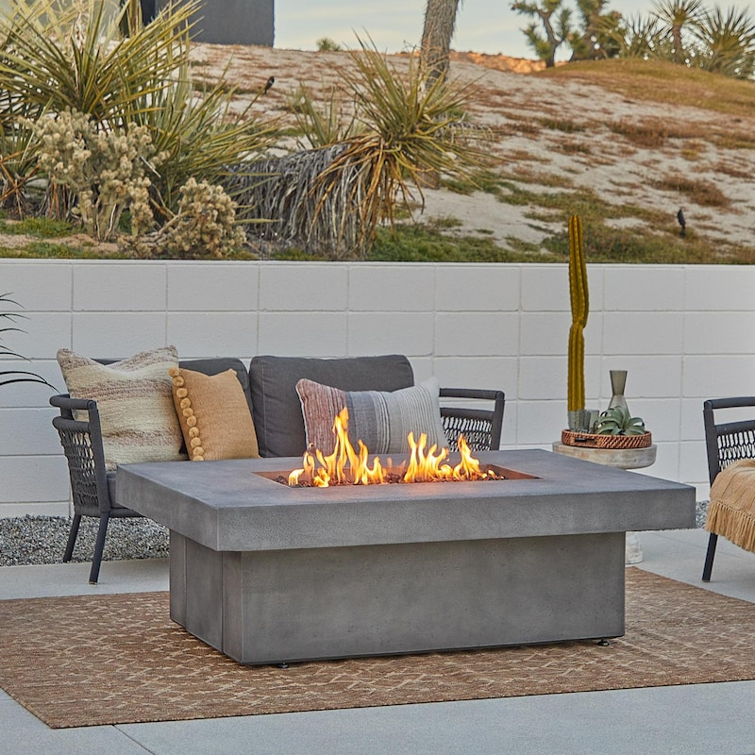
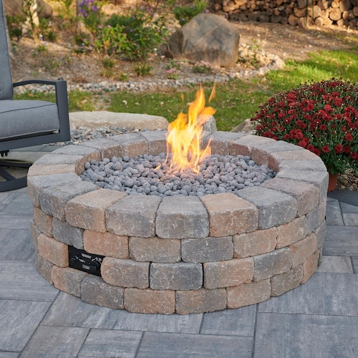
Outdoor Fire Regulations
Exception – Propane Units
  No Cover is Needed
  No Setback Requirements

Slide 14
External Lighting – Relevant Definitions
Fully shielded fixtures means fixtures, as installed, that are designed or shielded in such a manner that all light rays emitted by the fixture, either directly from the luminaires or indirectly from the fixture, are not permitted to project above a horizontal plane running through the lowest point on the fixture where light is emitted.
Outdoor lighting means lighting that is installed or located outside or on the exterior of any building or part thereof, structure, sign or other improvement or stand or lighting which is installed to project outdoors for the purpose of lighting outdoors. Lighting located under canopies, under building overhangs or under roof eaves are included in the definition of Outdoor lighting.
Up lighting means lighting that causes light rays to project above a horizontal plane running through the lowest point on the fixture where light is emitted.

Slide 15
External Lighting
City Ordinance Sec. 5-505 General Outdoor Lighting Standards
All Outdoor Lighting shall be:
  Fully Shielded Fixtures
  The luminous elements of the fixture shall not be visible from any other property and have a color temperature of 3000k or less
Outdoor fixtures with a maximum output of 300 lumens may be left unshielded if:
  the fixture has an opaque top to prevent light from shining up
  the source of the light is not visible from any other property
Outdoor fixtures with a maximum output of 600 lumens may be shielded with a colored lens if:
  the colored lens reduces the lumen output in half
  the fixture has an opaque top to prevent the light from shining up
  the source of the light is not visible from any other property

Slide 16
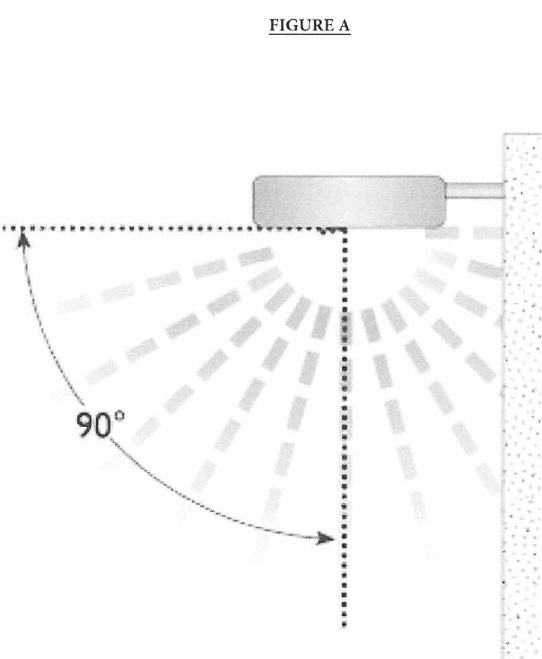
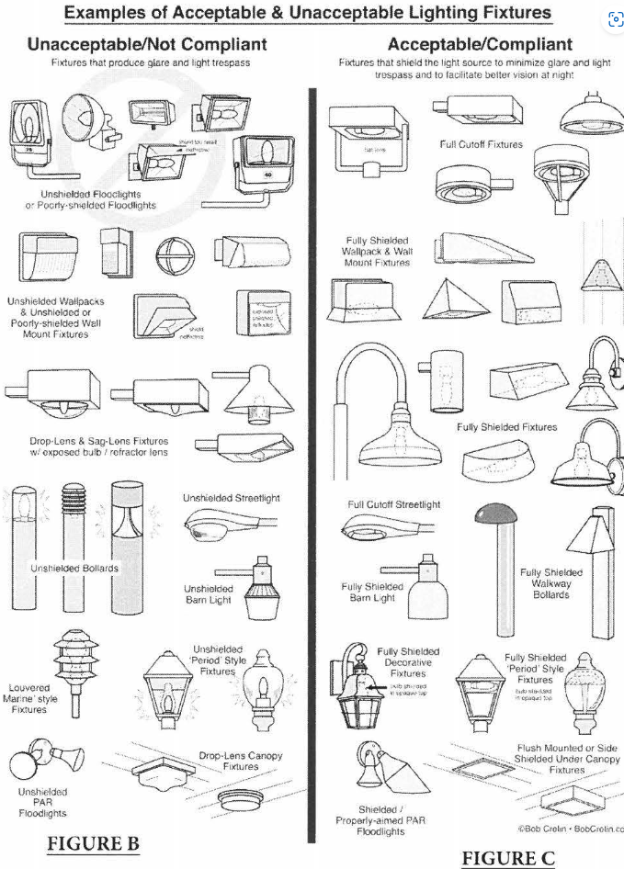
ILLUSTRATIONS FROM THE CODE

Slide 17
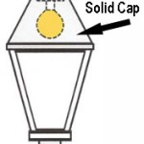
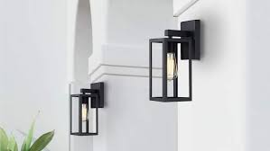
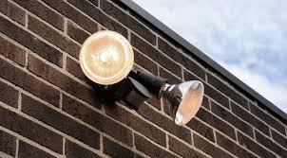
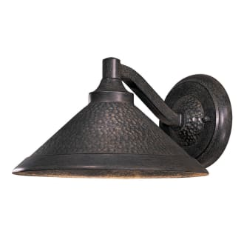
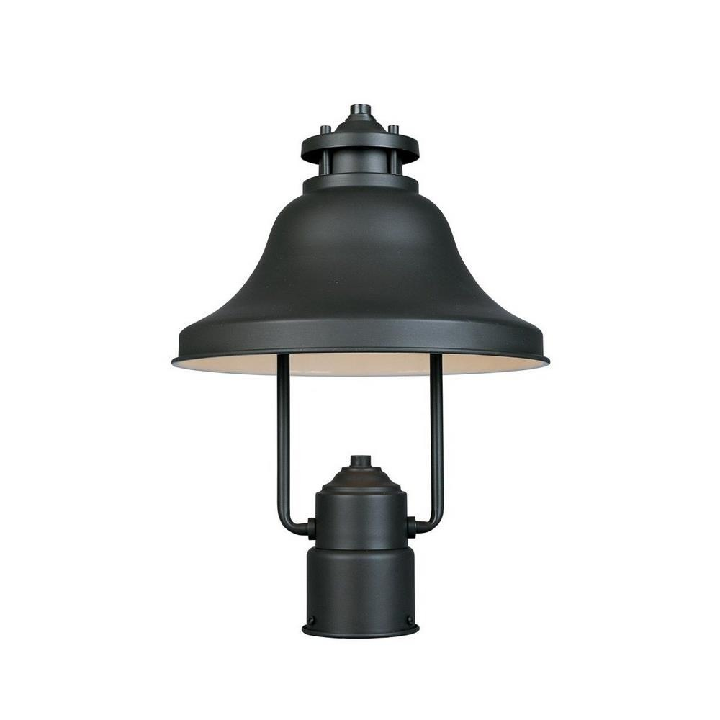
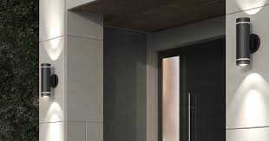
External Lighting
Acceptable
Unacceptable

Slide 18

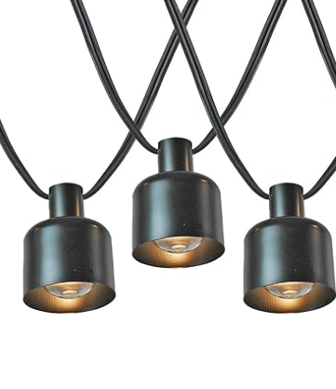
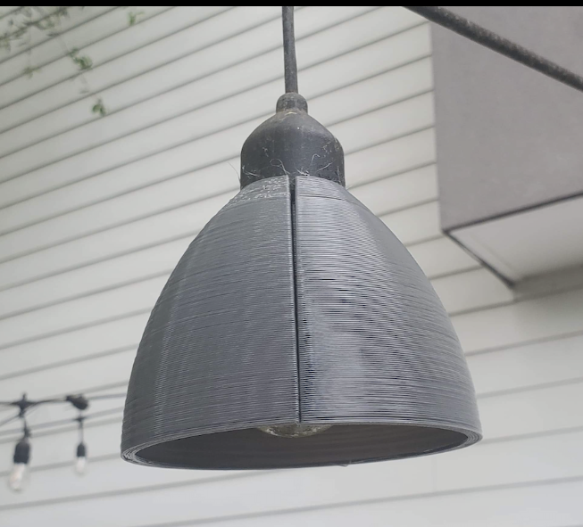
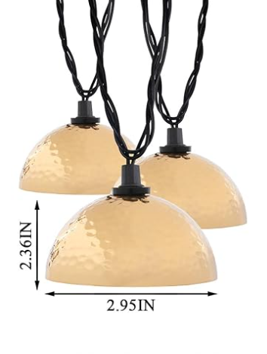


External Lighting
Acceptable String Lights
Unacceptable String Lights

Slide 19
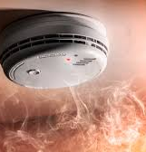
Life Safety
City Ordinance Sec. 20.222
Smoke Alarms
  A minimum of 1 on each floor/level
  1 in each bedroom
  1 in the corridor in the immediate vicinity of the bedrooms if the corridor serves more than 1 bedroom
Carbon Monoxide Detectors
  1 carbon monoxide detector on each floor if:
    Natural gas or propane is present
    There is an attached garage

Slide 20
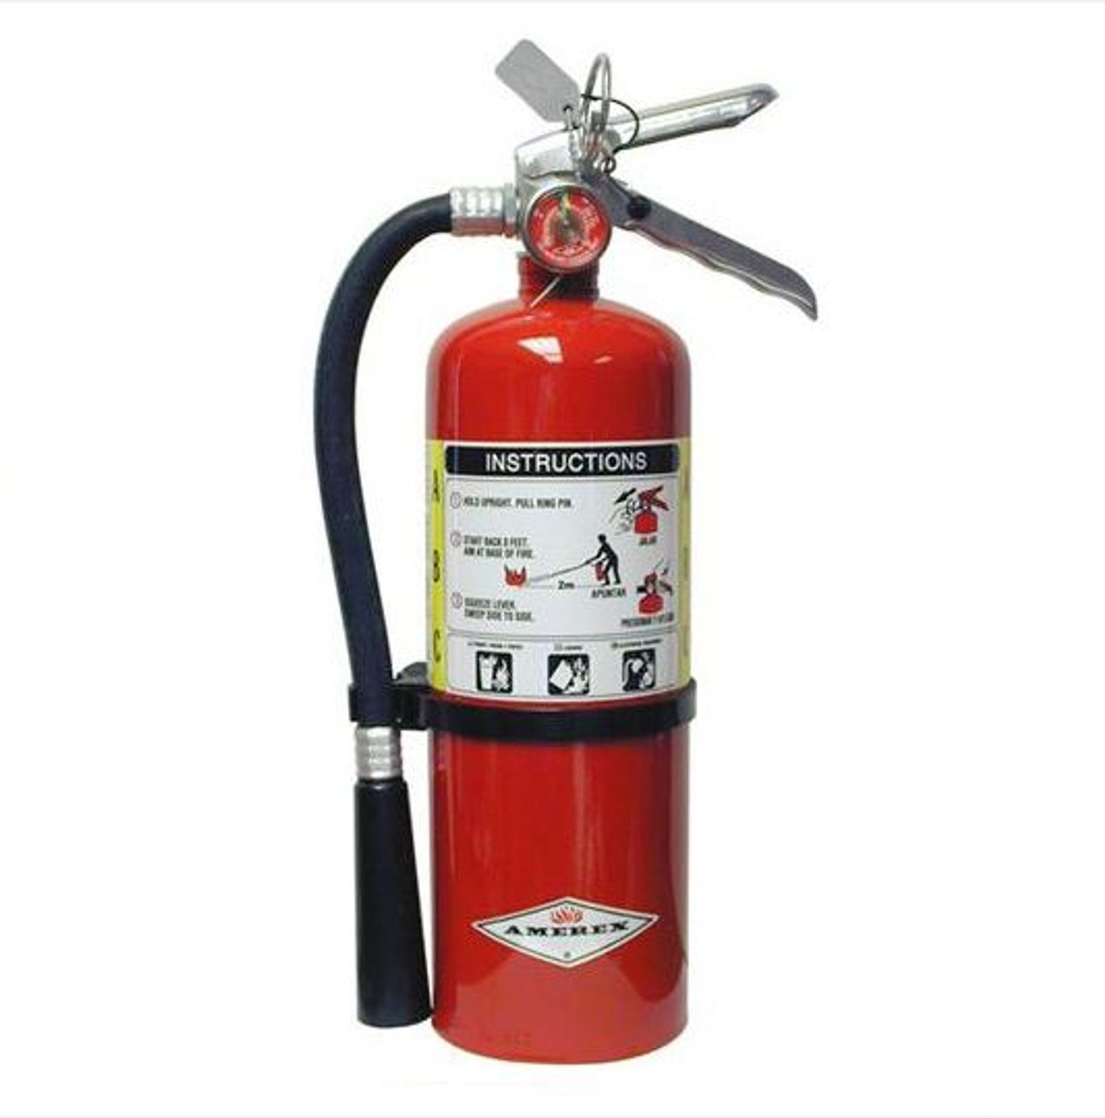
Life Safety
City Ordinance Sec. 20.222
Fire extinguisher
  1 Fire Extinguisher on Each Floor
  Fire Extinguisher at a minimum must be a 5 LB fire extinguisher (2A:10B: C type)
  2 – 3 LBs does not equal 1 – 5 LB
  Fire Extinguishers must be inspected annually by a third-party inspector and tagged

Slide 21
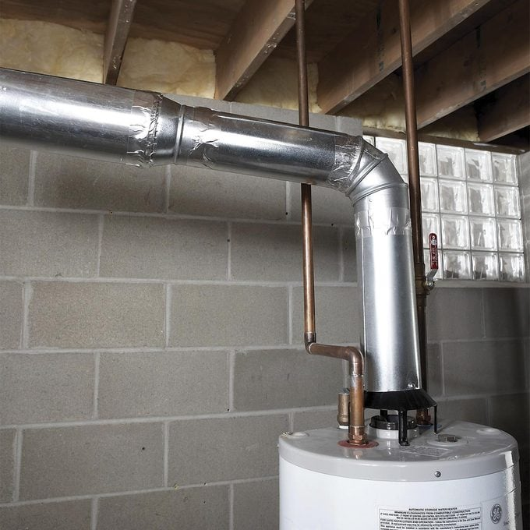
Life Safety
City Ordinance Sec. 20.222
Gas Appliances
  All Gas Appliances shall be properly ventilated to the outside of the home
Exception
  The only exception will be Gas Ranges and no others.

Slide 22
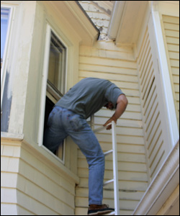
Emergency Egress
Adequate Emergency Egress
  Each Room used as a bedroom must have at least one means of egress opening directly to the outdoors
    Window – width of 36”
    door

Slide 23
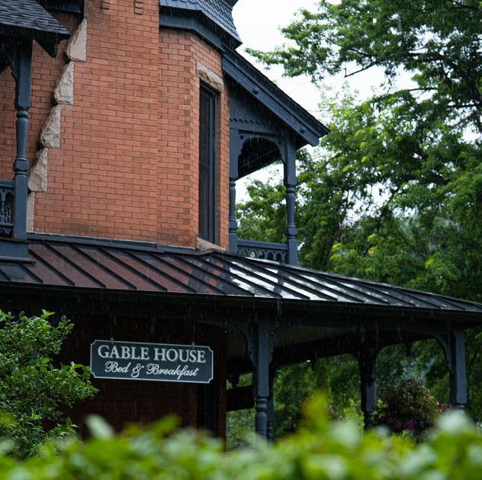
Signs
City Ordinance Sec 29-5(3)
Signs on the Structure
  1 Nameplate Sign is permitted
  No Larger than 2 square feet in size
  Must be attached to the Structure
  No other signs are permitted in Residential Zones – R1, R2, & R3

Slide 24
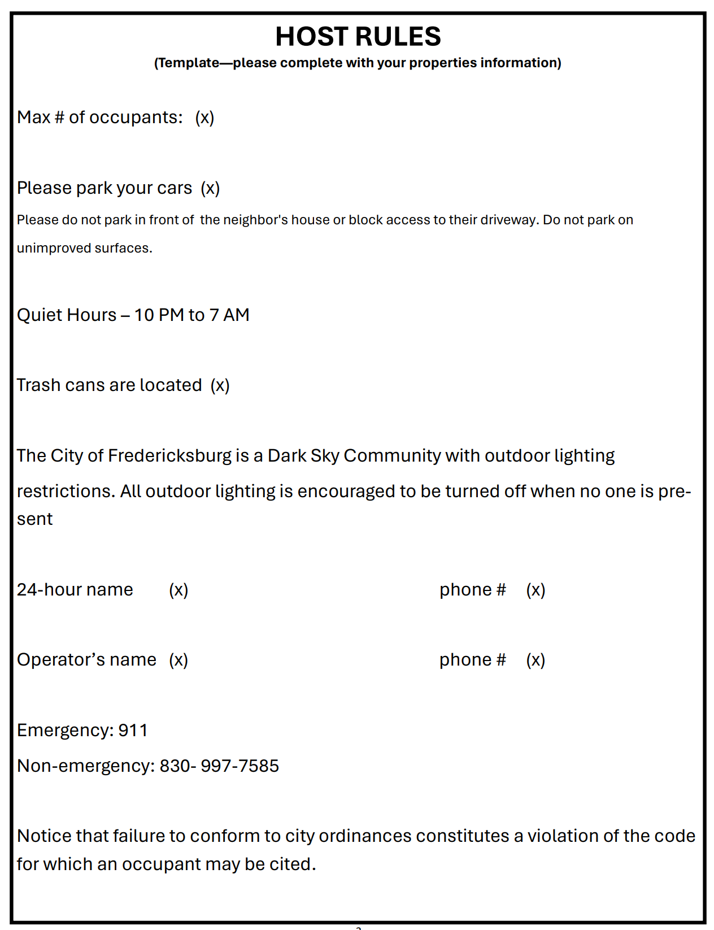
Host Rules
The owner and/or operator shall post in a conspicuous location of the short-term rental premises a packet containing, at a minimum, host rules with the following information.
  Maximum number of occupants
  Location of required off-street parking and prohibition of parking on unimproved areas
  Applicable quiet hours (10:00 pm to 7:00 am in residential zones)

Slide 25
Host Rules
Host Rules Cont’d
  Waste pick-up requirements, including location of waste and recycling receptacles
  Exterior lighting requirements due to dark sky regulations, which encourages lights to be turned off when no one is present
  24-hour contact name and phone number

Slide 26
Host Rules
Host Rules Cont’d
  Operator contact name and phone number
  If relevant, emergency evacuation procedures
  Emergency and Non-Emergency Dispatch numbers
    911
    830-990-8793 - Press 1 for Dispatch
  Notice that failure to conform to City Ordinances constitutes a Violation of the Code for which an occupant may be cited

Slide 27
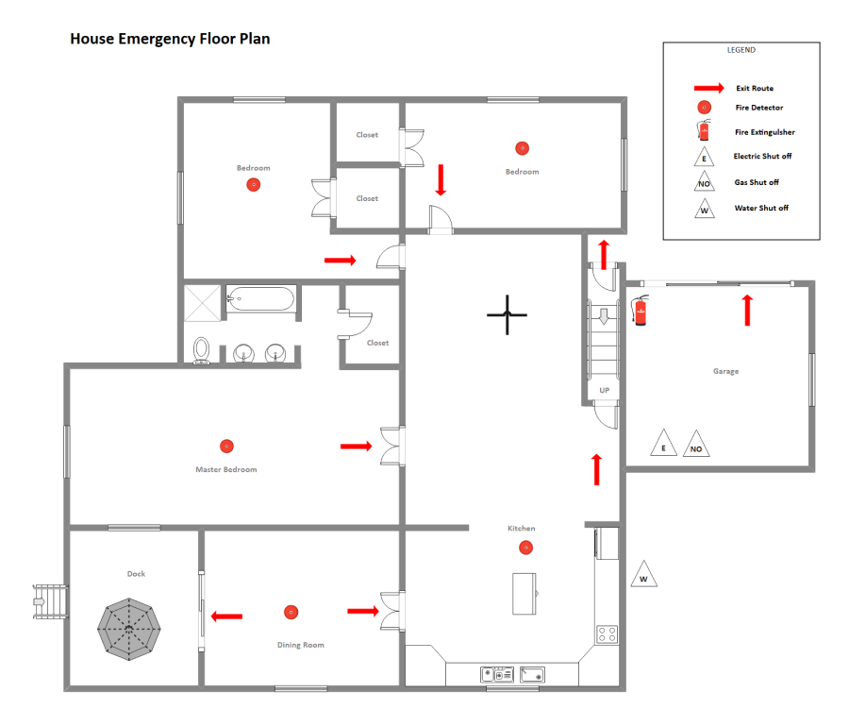
Evacuation Procedures/Plan
Evacuation plans will be relevant for most every residence
At a minimum, one plan needs to be posted in a prominent location near the host rules
It is recommended that one plan be posted in each bedroom

Slide 28

Questions

