Slide 1
Fredericksburg Police Department
2023 Overview

Slide 2



Slide 3
Fredericksburg Police Department
2023 Call Incidents:
18,146 Total
674 Public Relations (Vehicle Unlock)
570 Welfare Concerns
446 Alarms
426 Disturbances
405 Ordinance Violations
359 Illegal Parking
    6,816 Special Assignment
    1,358 Report Follow Up
    1,199 Animal Control Calls
    937 Pedestrian Stop
    892 Traffic Hazards
    833 Suspicious Activity

Slide 4
Fredericksburg Police Department
2023 Arrests:
  460 Arrest Bookings
  570 Arrest Incidents
    147 Driving While Intoxicated
    137 Public Intoxication
    42 Assaults
    42 Possession of Controlled Substance
    13 Theft
    11 Driving While License Invalid

Slide 5
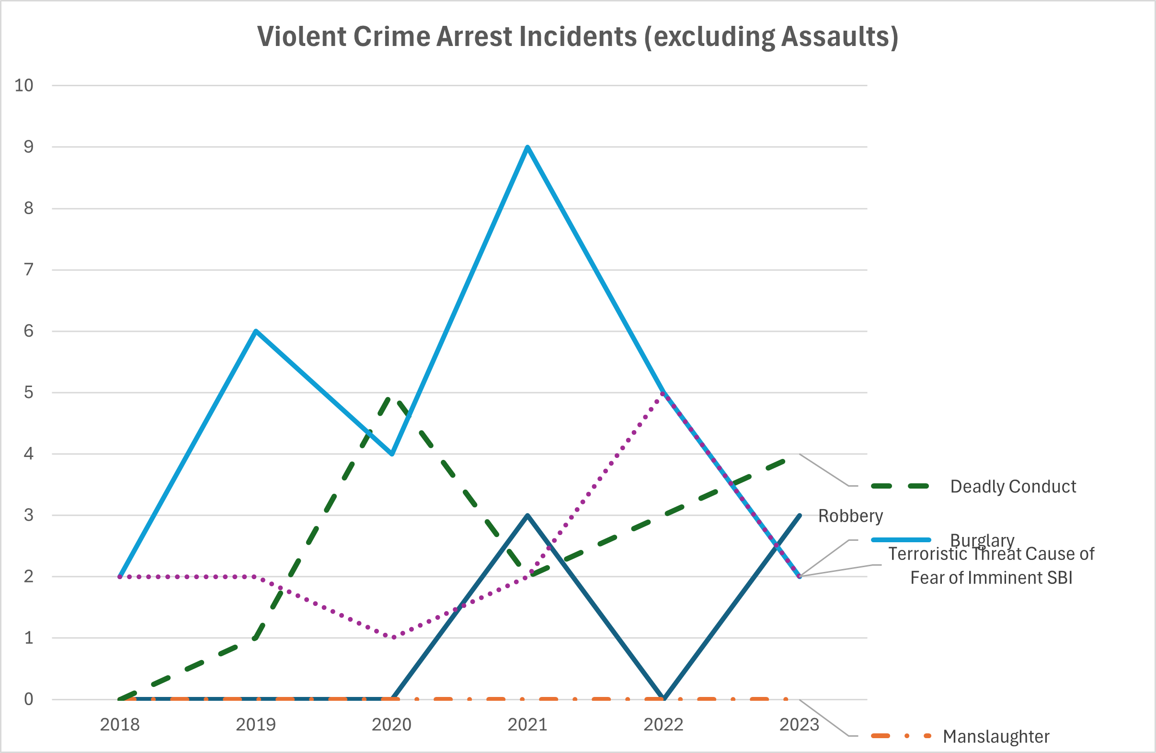
Fredericksburg Police Department
2018-2023 Violent Crime Arrests (excluding assaults):

Slide 6
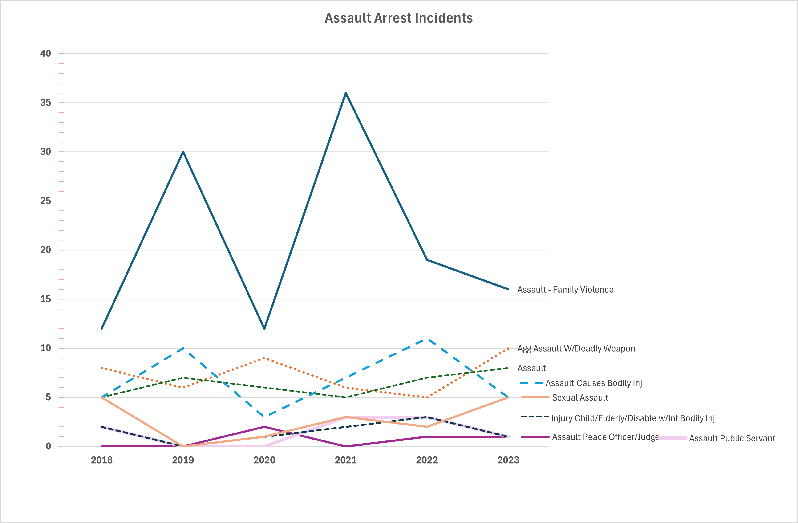
Fredericksburg Police Department
2018-2023 Assault Arrests:

Slide 7
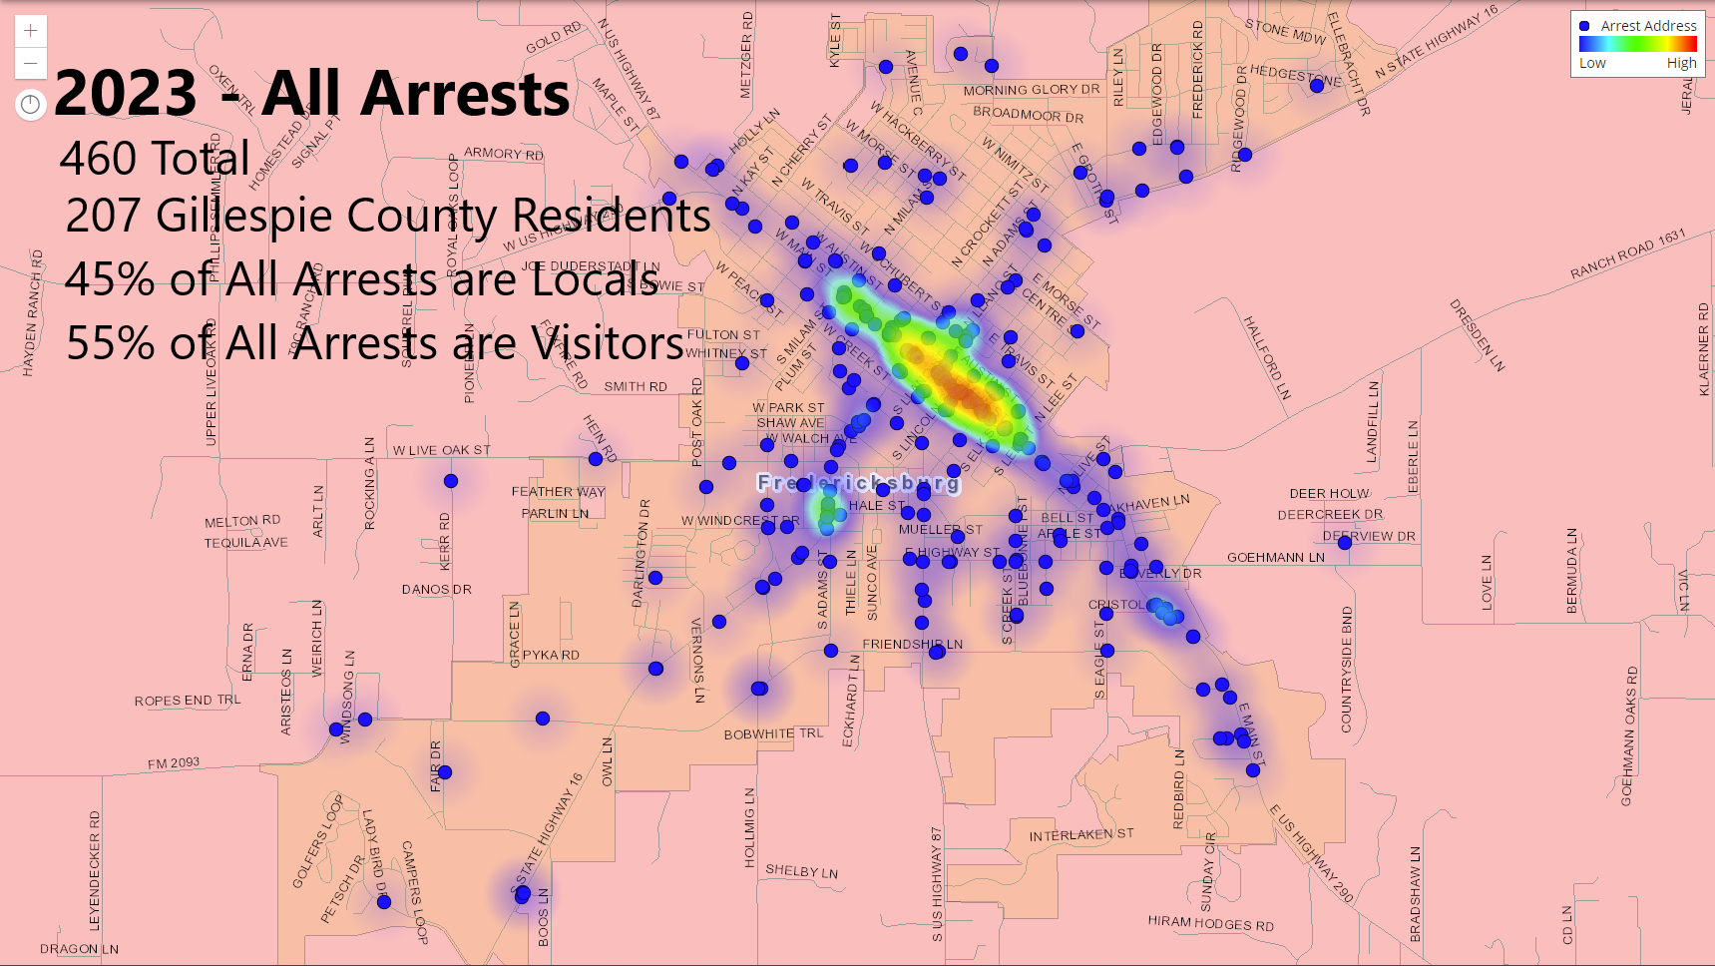
Fredericksburg Police Department
2023 Arrests:

Slide 8
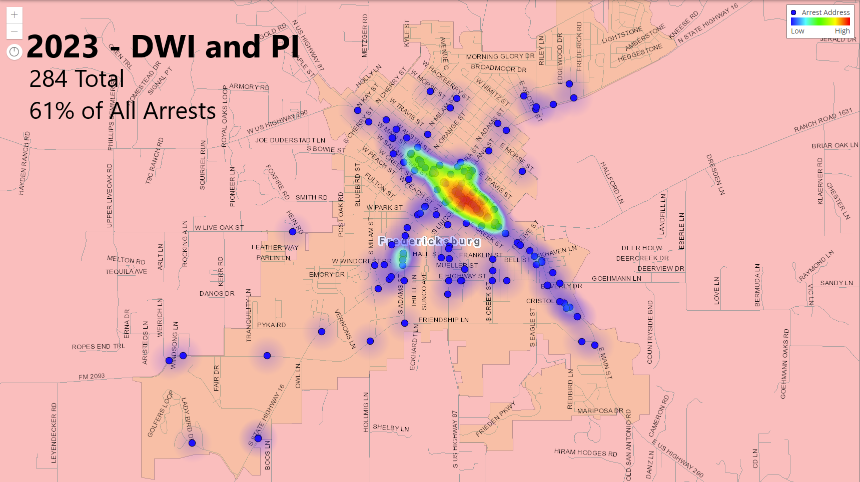
Fredericksburg Police Department
2023 Arrests:

Slide 9
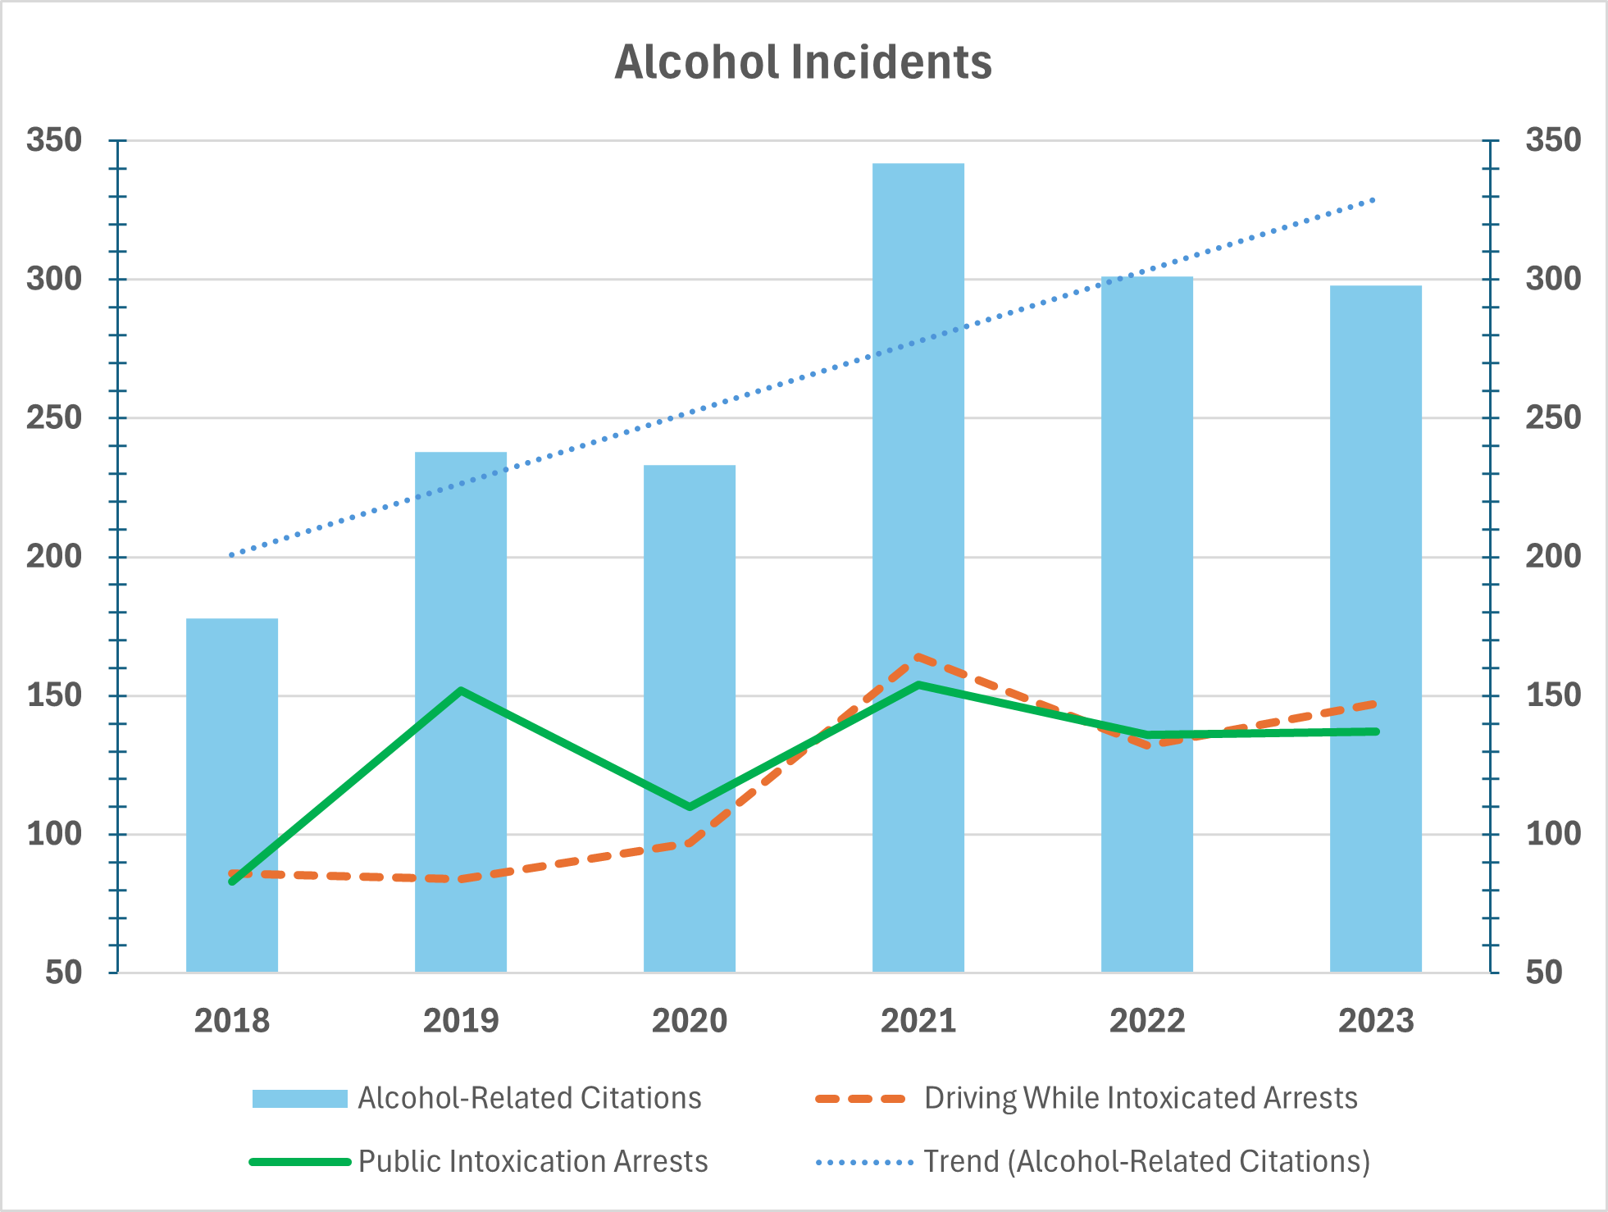
Fredericksburg Police Department
2018-2023 Alcohol Incidents:

Slide 10
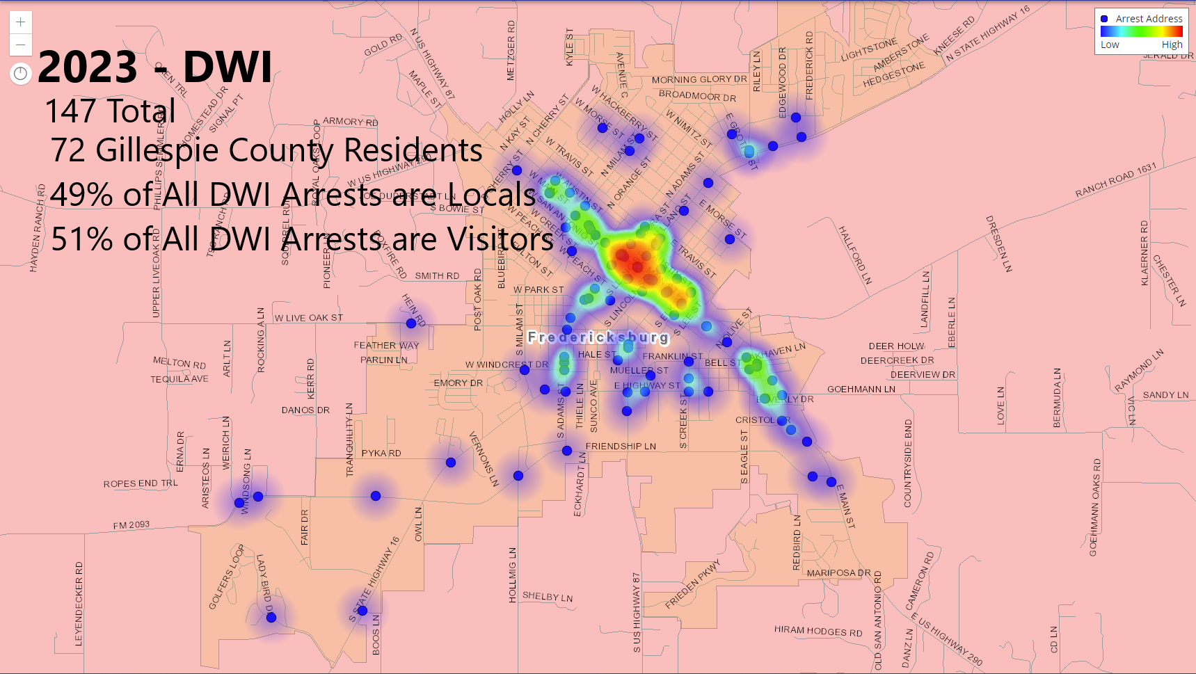
Fredericksburg Police Department
2023 Arrests:

Slide 11
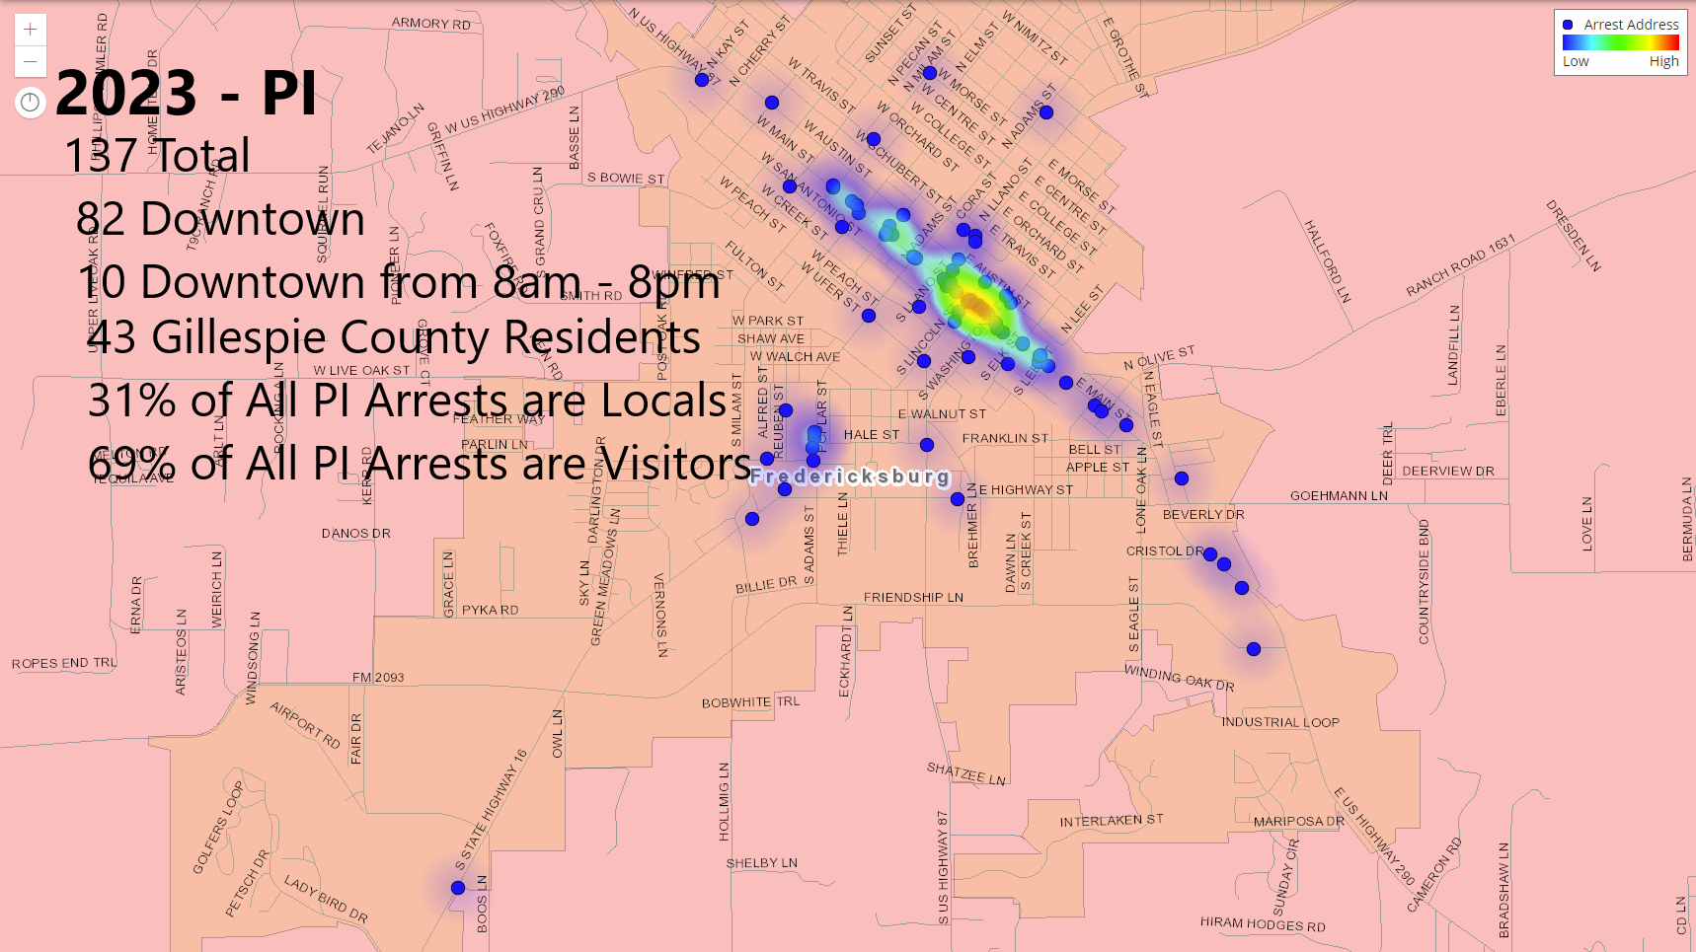
Fredericksburg Police Department
2023 Arrests:

Slide 12
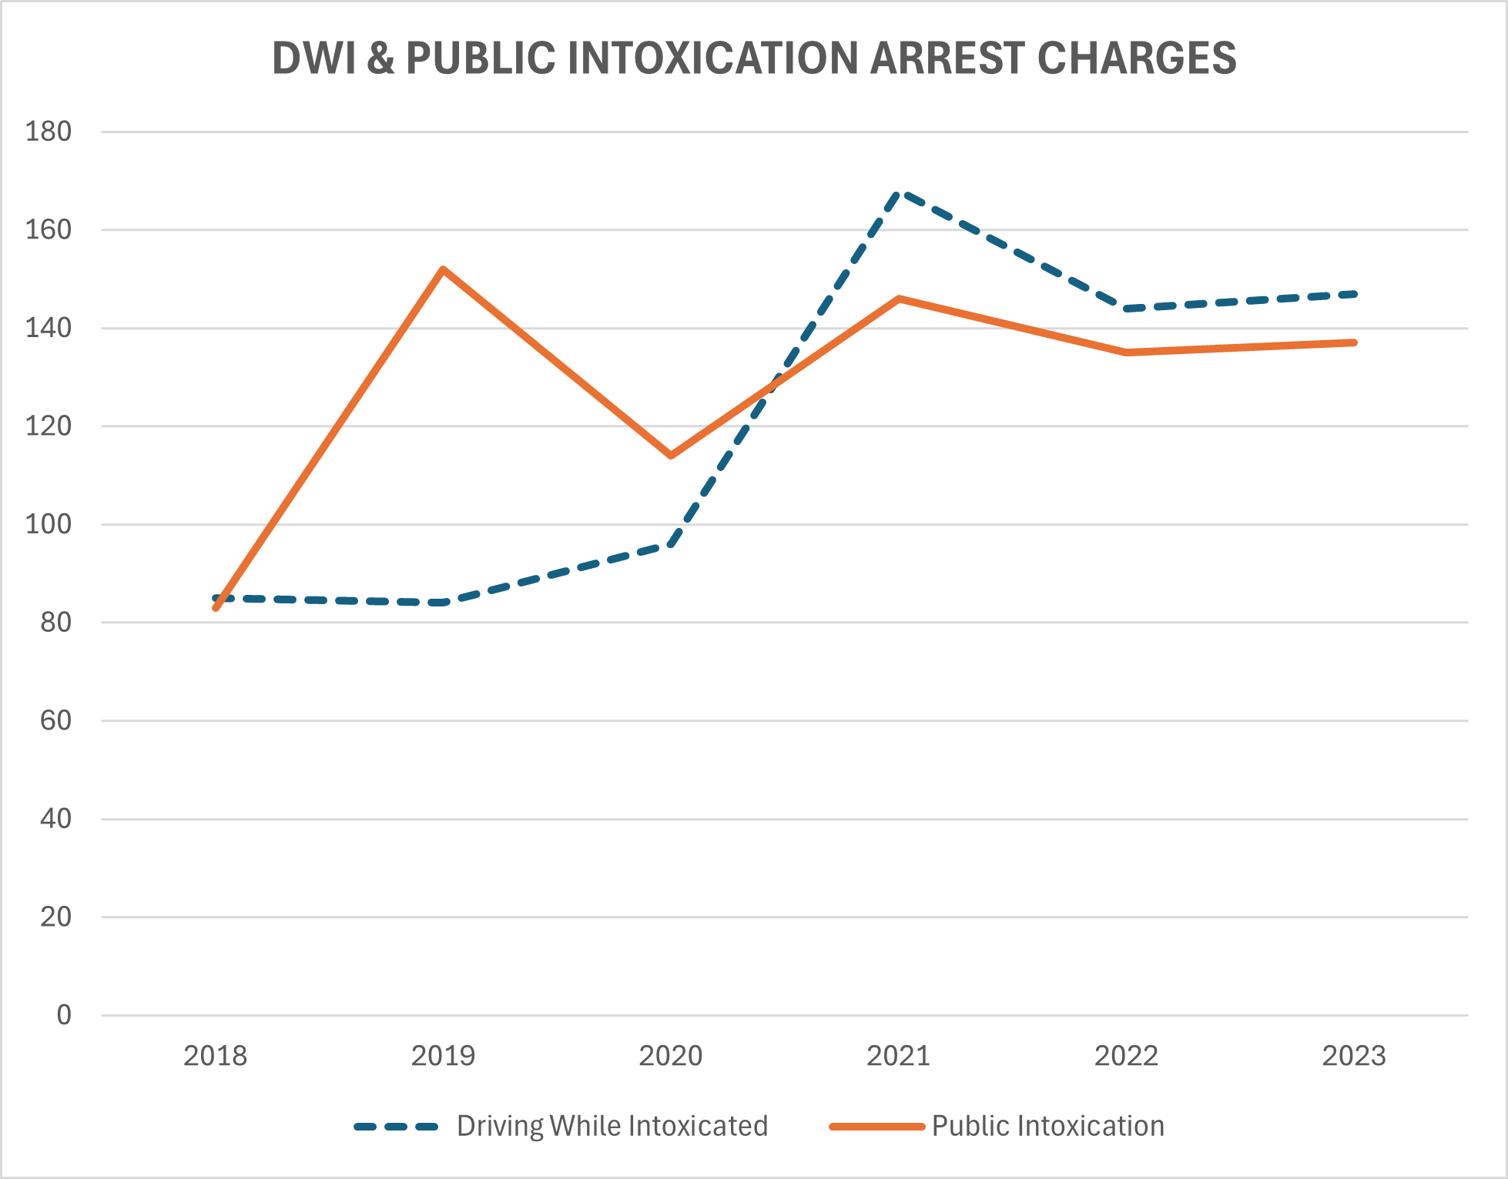
Fredericksburg Police Department
2018-2023 DWI & PI Arrest Charges:

Slide 13
Fredericksburg Police Department
2023
Traffic Violations
Accidents
  8,263 Warnings
  1,021 Citations
    671 Minor Accidents
    34 Major Accidents

Slide 14
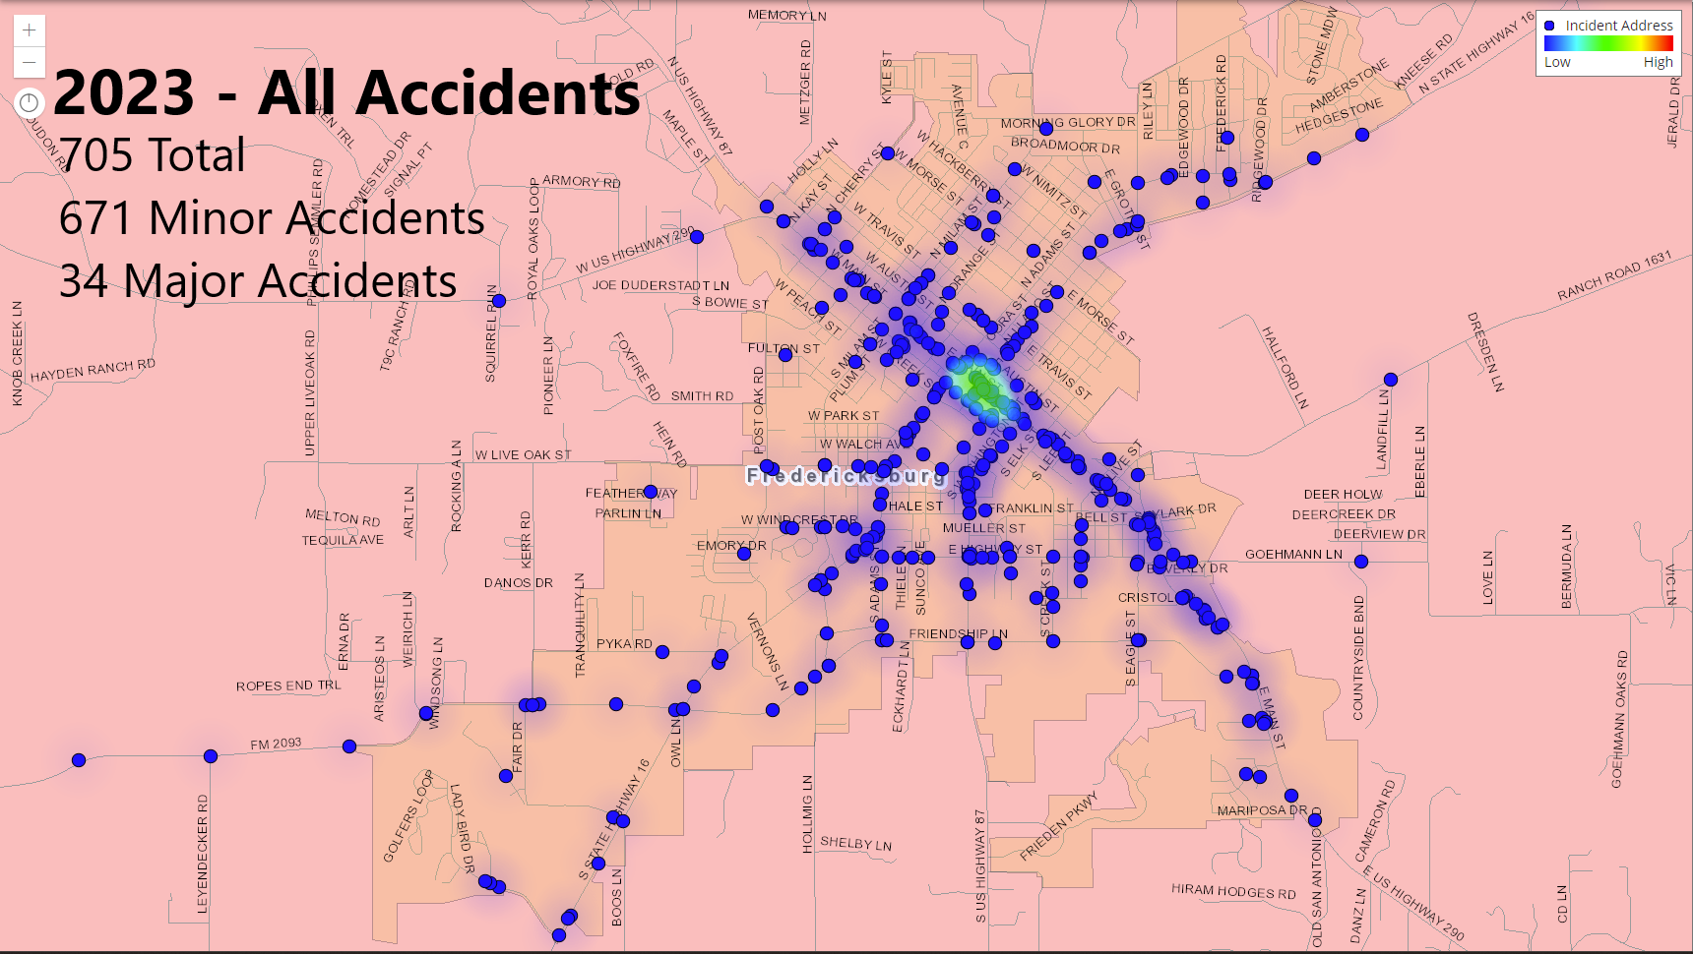
Fredericksburg Police Department
2023 Accidents:

Slide 15
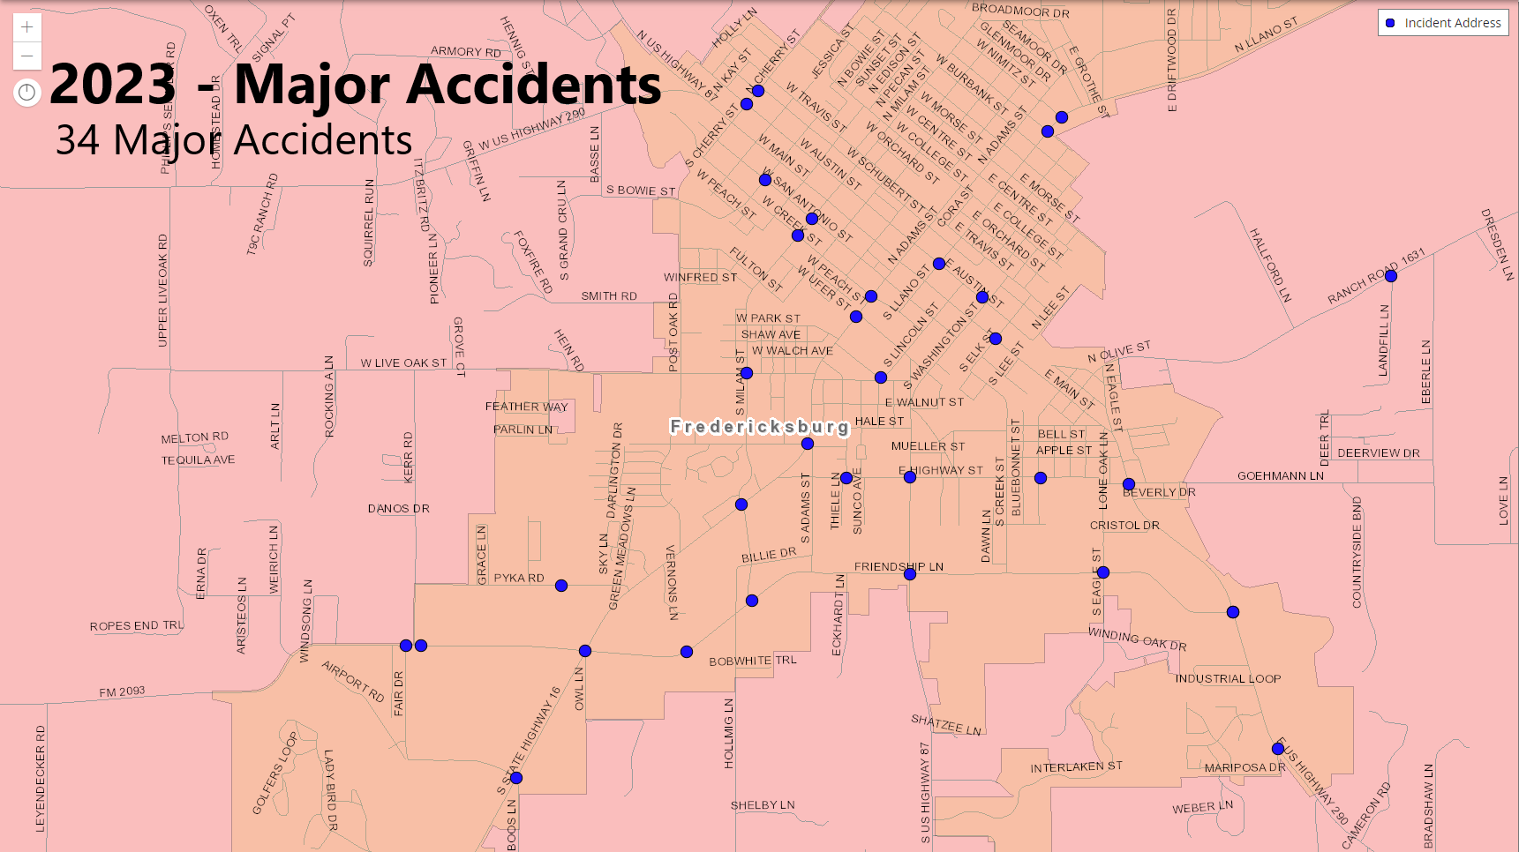
Fredericksburg Police Department
2023 Accidents:

Slide 16
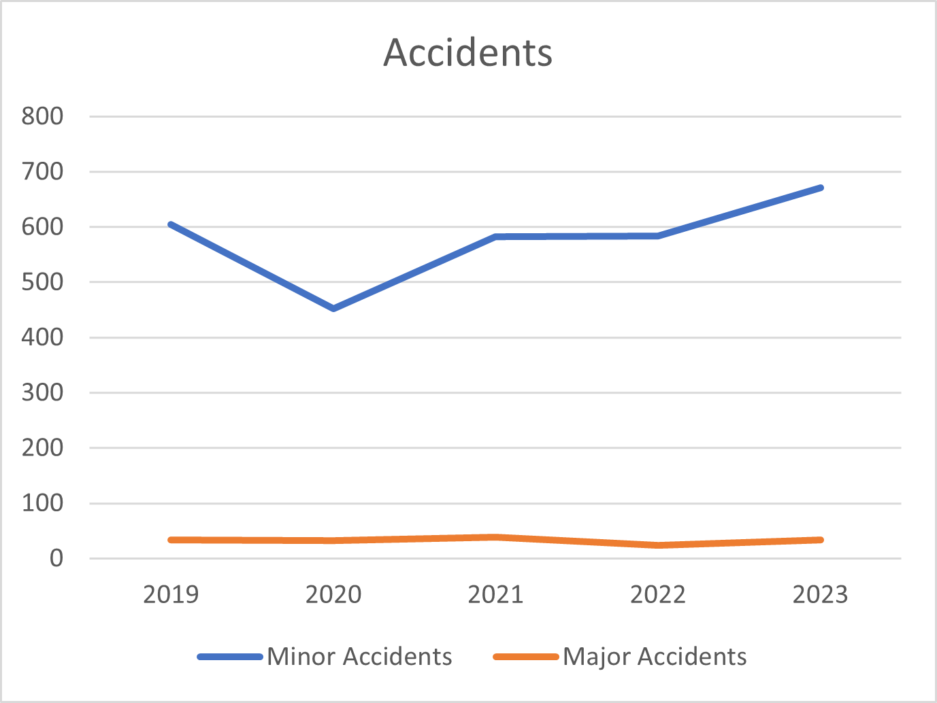
Fredericksburg Police Department
2018-2023 Accidents:

Slide 17
Fredericksburg Police Department
Questions

